Slide 1
Classical mechanics

Slide 2
Classical mechanics is among the oldest branches of physics,
it is one of the most basic, it describes motion of the objects around us.

Slide 3
Limits for use of classical mechanics
Classical mechanics is used for speeds, which are much smaller than speed of light and distances, which are much larger than 1 nano-meter and much smaller than the size of our Galaxy, which is measured in light years (beyond this it is dealt with by relativity theory, quantum physics, astrophysics).
Classical mechanics is usually used for macro objects (from 1 micro-meter to several kilometres) and for speeds between 0 and several speeds of sound).
Question:
Where can classical mechanics be used?

Slide 4
Material point
Material point is infinitely small, we neglect its sizes.
It is often possible with high accuracy and precision.
Examples of material points in physics can be bullet,
cannon ball, tennis ball, etc.
if we compare their sizes to much bigger objects,
such as Earth, Galaxy, etc.
If object is big enough then we can often consider it as material point,
located in the centre of mass.

Slide 5
One dimensional motion

Slide 6
Kinematics

Slide 7
Momentum:
Linear momentum:
p = mv (1)
$p=\sum_{i=1}^{n}{m_{i}v_{i}}$. (2)
(1) is the expression of linear momentum for one material point.
(2) is the expression of linear momentum for the mechanical system of n material points.

Slide 8
Collisions
We consider one-dimensional motion of material points.
Inelastic collisions or perfectly inelastic collisions:
Two balls (material points) collide without external forces (without friction, etc.) along the straight line (one-dimensional motion), after the inelastic collision both balls move with the same velocity being stick to each other.
Before the collision the masses and the velocities of the balls are m₁ and m₂, v₁ and v₂, respectively.
After the collision the balls move together with the same velocity v.
Momentum is conserved: momentum before the collision is equal to momentum after the collision.
m₁v₁ + m₂v₂ = (m₁ + m₂)v (3)
$v=\frac{m_{1}v_{1}+{ m}_{2}v_{2}}{m_{1}+ m_{2}}$ (4)

Slide 9
Elastic collisions or perfectly elastic collisions
This is more complex problem because instead of one unknown v there two unknowns V₁ and V₂.
This time we use the law of conservation of kinetic energy in addition to the law of conservation of momentum.
There two simultaneous equations to solve in this case for V₁ and V₂.
m₁v₁ + m₂v₂ = m₁V₁ + m₂V₂ (5)
$\frac{m_{1}v_{1}^{2}}{2}+\frac{m_{2}v_{2}^{2}}{2}=\frac{m_{1}V_{1}^{2}}{2}+\frac{m_{2}V_{2}^{2}}{2}$ (6)
These simultaneous equations are quadratic; there will be two solutions for V₁ and two solutions for V₂.
We must choose the correct solutions based on the physical conditions.
We solve the quadratic simultaneous equations by substitution, expressing V₂ through V₁ from the first equation and substituting the expression into the second equation.
$V_{2}=\frac{m_{1}v_{1}+m_{2}v_{2}−m_{1}V_{1}}{m_{2}}$ (7)
Substituting (7) to (6), we get the single quadratic equation for V₁. By solving the single quadratic equation and finding two values of V₁, we must decide with of the two answers is the correct physical value for V₁.
V₂ can be found through V₁ using (7).

Slide 10
Conservation of momentum
Momentum is conserved only for absolutely inelastic collision and absolutely elastic collision.
Absolutely elastic collision has 2 equations: conservation of momentum and conservation of kinetic energy
We neglect resistance to motion.

Slide 11
Question:
Solve the elastic collision problem for u₁ = k, u₂ = k/2, m₁ = k, m₂ = 2k.
http://physics16.weebly.com/uploads/5/9/8/5/59854633/linear2elastic4collision.txt

Slide 12
Acceleration kinematics
x = x₀ + tV₀ + 0.5at²
V = V₀ + at
V² = $V_{0}^{2}$+2a(x – x₀)
Question:
Prove that V² = $V_{0}^{2}$+2a(x – x₀).

Slide 13
Dynamics
Dynamics studies motion of bodies under the influence of forces.

Slide 14
Mechanical system
Mechanical system consists of many material points.
Centre of mass of discrete mechanical system is weighted average.
Centre of mass of continuous mechanical system is weighted average,
expressed through integrals.

Slide 15
Centre of mass
Only external force can change location of centre of mass of mechanical system.
Internal force cannot change location of centre of mass of mechanical system.
Equation for centre of mass for 2 material points is weighted average: $C_{m}=\frac{m_{1}x_{1}+m_{2}x_{2}}{m_{1}+m_{2}}$
The equation for any number of material points is similar, the difference is in the number of terms: 3 terms for 3 points, etc.
Centre of gravity may be different from centre of mass.
Question:
Find the centre of mass of 2 equal masses k meters apart.
https://physics15.weebly.com/uploads/3/0/2/7/30272185/centerofmass23sept.txt

Slide 16
Internal forces and external forces
I cannot pull myself out of mud because my force is internal force for the mechanical system.
I can only get out of mud if I use external friction force or get help from other people.
Question:
Can I pull myself out of mud? Why?

Slide 17
Momentum
Momentum of material point is mv.
Here m is mass of material point and V is velocity of material point.

Slide 18
Kinetic energy
Kinetic energy of material point is mv²/2
Note that derivative of kinetic energy with respect to velocity is equal to momentum.
Question:
Prove that derivative of kinetic energy with respect to velocity is equal to momentum.

Slide 19
Potential energy is mgh
m is mass.
g is gravity acceleration.
h is heigh.

Slide 20
Laws of Newton
Laws of Newton describe motion or stationary states of bodies under the influence of forces
First Law of Newton says that there is no acceleration without force, it follows from Second Law of Newton.
Second Law of Newton: F = ma
Third Law of Newton says that action is equal to reaction: F₁ = - F₂.

Slide 21
Mass
Mass is the measure of inertial of body, measure of how much body resists acceleration.
There is also gravitational mass, which shows how much body is attracted by other bodies due to gravitational force.
Question:
What is mass?

Slide 22
Two-dimensional motion

Slide 23
Projectile
Projectile is particular case of motion with constant acceleration a = -g.
g is gravity acceleration.
Projectile is described by Second Law of Newton in 2 dimensions.
We solve ordinary differential equations of second order.
x: F_{x} = 0, therefore no acceleration along x, there will be constant velocity along x.
y: F_{y} = -mg = ma, therefore there is constant acceleration along y.
To get the velocity, we must integrate differential equation of Second Law of Newton once.

Slide 24
Projectile (continued)
Velocity of the projectile is:
V_{x} = V₀cosA
V_{y} = V₀sinA – gt
Here we used initial conditions for time t = 0
V_{x}(0) = V₀cosA
V_{y}(0) = V₀sinA

Slide 25
Projectile (continued)
Using the fact that V_{y} = 0 at maximum height and symmetry of trajectory:
Total time is: 2(V₀sinA)/g
Time for maximum height is: (V₀sinA)/g

Slide 26
Projectile (continued)
To find distance, we must integrate differential equations of Second Law of Newton twice.
x = x₀ + tV₀cosA
y = y₀ + tV₀sinA – 0.5gt²
Here we used initial conditions for time t = 0
x(0) = x₀
y(0) = y₀

Slide 27
Projectile (continued)
y as a function of x:
y = xtanA – (1 + (tanA)²)gx²/(2(V₀)²)
tanA = sinA/cosA

Slide 28
Projectile (continued)
You can find minimum initial velocity and corresponding angle of release to hit any point in space.

Slide 29
Projectile (continued)
Question:
Find the velocity at time = T seconds, for angle of release A = T degrees, initial velocity V₀ = T meters per second, x₀ = y₀ = 0 meters for projectile.
https://physics15.weebly.com/uploads/3/0/2/7/30272185/velocityofprojectile23sept.txt

Slide 30
Projectile (continued)
Question:
Calculate total time of the motion and time for maximum height for angle of release A = T degrees, initial velocity V₀ = T meters per second, x₀ = y₀ = 0 meters for projectile.
https://physics15.weebly.com/uploads/3/0/2/7/30272185/timeofprojectile23sept.txt

Slide 31
One dimensional motion

Slide 32
Truck and trolley
Torque is applied to wheels of truck, which in more efficient than trolley, which is pushed or pulled.
Question:
Compare efficiency of truck and trolley.
Use what we discussed in our class about pulling trolley and rotating wheels of truck.

Slide 33
Collided eggs
Your own speed is the most dangerous for you.
Question:
Is moving or stationary egg more likely to crack after the collision?

Slide 34
Volume
Question:
Air purifier purifies 5 cubic meters of air. How many such air purifiers are needed for a room 5×5×10meters?
https://physics15.weebly.com/uploads/3/0/2/7/30272185/volumeforairpurifier23sept.txt

Slide 35
One dimensional motion

Slide 36
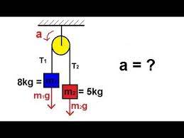
Pulley problem

Slide 37
Pulley problem (continued)
Pulley problem is solved by projecting all forces to the cord.
Is there are two non-zero different masses, acceleration is not g and not -g, then there will be acceleration a of the masses and tension in the cord.
We neglect the resistance. We assume cord to be massless.
Tension is internal force.
Difference in weights is external force.

Slide 38
Pulley problem (continued)
If the masses are the same, then there will be no acceleration but there will be tension.
If both masses are zero, then there will be no acceleration and no tension.
If one mass is zero, then there will be acceleration but no tension.
If acceleration is g, then there will be no tension (free fall).

Slide 39
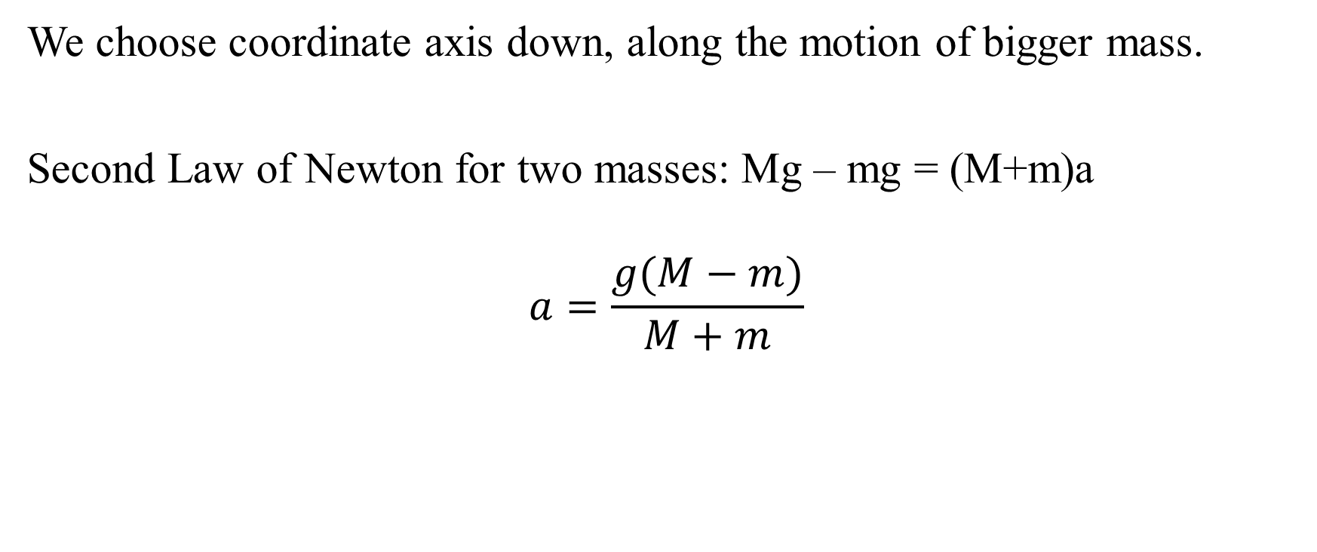
Pulley problem (continued)
We choose coordinate axis down, along the motion of bigger mass.
Second Law of Newton for two masses: Mg – mg = (M+m)a
$$a=\frac{g(M−m)}{M+m}$$

Slide 40
Pulley problem (continued)
T is tension in rope. T is internal force, which can break the rope.
Using free-body diagram for mass M, we will get: Mg – T = Ma
T = M(g - a)
Using free-body diagram for mass m, we will get: T – mg = ma
T = m(g + a)

Slide 41
Pulley problem (continued)
Question:
Find the acceleration of a simple pulley and tension in the rope for two masses: L kg and T kg.
http://physics16.weebly.com/uploads/5/9/8/5/59854633/problem4pulleys.txt
youtube.com/watch?v=kvCnjVSpuv0

Slide 42
Friction
Friction force is resistance to motion.
We often consider sliding friction, for which friction force F = μN.
μ is coefficient of friction.
N is normal reaction.

Slide 43
Friction (continued)
Question:
Calculate friction force F = μN. μ = 1/T. N = k.
https://en.wikipedia.org/wiki/Friction
https://physics15.weebly.com/uploads/3/0/2/7/30272185/frictionforce23sept.txt

Slide 44

mv = Ft
mv = Ft is simplified mechanical equation, which says that change in momentum is equal to impulse of force.
This equation is a particular case of the equation $\frac{d(mv)}{dt}=F$, d(mv) = Fdt, $mv= \int{Fdt}$

Slide 45
mv = Ft (continued)
Question:
A dust particle with mass of 0.00001kg and speed of 5 m/s is subjected to a force of 0.00001N of the filter. How much time will it take to stop the particle?
Use the equations mv = Ft and t = mv/F
https://physics15.weebly.com/uploads/3/0/2/7/30272185/airpurifierproblem23sept.txt

Slide 46
mv = Ft (continued)
Question:
Biker of mass T kg starts moving from rest. Friction coefficient μ = 1/T. What is the maximum velocity after T seconds?
Use the equations mv = Ft and v = Ft/m
https://physics15.weebly.com/uploads/3/0/2/7/30272185/bikerfrictionmaxspeed23sept.txt

Slide 47
Rotational motion
Rotational motion is possible for systems of material points or solids.
Rotation of satellite around planet is often considered as rotation one material point around the other.
Not only satellite is substituted by its centre of mass, but also planet is substituted by its centre of mass.
Period = 1/frequency
Liner acceleration for rotational motion is a = Rω²
ω is angular velocity, ω = A/t
A is Angle.
t is time.
Linear velocity of rotational motion is: V = Rω.

Slide 48
Rotational motion (continued)
Question:
Find linear accretion due to rotation for a person on planet with period of rotation of 24 hours and radius s millimetres.
https://physics15.weebly.com/uploads/3/0/2/7/30272185/rotationallinearacceleration23sept.txt

Slide 49
Breaking rope during rotation of the mass
If the mass rotates on rope and rope breaks, then the mass will move along the tangent to the circumference of rotation at the point of breaking the rope because there is no force (First Law of Newton), which means that velocity must be the same and velocity during rotational motion is along tangent line to circumference of rotation.
Question:
If the mass rotates on rope and rope breaks, what will be velocity of the mass?

Slide 50
Rotation vs translation
Angle A for rotation, distance D for translation
Angular velocity ω for rotation, liner velocity V for translation
Moment of inertia J for rotation, mass m for translation
Angular momentum Jω for rotation, liner momentum mV for translation
Kinetic energy for rotation 0.5Jω², kinetic energy for translation 0.5mV²

Slide 51
Rotation vs translation (continued)
Torque M for rotation, force F for translation
Translation is rotation with infinitely far centre of rotation.
Vectors of angular velocity, angular acceleration, torque are perpendicular to the plain in which there is rotation.
Question:
Compare rotation and translation.

Slide 52
Energy, work and power
Energy is the ability to do work.
Work is not always W = DF but sometimes dot-product W = DF or curvilinear integral W = $\int{FdD}$
Power is not always P = W/t but sometimes P = $\frac{dW}{dt}$

Slide 53
Energy, work and power (continued)
P = FV
W is work
D is distance
F is force
P is power
t is time
V is velocity
Question:
Explain energy, work and power.

Slide 54
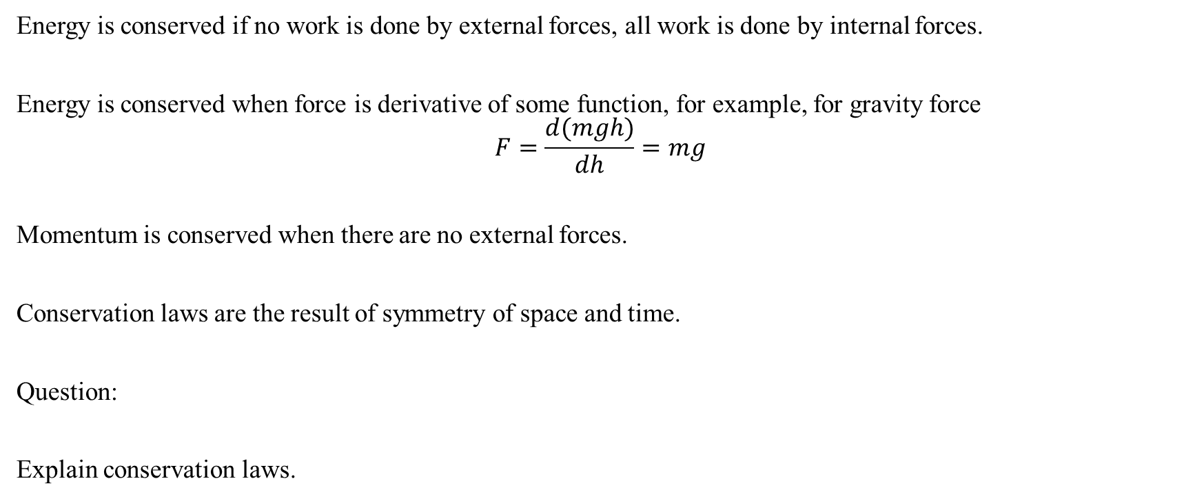
Conservation laws
Energy is conserved if no work is done by external forces, all work is done by internal forces.
Energy is conserved when force is derivative of some function, for example, for gravity force
$$F=\frac{d(mgh)}{dh}=mg$$
Momentum is conserved when there are no external forces.
Conservation laws are the result of symmetry of space and time.
Question:
Explain conservation laws.

Slide 55
Gravity force of Newton
Gravity force of Newton is expressed by equation similar to Law of Colomb
F = G*m₁*m₂/R²
G is gravity constant
m₁ and m₂ are masses of bodies between which this force is.
R is the distance between centres of masses of the bodies.

Slide 56
Gravity force of Newton (continued)
Question:
Calculate the difference in weight on the pole and on the equator of the Earth. Take the difference in the distance from the centre of the Earth as 21km.
https://physics15.weebly.com/uploads/3/0/2/7/30272185/differenceingravityforceduetodistance23sept.txt

Slide 57
Escape velocity, orbital velocity and gravity acceleration
Escape velocity is velocity of a body falling on a planet from the infinity.
Escape velocity can be found from equation of energy conservation mgh = 0.5mv²
Orbital velocity is such velocity of projectile for which it will never fall on planet and will become its satellite.
Orbital velocity is found from equation of g = centripetal acceleration: g = V²/R = Rω².
Gravity acceleration can be found, using mass of planet and its radius.

Slide 58
(continued)
We use law of gravity of Newton: F = Gm₁m₂/R².
F is gravitational force of Newton.
G is gravitational constant of Newton.
m₁ is mass of first body.
m₂ is mass of second body.
R is distance between centres of masses of bodies.

Slide 59
(continued)
Question:
Find gravity acceleration g, orbital velocity Vo and escape velocity Ve for planet with mass s billion tons and radius s millimetres.
https://physics18.weebly.com/uploads/5/9/8/5/59854633/g1orbital1velocity1escape1velocity13oct2017.txt

Slide 60
Work-energy theorem
Change in kinetic energy of mechanical system is equal to work of all external forces and all internal forces.
This theorem solves almost all problems of classical mechanics.
We can illustrate this theorem using V² = $V_{0}^{2}$+2a(x – x₀) but we can also use this theorem for any number of dimensions.

Slide 61
Solid mechanics
Solid mechanics considers motion of rigid bodies (they cannot be deformed).
For rigid body can be subjected to torque M = DF or, for more general case, using cross-product ×,
M = D×F.
D is the distance to pivot from the direction of force.
F is force.
M is torque.

Slide 62
Solid mechanics (continued)
It is not possible to apply torque to material point where distance = 0.
Solid has moments of inertia with respect to different axes of rotation.
For solids there is rotational equivalent to Second Law of Newton: M = Jε
J is tensor of moments of inertia.
ε is angular acceleration.
Bold letters mean vectors.

Slide 63
Solid mechanics (continued)
Sliding vector of force must be directed only along one straight line, otherwise, parallel force will cause additional torque.
Free vectors of torque, velocity, angular velocity, momentum, angular momentum can be applied along any parallel straight line.

Slide 64
Weight
Weight is the force that object exerts on ground due to gravitational attraction to Earth or another similar object.
weight = mg
Question:
What is your weight?
https://physics15.weebly.com/uploads/3/0/2/7/30272185/weightonearththroughmass23sept.txt

Slide 65
Free-body diagram
Free-body diagram shows all forces, which are acting on a body.
Question:
Explain free-body diagram.

Slide 66
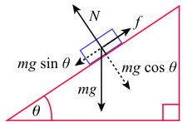
Inclined plane

Slide 67
Inclined plane (continued)
Inclined plane problem requires adding up all forces as vectors, finding the resulting force.
It includes weight, normal reaction and friction force.

Slide 68
Inclined plane (continued)
For no friction:
sinAmg = ma
sinAg = a

Slide 69
Inclined plane (continued)
For static friction:
F ≤ Nµ_{static}
For sliding friction:
µ < µ_{static}
µ is sliding friction coefficient.

Slide 70
Inclined plane (continued)
We use free-body diagram, identifying all forces acting on mass.
x: sinAmg – µN = ma
y: N – cosAmg = 0
N = cosAmg
sinAmg – µ cosAmg = ma
(sinA – µ cosA)g = a

Slide 71
Inclined plane (continued)
Question:
Find acceleration of a mass at the inclined plane with
A = T degrees and the friction coefficient μ = 1/T.
youtube.com/watch?v=8xOU25PWx8M
https://physics15.weebly.com/uploads/3/0/2/7/30272185/sept23rampinclinedplane.txt
https://physics16.weebly.com/uploads/5/9/8/5/59854633/ramp4inclined4plane2019oct.txt
http://physics16.weebly.com/uploads/5/9/8/5/59854633/inclined4plane.txt

Slide 72
Centre of gravity is the centre of parallel forces.
Centre of gravity is not always the same as centre of mass.

Slide 73
Statics

Slide 74
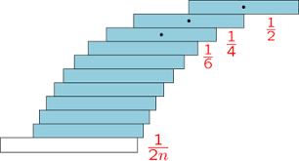
Blocks stacking problem

Slide 75
Block stacking problem (continued)
Blocks stacking problem finds locations of blocs to make maximum hangover, which follows harmonic series 1/n, which diverges, which means that hangover can be infinitely big.
We use equations of static equilibrium to solve the problem.
This is logistical problem for computer programmers to solve.

Slide 76
Block stacking problem (continued)
Question:
Find the hangover for the s blocks in the blocks stacking problem.
http://physics16.weebly.com/uploads/5/9/8/5/59854633/hangover.txt
youtube.com/watch?v=Gaua_V9Fse4

Slide 77
Angular acceleration, torque, force
Question:
Find F = ma, M = Jε, for m = a = J = ε = T.
https://physics15.weebly.com/uploads/3/0/2/7/30272185/forceandmomentofforce23sept.txt

Slide 78
Spring force F = -kx
k is property of spring
x is displacement

Slide 79
Pendulum
Pendulum is used for many useful things: counting time, monitoring rotation of Earth, etc.

Slide 80
Oscillation
Oscillation is periodic motion.
We solve ordinary differential equation to describe oscillation.
We can describe oscillation of mass, attached to spring.

Slide 81
Resonance is when amplitude of oscillation becomes infinite because frequencies of external force and natural frequency of the oscillator are the same.

Slide 82

Oscillation (continued)
Question:
Give period of spring oscillator $T=2π\sqrt{\frac{m}{k}}$. m = m₃₅. k = m₁₀₀₀₀.
https://physics16.weebly.com/uploads/5/9/8/5/59854633/spring4oscillator2019nov.txt

Slide 83

Oscillation (continued)
Question:
Find period of pendulum $T=2π\sqrt{\frac{L}{g}}$. L = m₁₀.
https://physics16.weebly.com/uploads/5/9/8/5/59854633/pendulum4period2019nov.txt

Slide 84
Oscillation (continued)
Question:
Find the displacement of a harmonic oscillator after s seconds with amplitude k, frequency k and initial phase k/2.
http://physics16.weebly.com/uploads/5/9/8/5/59854633/harmonic4oscillator.txt

Slide 85
Oscillation (continued)
Question:
Solve oscillation problem y'' + yT² = 0.
https://www.wolframalpha.com/input/?i=y%27%27+%2B+16y+%3D+0

Slide 86
Oscillation (continued)
Question:
Ty'' + Ly = sin(ωx)
Find resonant ω.
https://physics16.weebly.com/uploads/5/9/8/5/59854633/resonant4frequency2019nov.txt

Slide 87
Oscillation (continued)
Question:
Forced vibration with damping:
Ty'' + my' + Ly = sin(Tx)
Is there resonance?
m = m₃₅
L = m₁₀
http://www.wolframalpha.com/widgets/view.jsp?id=e602dcdecb1843943960b5197efd3f2a

Slide 88
Waves
Wave is spread of oscillation in space.
Waves have properties of interference and diffraction.
Interference is when waves of the seme frequency interact creating picture of maxima and minima.
Diffraction is when wave goes around the obstacle.

Slide 89
Waves (continued)
Question:
Solve the string oscillatory equation for v = T, frequency = L = m₁₀, Amplitude = T.
Find the displacement after s seconds at m meters.
https://physics18.weebly.com/uploads/5/9/8/5/59854633/string1wave1oscillation22oct2017.txt

Slide 90
Interference
sin(ω(t – x/v)) + sin(L + ω(t – x/v)) = 2sin(0.5L + ω(t – x/v)cos(0.5L)
Question:
Give interference equation for sin(ω(t – x/v)) and sin(L + ω(t – x/v)). L = m₁₀. ω = T. t = T.
https://physics16.weebly.com/uploads/5/9/8/5/59854633/interference2019nov.txt

Slide 91
Mathematics for physics
Angular calculus
Degrees and radians
Trigonometric calculus
Derivatives and integrals of sin, cos, tan and other trigonometric functions
Differential equations
Functions of many variables
Vector calculus
Add, subtract, multiply vectors (dot-product, cross-product)
Tensor calculus
Multiply tensor by vector

Slide 92
Mathematics for physics (continued)
Details for mathematics in physics are here:
calculus12s.weebly.com
calculus17.weebly.com
calculus1only.weebly.com
calculus2only.weebly.com
discrete4math.weebly.com
discrete7math.weebly.com
algebra4students.weebly.com
statistics4students.weebly.com
biomath.weebly.com/

