Slide 1
5 Lecture in physics
Thermodynamics and its links to mechanics, electricity, astrophysics and particle physics

Slide 2
Thermodynamics
Thermodynamics is a branch of physics concerned with heat and temperature and their relation to energy and work. It defines macroscopic variables, such as internal energy, entropy, and pressure, that partly describe a body of matter or radiation. It states that the behavior of those variables is subject to general constraints, that are common to all materials, not the peculiar properties of particular materials. These general constraints are expressed in the four laws of thermodynamics. Thermodynamics describes the bulk behavior of the body, not the microscopic behaviors of the very large numbers of its microscopic constituents, such as molecules. Its laws are explained by statistical mechanics, in terms of the microscopic constituents.
Thermodynamics applies to a wide variety of topics in science and engineering.

Slide 3
Thermodynamics (continued)
Historically, thermodynamics developed out of a desire to increase the efficiency and power output of early steam engines, particularly through the work of French physicist Nicolas Léonard Sadi Carnot (1824) who believed that the efficiency of heat engines was the key that could help France win the Napoleonic Wars. Irish-born British physicist Lord Kelvin was the first to formulate a concise definition of thermodynamics in 1854:
"Thermo-dynamics is the subject of the relation of heat to forces acting between contiguous parts of bodies, and the relation of heat to electrical agency."

Slide 4
(continued) Thermodynamics
Initially, thermodynamics, as applied to heat engines, was concerned with the thermal properties of their 'working materials' such as steam, in an effort to increase the efficiency and power output of engines. Thermodynamics later expanded to the study of energy transfers in chemical processes, for example to the investigation, published in 1840, of the heats of chemical reactions by Germain Hess, which was not originally explicitly concerned with the relation between energy exchanges by heat and work. From this evolved the study of Chemical thermodynamics and the role of entropy in chemical reactions.

Slide 5
Brownian motion
Brownian motion or pedesis (from Greek: πήδησις /pɛ̌ːdɛːsis/ "leaping") is the random motion of particles suspended in a fluid (a liquid or a gas) resulting from their collision with the quick atoms or molecules in the gas or liquid. The term "Brownian motion" can also refer to the mathematical model used to describe such random movements, which is often called a particle theory.

Slide 6
Brownian motion (continued)
This transport phenomenon is named after the botanist Robert Brown. In 1827, while looking through a microscope at particles found in pollen grains in water, he noted that the particles moved through the water but was not able to determine the mechanisms that caused this motion. Atoms and molecules had long been theorized as the constituents of matter, and many decades later, Albert Einstein published a paper in 1905 that explained in precise detail how the motion that Brown had observed was a result of the pollen being moved by individual water molecules. This explanation of Brownian motion served as definitive confirmation that atoms and molecules actually exist, and was further verified experimentally by Jean Perrin in 1908. Perrin was awarded the Nobel Prize in Physics in 1926 "for his work on the discontinuous structure of matter" (Einstein had received the award five years earlier "for his services to theoretical physics" with specific citation of different research). The direction of the force of atomic bombardment is constantly changing, and at different times the particle is hit more on one side than another, leading to the seemingly random nature of the motion.

Slide 7
(continued) Brownian motion
The mathematical model of Brownian motion has numerous real-world applications. For instance, Stock market fluctuations are often cited, although Benoit Mandelbrot rejected its applicability to stock price movements in part because these are discontinuous.
Brownian motion is among the simplest of the continuous-time stochastic (or probabilistic) processes, and it is a limit of both simpler and more complicated stochastic processes (see random walk and Donsker's theorem). This universality is closely related to the universality of the normal distribution. In both cases, it is often mathematical convenience, rather than the accuracy of the models, that motivates their use.

Slide 8
Turbulence

Slide 9
Chaos

Slide 10
Thermal equilibrium
Two physical systems are in thermal equilibrium if no heat flows between them when they are connected by a path permeable to heat. Thermal equilibrium obeys the Zeroth Law of Thermodynamics. A system is said to be in thermal equilibrium with itself if the temperature within the system is spatially and temporally uniform.
Systems in thermodynamic equilibrium are always in thermal equilibrium, but the converse is not always true. If the connection between the systems allows transfer of energy as heat but does not allow transfer of matter or transfer of energy as work, the two systems may reach thermal equilibrium without reaching thermodynamic equilibrium.

Slide 11
Zeroth law of thermodynamics
The zeroth law of thermodynamics states that if two thermodynamic systems are each in thermal equilibrium with a third, then all three are in thermal equilibrium with each other.

Slide 12
Zeroth law of thermodynamics (continued)
Two systems are said to be in the relation of thermal equilibrium if they are linked by a wall permeable only to heat, and do not change over time. As a convenience of language, systems are sometimes also said to be in a relation of thermal equilibrium if they are not linked so as to be able to transfer heat to each other, but would not do so if they were connected by a wall permeable only to heat. Thermal equilibrium between two systems is a transitive relation.

Slide 13
(continued) Zeroth law of thermodynamics
The physical meaning of the law was expressed by Maxwell in the words: "All heat is of the same kind". For this reason, another statement of the law is "All diathermal walls are equivalent".
The law is important for the mathematical formulation of thermodynamics, which needs the assertion that the relation of thermal equilibrium is an equivalence relation. This information is needed for the mathematical definition of temperature that will agree with the physical existence of valid thermometers.

Slide 14
Ideal gas law
PV = nRT

Slide 15
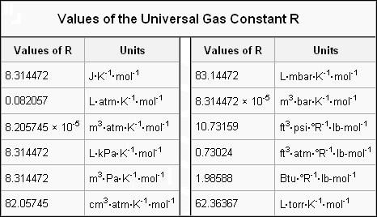
R

Slide 20
Boltzmann constant

Slide 21
Isothermal, isochoric, isobaric, adiabatic processes

Slide 22
Otto cycle
An Otto cycle is an idealized thermodynamic cycle that describes the functioning of a typical spark ignition piston engine. It is the thermodynamic cycle most commonly found in automobile engines.
Pressure-Volume diagram
Temperature-Entropy diagram The idealized diagrams of a four-stroke Otto cycle Both diagrams: the intake (A) stroke is performed by an isobaric expansion, followed by an adiabatic compression (B) stroke. Through the combustion of fuel, heat is added in an a constant volume (isochoric process) process, followed by an adiabatic expansion process power (C) stroke. The cycle is closed by the exhaust (D) stroke, characterized by isochoric cooling and isentropic compression processes.
The Otto cycle is a description of what happens to a mass of gas as it is subjected to changes of pressure, temperature, volume, addition of heat, and removal of heat. The mass of gas that is subjected to those changes is called the system. The system, in this case, is defined to be the fluid (gas) within the cylinder. By describing the changes that take place within the system, it will also describe in inverse, the system's effect on the environment. In the case of the Otto cycle, the effect will be to produce enough net work from the system so as to propel an automobile and its occupants in the environment.

Slide 23
Diesel cycle
The Diesel cycle is the thermodynamic cycle which approximates the pressure and volume of the combustion chamber of the diesel engine, invented by Rudolph Diesel in 1897.

Slide 24
Heat pump
A heat pump is a device that provides heat energy from a source of heat or "heat sink" to a destination. Heat pumps are designed to move thermal energy opposite to the direction of spontaneous heat flow by absorbing heat from a cold space and releasing it to a warmer one. A heat pump uses some amount of external power to accomplish the work of transferring energy from the heat source to the heat sink.

Slide 25
Refrigerator
A refrigerator (colloquially fridge) is a common household appliance that consists of a thermally insulated compartment and a heat pump (mechanical, electronic, or chemical) that transfers heat from the inside of the fridge to its external environment so that the inside of the fridge is cooled to a temperature below the ambient temperature of the room. Refrigeration is an essential food storage technique in developed countries. The lower temperature lowers the reproduction rate of bacteria, so the refrigerator reduces the rate of spoilage. A refrigerator maintains a temperature a few degrees above the freezing point of water.

Slide 26
E = 1.5kT for stars

Slide 27
Real gas
Real gases – as opposed to a perfect or ideal gas – exhibit properties that cannot be explained entirely using the ideal gas law. To understand the behavior of real gases, the following must be taken into account:
compressibility effects;
variable specific heat capacity;
van der Waals forces;
non-equilibrium thermodynamic effects;
issues with molecular dissociation and elementary reactions with variable composition.

Slide 28
Real gas (continued)
For most applications, such a detailed analysis is unnecessary, and the ideal gas approximation can be used with reasonable accuracy. On the other hand, real-gas models have to be used near the condensation point of gases, near critical points, at very high pressures, to explain the Joule–Thomson effect and in other less usual cases.

Slide 29
Van der Waals equation
The van der Waals equation is an equation of state for a fluid composed of particles that have a non-zero volume and a pairwise attractive inter-particle force (such as the van der Waals force). It was derived in 1873 by Johannes Diderik van der Waals, who received the Nobel prize in 1910 for "his work on the equation of state for gases and liquids". The equation is based on a modification of the ideal gas law and approximates the behavior of real fluids, taking into account the nonzero size of molecules and the attraction between them.

Slide 30
Van der Waals equation (continued)

Slide 31
Phase transition
A phase transition is the transformation of a thermodynamic system from one phase or state of matter to another one by heat transfer. The term is most commonly used to describe transitions between solid, liquid and gaseous states of matter, and, in rare cases, plasma. A phase of a thermodynamic system and the states of matter have uniform physical properties. During a phase transition of a given medium certain properties of the medium change, often discontinuously, as a result of the change of some external condition, such as temperature, pressure, or others. For example, a liquid may become gas upon heating to the boiling point, resulting in an abrupt change in volume. The measurement of the external conditions at which the transformation occurs is termed the phase transition. Phase transitions are common in nature and used today in many technologies.

Slide 32
Kinetic theory
The kinetic theory of gases describes a gas as a large number of small particles (atoms or molecules), all of which are in constant, random motion. The rapidly moving particles constantly collide with each other and with the walls of the container. Kinetic theory explains macroscopic properties of gases, such as pressure, temperature, viscosity, thermal conductivity, and volume, by considering their molecular composition and motion. The theory posits that gas pressure is due to the impacts, on the walls of a container, of molecules or atoms moving at different velocities.
Kinetic theory defines temperature in its own way, not identical with the thermodynamic definition.

Slide 33
Kinetic theory (continued)
While the particles making up a gas are too small to be visible, the jittering motion of pollen grains or dust particles which can be seen under a microscope, known as Brownian motion, results directly from collisions between the particles and gas molecules. As analyzed by Albert Einstein in 1905, this experimental evidence for kinetic theory is generally seen as having confirmed the existence of atoms and molecules.

Slide 34
Molecular interpretation of temperature
A temperature is a numerical measure of hot and cold. Its measurement is by detection of heat radiation, particle velocity, kinetic energy, or most commonly, by the bulk behavior of a thermometric material. It may be calibrated in any of various temperature scales, Celsius, Fahrenheit, Kelvin, etc.

Slide 35
Molecular interpretation of temperature (continued)
Measurements with a small thermometer, or by detection of heat radiation, can show that the temperature of a body of material can vary from time to time and from place to place within it. If changes happen too fast, or with too small a spacing, within a body, it may be impossible to define its temperature. Thus the concept of temperature in general has an empirical content.

Slide 36
(continued) Molecular interpretation of temperature
Within a body that exchanges no energy or matter with its surroundings, temperature tends to become spatially uniform as time passes. When a path permeable only to heat is open between two bodies, energy always transfers spontaneously as heat from a hotter body to a colder one. The transfer rate depends on the nature of the path. If they are connected by a path permeable only to heat, and no heat flows between them, then the two bodies are equally hot. If changes are slow and spatially smooth enough to allow consistent comparisons of their hotness with other bodies that are respectively in their own states of internal thermodynamic equilibrium, they obey the Zeroth law of thermodynamics and then they have well defined and equal temperatures. Then thermodynamics provides a fundamental physical definition of temperature, on an absolute scale, relying on the second law of thermodynamics.

Slide 37
Molecular interpretation of temperature (continued)
The kinetic theory offers a valuable but limited account of the behavior of the materials of macroscopic systems. It indicates the absolute temperature as proportional to the average kinetic energy of the random microscopic motions of their constituent microscopic particles such as electrons, atoms, and molecules.
Thermal vibration of a segment of protein alpha helix. The amplitude of the vibrations increases with temperature.
The coldest theoretical temperature is called absolute zero. It can be approached but not reached in any actual physical system. It is denoted by 0 K on the Kelvin scale, −273.15 °C on the Celsius scale, and −459.67 °F on the Fahrenheit scale. In matter at absolute zero, the motions of microscopic constituents are minimal.
Temperature is important in all fields of natural science, including physics, geology, chemistry, atmospheric sciences and biology.

Slide 38
Maxwell–Boltzmann distribution
The Maxwell–Boltzmann distribution or Maxwell speed distribution describes particle speeds in idealized gases where the particles move freely inside a stationary container without interacting with one another, except for very brief collisions in which they exchange energy and momentum with each other or with their thermal environment. Particle in this context refers to gaseous atoms or molecules, and the system of particles is assumed to have reached thermodynamic equilibrium.

Slide 39
Maxwell–Boltzmann distribution (continued)
The distribution is a probability distribution for the speed of a particle within the gas - the magnitude of its velocity. This probability distribution indicates which speeds are more likely: a particle will have a speed selected randomly from the distribution, and is more likely to be within one range of speeds than another. The distribution depends on the temperature of the system and the mass of the particle.

Slide 40
(continued) Maxwell–Boltzmann distribution
The Maxwell–Boltzmann distribution applies to the classical ideal gas, which is an idealization of real gases. In real gases, there are various effects (e.g., van der Waals interactions, relativistic speed limits, and quantum exchange interactions) that make their speed distribution sometimes very different from the Maxwell–Boltzmann form. That said, rarefied gases at ordinary temperatures behave very nearly like an ideal gas and the Maxwell speed distribution is an excellent approximation for such gases. Thus, it forms the basis of the kinetic theory of gases, which provides a simplified explanation of many fundamental gaseous properties, including pressure and diffusion.

Slide 41
Maxwell–Boltzmann distribution (continued)
The distribution is named after James Clerk Maxwell and Ludwig Boltzmann. While the distribution was first derived by Maxwell in 1860 on basic grounds, Boltzmann later carried out significant investigations into the physical origins of this distribution.

Slide 42
Equipartition theorem
The equipartition theorem is a general formula that relates the temperature of a system with its average energies. The equipartition theorem is also known as the law of equipartition, equipartition of energy, or simply equipartition. The original idea of equipartition was that, in thermal equilibrium, energy is shared equally among all of its various forms; for example, the average kinetic energy per degree of freedom in the translational motion of a molecule should equal that of its rotational motions.

Slide 43
Vapor pressure
Vapor pressure or equilibrium vapor pressure is defined as the pressure exerted by a vapor in thermodynamic equilibrium with its condensed phases (solid or liquid) at a given temperature in a closed system. The equilibrium vapor pressure is an indication of a liquid's evaporation rate. It relates to the tendency of particles to escape from the liquid (or a solid). A substance with a high vapor pressure at normal temperatures is often referred to as volatile.

Slide 44
Vapor pressure (continued)
The vapor pressure of any substance increases non-linearly with temperature according to the Clausius–Clapeyron relation. The atmospheric pressure boiling point of a liquid (also known as the normal boiling point) is the temperature at which the vapor pressure equals the ambient atmospheric pressure. With any incremental increase in that temperature, the vapor pressure becomes sufficient to overcome atmospheric pressure and lift the liquid to form vapor bubbles inside the bulk of the substance. Bubble formation deeper in the liquid requires a higher pressure, and therefore higher temperature, because the fluid pressure increases above the atmospheric pressure as the depth increases.

Slide 45
(continued) Vapor pressure
The vapor pressure that a single component in a mixture contributes to the total pressure in the system is called partial pressure. For example, air at sea level, and saturated with water vapor at 20 °C, has partial pressures of about 23 mbar of water, 780 mbar of nitrogen, 210 mbar of oxygen and 9 mbar of argon.

Slide 46
Humidity
Humidity is the amount of water vapor in the air. Water vapor is the gaseous state of water and is invisible. Humidity indicates the likelihood of precipitation, dew, or fog. Higher humidity reduces the effectiveness of sweating in cooling the body by reducing the rate of evaporation of moisture from the skin. This effect is calculated in a heat index table or humidex, used during summer weather.

Slide 47
Humidity (continued)
There are three main measurements of humidity: absolute, relative and specific. Absolute humidity is the water content of air. Relative humidity, expressed as a percent, measures the current absolute humidity relative to the maximum for that temperature. Specific humidity is a ratio of the water vapor content of the mixture to the total air content on a mass basis.

Slide 48
Diffusion
Diffusion is the net movement of a substance (e.g., an atom, ion or molecule) from a region of high concentration to a region of low concentration. This is also referred to as the movement of a substance down a concentration gradient. A gradient is the change in the value of a quantity (e.g., concentration, pressure, temperature) with the change in another variable (e.g., distance). For example, a change in concentration over a distance is called a concentration gradient, a change in pressure over a distance is called a pressure gradient, and a change in temperature over a distance is a called a temperature gradient.

Slide 49
Diffusion (continued)
The word diffusion is derived from the Latin word, "diffundere", which means "to spread out" (if a substance is “spreading out”, it is moving from an area of high concentration to an area of low concentration). A distinguishing feature of diffusion is that it results in mixing or mass transport, without requiring bulk motion (bulk flow). Thus, diffusion should not be confused with convection, or advection, which are other transport phenomena that utilize bulk motion to move particles from one place to another.

Slide 50
Fick's laws of diffusion
Fick's laws of diffusion describe diffusion and can be used to solve for the diffusion coefficient, D. They were d
Fick's first law relates the diffusive flux to the concentration under the assumption of steady state. It postulates that the flux goes from regions of high concentration to regions of low concentration, with a magnitude that is proportional to the concentration gradient (spatial derivative), or in simplistic terms the concept that a solute will move from a region of high concentration to a region of low concentration across a concentration gradient.erived by Adolf Fick in 1855.

Slide 51
Dalton's law
Dalton's law (also called Dalton's law of partial pressures) states that in a mixture of non-reacting gases, the total pressure exerted is equal to the sum of the partial pressures of the individual gases. This empirical law was observed by John Dalton in 1801 and is related to the ideal gas laws.

Slide 52
Mean free path
The mean free path is the average distance travelled by a moving particle (such as an atom, a molecule, a photon) between successive impacts (collisions), which modify its direction or energy or other particle properties.

Slide 53
Mean free path

Slide 54
Random walk process
A random walk is a mathematical formalization of a path that consists of a succession of random steps. For example, the path traced by a molecule as it travels in a liquid or a gas, the search path of a foraging animal, the price of a fluctuating stock and the financial status of a gambler can all be modeled as random walks, although they may not be truly random in reality. The term random walk was first introduced by Karl Pearson in 1905. Random walks have been used in many fields: ecology, economics, psychology, computer science, physics, chemistry, and biology.

Slide 55
Heat equation
The heat equation is a parabolic partial differential equation that describes the distribution of heat (or variation in temperature) in a given region over time.

Slide 56
Black-Scholes equation

Slide 57
Heat transfer
Heat transfer describes the exchange of thermal energy, between physical systems depending on the temperature and pressure, by dissipating heat. The fundamental modes of heat transfer are conduction or diffusion, convection and radiation.

Slide 58
Heat transfer (continued)
The exchange of kinetic energy of particles through the boundary between two systems which are at different temperatures from each other or from their surroundings. Heat transfer always occurs from a region of high temperature to another region of lower temperature. Heat transfer changes the internal energy of both systems involved according to the First Law of Thermodynamics.^{[1]} The Second Law of Thermodynamics defines the concept of thermodynamic entropy, by measurable heat transfer.

Slide 59
(continued) Heat transfer
Thermal equilibrium is reached when all involved bodies and the surroundings reach the same temperature. Thermal expansion is the tendency of matter to change in volume in response to a change in temperature.

Slide 60
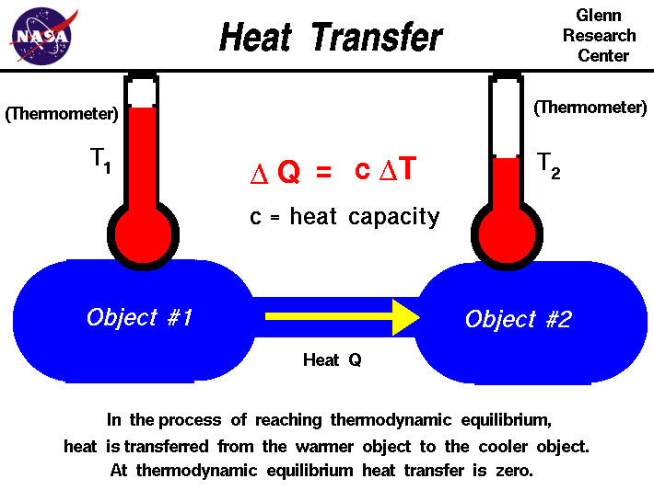

Slide 61
Conduction
Heat conduction (or thermal conduction) is the transfer of internal energy by microscopic diffusion and collisions of particles or quasi-particles within a body due to a temperature gradient. The microscopically diffusing and colliding objects include molecules, electrons, atoms, and phonons. They transfer disorganized microscopic kinetic and potential energy, which are jointly known as internal energy. Conduction can only take place within an object or material, or between two objects that are in direct or indirect contact with each other. Conduction takes place in all forms of ponderable matter, such as solids, liquids, gases and plasmas.
Whether by conduction or by thermal radiation, heat spontaneously flows from a hotter to a colder body. In the absence of external drivers, temperature differences decay over time, and the bodies approach thermal equilibrium.

Slide 62
Convection
Convection is the concerted, collective movement of groups or aggregates of molecules within fluids (e.g., liquids, gases) and rheids, either through advection or through diffusion or as a combination of both of them. Convection of mass cannot take place in solids, since neither bulk current flows nor significant diffusion can take place in solids. Diffusion of heat can take place in solids, but that is called heat conduction. Convection can be demonstrated by placing a heat source (e.g. a Bunsen burner) at the side of a glass full of a liquid, and observing the changes in temperature in the glass caused by the warmer fluid moving into cooler areas.
Convective heat transfer is one of the major modes of heat transfer, and convection is also a major mode of mass transfer in fluids. Convective heat and mass transfer take place both by diffusion – the random Brownian motion of individual particles in the fluid – and by advection, in which matter or heat is transported by the larger-scale motion of currents in the fluid. In the context of heat and mass transfer, the term "convection" is used to refer to the sum of advective and diffusive transfer. In common use the term "convection" may refer loosely to heat transfer by convection, as opposed to mass transfer by convection, or the convection process in general. Sometimes "convection" is even used to refer specifically to "free heat convection" (natural heat convection) as opposed to forced heat convection. However, in mechanics the correct use of the word is the general sense, and different types of convection should be properly qualified for clarity.

Slide 63
Radiation
Thermal radiation occurs through a vacuum or any transparent medium (solid or fluid). It is the transfer of energy by means of photons in electromagnetic waves governed by the same laws. Earth's radiation balance depends on the incoming and the outgoing thermal radiation, Earth's energy budget. Anthropogenic perturbations in the climate system, are responsible for a positive radiative forcing which reduces the net longwave radiation loss out to Space.
Thermal radiation is energy emitted by matter as electromagnetic waves, due to the pool of thermal energy in all matter with a temperature above absolute zero. Thermal radiation propagates without the presence of matter through the vacuum of space.
Thermal radiation is a direct result of the random movements of atoms and molecules in matter. Since these atoms and molecules are composed of charged particles (protons and electrons), their movement results in the emission of electromagnetic radiation, which carries energy away from the surface.

Slide 64
Internal energy
The internal energy is one of the two cardinal state functions of the state variables of a thermodynamic system. It refers to energy contained within the system, while excluding the kinetic energy of motion of the system as a whole and the potential energy of the system as a whole due to external force fields. It keeps account of the gains and losses of energy of the system.

Slide 65
Internal energy (continued)
The internal energy of a system can be changed by (1) heating the system, or (2) by doing work on it, or (3) by adding or taking away matter. When matter transfer is prevented by impermeable walls containing the system, it is said to be closed. Then the first law of thermodynamics states that the increase in internal energy is equal to the total heat added and work done on the system by the surroundings. If the containing walls pass neither matter nor energy, the system is said to be isolated. Then its internal energy cannot change.

Slide 66
Internal energy (continued)
U = Q - W

Slide 67
W = PV

Slide 68
Calorimetry
Calorimetry is the science or act of measuring changes state variables of a body for the purpose of deriving the heat transfer associated with changes of its state due for example to chemical reactions, physical changes, or phase transitions under specified constraints. Calorimetry is performed with a calorimeter. The word calorimetry is derived from the Latin word calor, meaning heat and the Greek word μέτρον (metron), meaning measure. Scottish physician and scientist Joseph Black, who was the first to recognize the distinction between heat and temperature, is said to be the founder of the science of calorimetry.

Slide 69
Calorimetry (continued)
Indirect calorimetry calculates heat that living organisms produce by measuring either their production of carbon dioxide and nitrogen waste (frequently ammonia in aquatic organisms, or urea in terrestrial ones), or from their consumption of oxygen. Lavoisier noted in 1780 that heat production can be predicted from oxygen consumption this way, using multiple regression. The Dynamic Energy Budget theory explains why this procedure is correct. Heat generated by living organisms may also be measured by direct calorimetry, in which the entire organism is placed inside the calorimeter for the measurement.

Slide 70
(continued) Calorimetry
A widely used modern instrument is the differential scanning calorimeter, a device which allows thermal data to be obtained on small amounts of material. It involves heating the sample at a controlled rate and recording the heat flow either into or from the specimen.

Slide 71
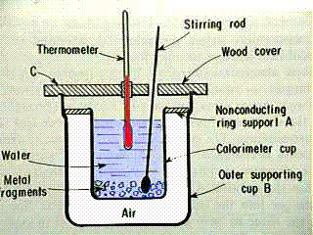
(continued) Calorimetry

Slide 72
Latent heat
Latent heat is the energy released or absorbed by a body or a thermodynamic system during a constant-temperature process. A typical example is a change of state of matter, meaning a phase transition such as the melting of ice or the boiling of water. The term was introduced around 1762 by Scottish chemist Joseph Black. It is derived from the Latin latere (to lie hidden). Black used the term in the context of calorimetry when referring to the heat transferred that caused a change of volume while the thermodynamic system was held at constant temperature.
In contrast to latent heat, an energy is called a sensible energy or heat when it causes processes that do result in a change of the temperature of the system.

Slide 73
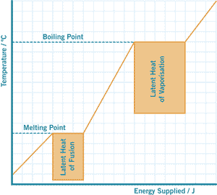
Latent heat

Slide 74
Heat capacity
Heat capacity, or thermal capacity, is a measurable physical quantity; it's the ratio of the heat added to (or subtracted from) an object to the resulting temperature change.

Slide 75
Heat capacity

Slide 76
Laws of thermodynamics
The four laws of thermodynamics define fundamental physical quantities (temperature, energy, and entropy) that characterize thermodynamic systems. The laws describe how these quantities behave under various circumstances, and forbid certain phenomena (such as perpetual motion).

Slide 77
Laws of thermodynamics (continued)
The four laws of thermodynamics are:
Zeroth law of thermodynamics: If two systems are in thermal equilibrium separately, with a third system, they must be in thermal equilibrium with each other. This law helps define the notion of temperature.
First law of thermodynamics: Because energy is conserved, the internal energy of a system changes as heat flows in or out of it. Equivalently, perpetual motion machines of the first kind are impossible.
Second law of thermodynamics: The entropy of any isolated system never decreases. Such systems spontaneously evolve towards thermodynamic equilibrium — the state of maximum entropy of the system. Equivalently, perpetual motion machines of the second kind are impossible.
Third law of thermodynamics: The entropy of a system approaches a constant value as the temperature approaches absolute zero. With the exception of glasses the entropy of a system at absolute zero is typically close to zero, and is equal to the log of the multiplicity of the quantum ground state.

Slide 78
Heat engine
A heat engine is a system that converts heat or thermal energy to mechanical energy, which can then be used to do mechanical work. It does this by bringing a working substance from a higher state temperature to a lower state temperature. A heat "source" generates thermal energy that brings the working substance to the high temperature state. The working substance generates work in the "working body" of the engine while transferring heat to the colder "sink" until it reaches a low temperature state. During this process some of the thermal energy is converted into work by exploiting the properties of the working substance. The working substance can be any system with a non-zero heat capacity, but it usually is a gas or liquid.

Slide 79
Heat engine (continued)
In general an engine converts energy to mechanical work. Heat engines distinguish themselves from other types of engines by the fact that their efficiency is fundamentally limited by Carnot's theorem. Although this efficiency limitation can be a drawback, an advantage of heat engines is that most forms of energy can be easily converted to heat by processes like exothermic reactions (such as combustion), absorption of light or energetic particles, friction, dissipation and resistance. Since the heat source that supplies thermal energy to the engine can thus be powered by virtually any kind of energy, heat engines are very versatile and have a wide range of applicability.
Heat engines are often confused with the cycles they attempt to mimic. Typically when describing the physical device the term 'engine' is used. When describing the model the term 'cycle' is used.

Slide 80
Carnot cycle
The Carnot cycle is a theoretical thermodynamic cycle proposed by Nicolas Léonard Sadi Carnot in 1824 and expanded by others in the 1830s and 1840s. It can be shown that it is the most efficient cycle for converting a given amount of thermal energy into work, or conversely, creating a temperature difference (e.g. refrigeration) by doing a given amount of work.
Every single thermodynamic system exists in a particular state. When a system is taken through a series of different states and finally returned to its initial state, a thermodynamic cycle is said to have occurred. In the process of going through this cycle, the system may perform work on its surroundings, thereby acting as a heat engine. A system undergoing a Carnot cycle is called a Carnot heat engine, although such a "perfect" engine is only a theoretical limit and cannot be built in practice.

Slide 81
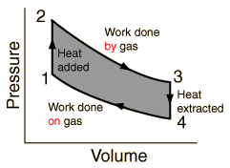

Slide 82
Entropy
Entropy (usual symbol S) is a measure of the number of specific ways in which a thermodynamic system may be arranged, commonly understood as a measure of disorder. According to the second law of thermodynamics the entropy of an isolated system never decreases; such systems spontaneously evolve towards thermodynamic equilibrium, the configuration with maximum entropy. Systems that are not isolated may decrease in entropy. Since entropy is a state function, the change in the entropy of a system is the same for any process going from a given initial state to a given final state, whether the process is reversible or irreversible. However irreversible processes increase the combined entropy of the system and its environment.

Slide 83
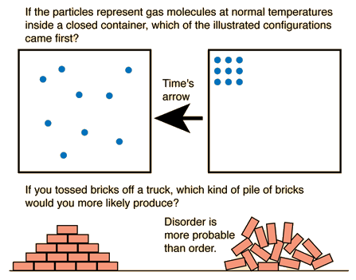
Entropy

Slide 84
Heat death of the universe
The heat death of the universe is a historically suggested ultimate fate of the universe in which the universe has diminished to a state of no thermodynamic free energy and therefore can no longer sustain processes that consume energy (including computation and life). Heat death does not imply any particular absolute temperature; it only requires that temperature differences or other processes may no longer be exploited to perform work. In the language of physics, this is when the universe reaches thermodynamic equilibrium (maximum entropy). The hypothesis of heat death stems from the ideas of William Thomson, 1st Baron Kelvin, who in the 1850s took the theory of heat as mechanical energy loss in nature (as embodied in the first two laws of thermodynamics) and extrapolated it to larger processes on a universal scale.
In a more recent view than Kelvin's, it has been recognized by a respected authority on thermodynamics, Max Planck, that the phrase 'entropy of the universe' has no meaning because it admits of no accurate definition. Kelvin's speculation falls with this recognition.

Slide 85
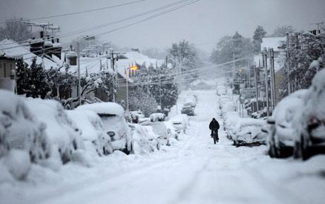
Heat death of the universe

Slide 86
Time’s arrow
The arrow of time, or time's arrow, is a concept developed in 1927 by the British astronomer Arthur Eddington involving the "one-way direction" or "asymmetry" of time. This direction, which can be determined, according to Eddington, by studying the organization of atoms, molecules and bodies, might be drawn upon a four-dimensional relativistic map of the world ("a solid block of paper").
Physical processes at the microscopic level are believed to be either entirely or mostly time-symmetric: if the direction of time were to reverse, the theoretical statements that describe them would remain true. Yet at the macroscopic level it often appears that this is not the case: there is an obvious direction (or flow) of time.

Slide 87
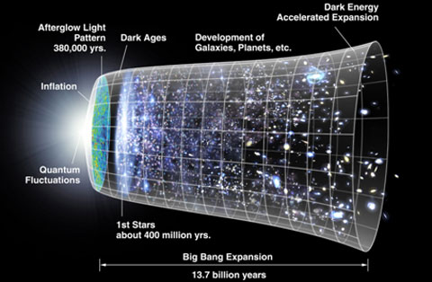
Time’s arrow

Slide 88
A human can be destroyed but cannot be recreated

Slide 89
Thermal pollution
Thermal pollution is the degradation of water quality by any process that changes ambient water temperature.
A common cause of thermal pollution is the use of water as a coolant by power plants and industrial manufacturers. When water used as a coolant is returned to the natural environment at a higher temperature, the change in temperature decreases oxygen supply and affects ecosystem composition. Urban runoff–stormwater discharged to surface waters from roads and parking lots–can also be a source of elevated water temperatures.
When a power plant first opens or shuts down for repair or other causes, fish and other organisms adapted to particular temperature range can be killed by the abrupt change in water temperature known as "thermal shock."

Slide 90
Enthalpy
Enthalpy is a defined thermodynamic potential, designated by the letter "H", that consists of the internal energy of the system (U) plus the product of pressure (p) and volume (V) of the system.
Since enthalpy, H, consists of internal energy, U, plus the product of pressure (p) and the volume (V) of the system, which are all functions of the state of the thermodynamic system, enthalpy is a state function.
The unit of measurement for enthalpy in the International System of Units (SI) is the joule, but other historical, conventional units are still in use, such as the British thermal unit and the calorie.

Slide 91
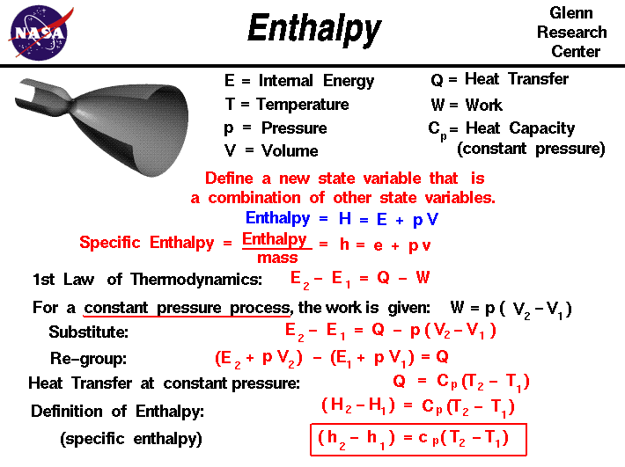

Slide 92
Computing thermodynamics

Slide 93
Reversible computing
Reversible computing is a model of computing where the computational process to some extent is reversible, i.e., time-invertible. In a computational model that uses transitions from one state of the abstract machine to another, a necessary condition for reversibility is that the relation of the mapping from states to their successors must be one-to-one. Reversible computing is generally considered an unconventional form of computing.
There are two major, closely related, types of reversibility that are of particular interest for this purpose: physical reversibility and logical reversibility.
A process is said to be physically reversible if it results in no increase in physical entropy; it is isentropic. These circuits are also referred to as charge recovery logic, adiabatic circuits, or adiabatic computing. Although in practice no nonstationary physical process can be exactly physically reversible or isentropic, there is no known limit to the closeness with which we can approach perfect reversibility, in systems that are sufficiently well-isolated from interactions with unknown external environments, when the laws of physics describing the system's evolution are precisely known.

Slide 94
Black body problem
Absolutely black body

Slide 95
Black body
A black body is an idealized physical body that absorbs all incident electromagnetic radiation, regardless of frequency or angle of incidence. A white body is one with a "rough surface [that] reflects all incident rays completely and uniformly in all directions."
A black body in thermal equilibrium (that is, at a constant temperature) emits electromagnetic radiation called black-body radiation. The radiation is emitted according to Planck's law, meaning that it has a spectrum that is determined by the temperature alone (see figure at right), not by the body's shape or composition.
A black body in thermal equilibrium has two notable properties:
It is an ideal emitter: at every frequency, it emits as much energy as – or more energy than – any other body at the same temperature.
It is a diffuse emitter: the energy is radiated isotropically, independent of direction.

Slide 96
One-way function and thermodynamics parallels

Slide 97
Electromagnetism

Slide 98
Static electricity

Slide 99
Coulomb's law
Similar to real gas in thermodynamics

Slide 100
Electrical circuits
direct current circuits
alternate current circuits

Slide 101
Gates
NOT
OR
AND

Slide 102
Maxwell’s Equations

