Slide 1
2 Lecture in physics
Review/Revision
Reference frame
Kinematics
Vectors
Projectile Motion
Circular motion

Slide 2
Review/Revision
Standards of basic units
Errors of compound physical quantities (sums, etc.)
Differentials: dF = F’dx

Slide 3
Error analysis

Slide 4
Antiderivative
An antiderivative, primitive integral or indefinite integral of a function f is a differentiable function F whose derivative is equal to f, i.e., F ′ = f. The process of solving for antiderivatives is called antidifferentiation (or indefinite integration) and its opposite operation is called differentiation, which is the process of finding a derivative. Antiderivatives are related to definite integrals through the fundamental theorem of calculus: the definite integral of a function over an interval is equal to the difference between the values of an antiderivative evaluated at the endpoints of the interval.

Slide 5
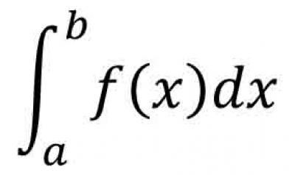
Integral

Slide 6
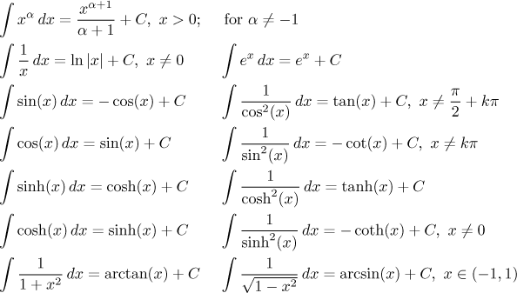
Integral

Slide 7
Review/Revision
Models:
Material point (model)
Continuity (model)

Slide 8
Mass
Mass is a property of a physical body which determines the body's resistance to being accelerated by a force and the strength of its mutual gravitational attraction with other bodies. The SI unit of mass is the kilogram (kg).
Mass is not the same thing as weight, even though we commonly calculate an object's mass by measuring its weight. A man standing on the Moon would weigh less than he would on Earth because of the lower gravity, but he would have the same mass (he would have to recalibrate his bathroom scale for lunar gravity).

Slide 9
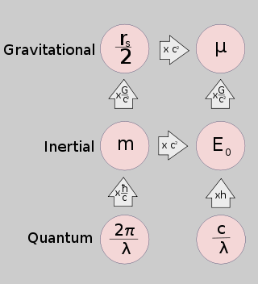
Mass

Slide 10
Center of mass
The center of mass of a distribution of mass in space is the unique point where the weighted relative position of the distributed mass sums to zero. The distribution of mass is balanced around the center of mass and the average of the weighted position coordinates of the distributed mass defines its coordinates. Calculations in mechanics are often simplified when formulated with respect to the center of mass.

Slide 11
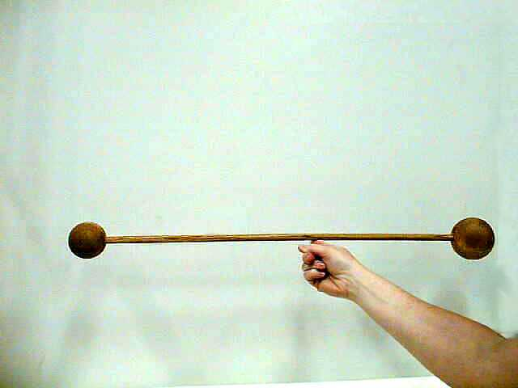
Center of mass

Slide 12
Frame of reference
A frame of reference (or reference frame) may refer to a coordinate system used to represent and measure properties of objects, such as their position and orientation, at different moments of time. It may also refer to a set of axes used for such representation. In a weaker sense, a reference frame does not specify coordinates, but only defines the same 3-dimensional space for all moments of time such that the frame can distinguish objects at rest from those that are moving.
In Einsteinian relativity, reference frames are used to specify the relationship between a moving observer and the phenomenon or phenomena under observation. In this context, the phrase often becomes "observational frame of reference" (or "observational reference frame"), which implies that the observer is at rest in the frame, although not necessarily located at its origin. A relativistic reference frame includes (or implies) the coordinate time, which does not correspond across different frames moving relatively each other. The situation thus differs from Galilean relativity, where all possible coordinate times are essentially equivalent.

Slide 13
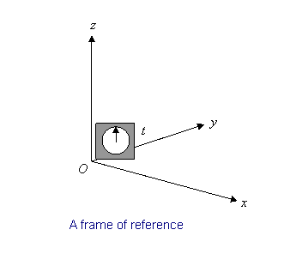
Frame of reference

Slide 14
Three-dimensional space
Three-dimensional space is a geometric three-parameter model of the physical universe (without considering time) in which all known matter exists. These three dimensions can be labeled by a combination of three chosen from the terms length, width, height, depth, and breadth. Any three directions can be chosen, provided that they do not all lie in the same plane.
A sequence of n numbers can be understood as a location in n-dimensional space. When n = 3, the set of all such locations is called three-dimensional Euclidean space. It is commonly represented by the symbol . This space is only one example of a great variety of spaces in three dimensions called 3-manifolds.

Slide 15
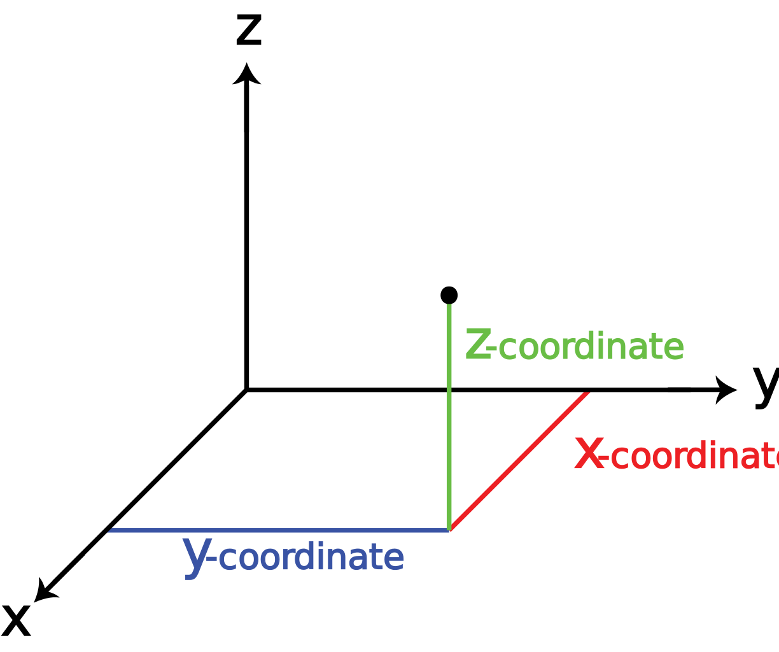
Three-dimensional space

Slide 16
Time
Time is the fourth dimension and a measure in which events can be ordered from the past through the present into the future, and also the measure of durations of events and the intervals between them. Time has long been a major subject of study in religion, philosophy, and science, but defining it in a manner applicable to all fields without circularity has consistently eluded scholars. Nevertheless, diverse fields such as business, industry, sports, the sciences, and the performing arts all incorporate some notion of time into their respective measuring systems. Some simple, relatively uncontroversial definitions of time include "time is what clocks measure" and "time is what keeps everything from happening at once".

Slide 17

Time

Slide 18
Velocity
Velocity is the rate of change of the position of an object, equivalent to a specification of its speed and direction of motion, e.g. 60 km/h to the north. Velocity is an important concept in kinematics, the branch of classical mechanics which describes the motion of bodies.
Velocity is a vector physical quantity; both magnitude and direction are required to define it. The scalar absolute value (magnitude) of velocity is called "speed", a quantity that is measured in metres per second (m/s or m·s⁻¹) in the SI (metric) system. For example, "5 metres per second" is a scalar (not a vector), whereas "5 metres per second east" is a vector.

Slide 19
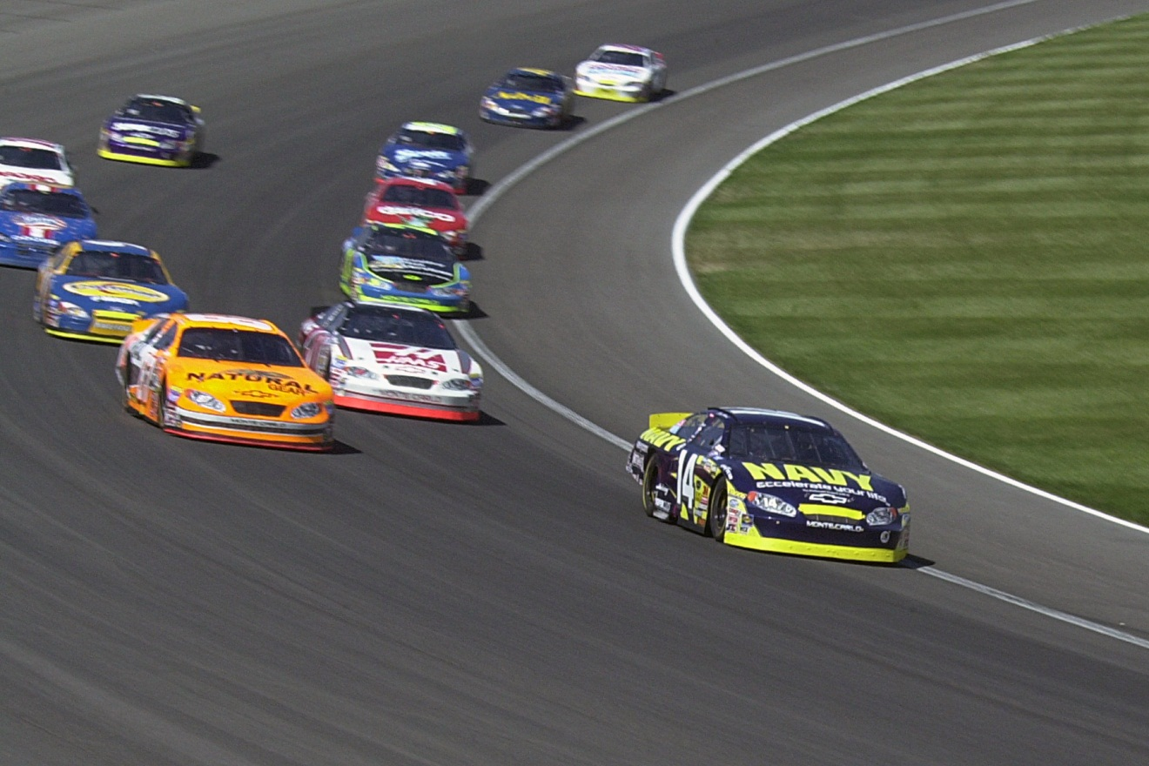
Velocity

Slide 20
Speed
The speed of an object is the magnitude of its velocity (the rate of change of its position); it is thus a scalar quantity. The average speed of an object in an interval of time is the distance travelled by the object divided by the duration of the interval; the instantaneous speed is the limit of the average speed as the duration of the time interval approaches zero.
Like velocity, speed has the dimensions of a length divided by a time; the SI unit of speed is the metre per second, but the most usual unit of speed in everyday usage is the kilometre per hour or, in the US and the UK, miles per hour. For air and marine travel the knot is commonly used.
The fastest possible speed at which energy or information can travel, according to special relativity, is the speed of light in a vacuum c = 299792458 metres per second (approximately 1079000000 km/h or 671000000 mph). Matter cannot quite reach the speed of light, as this would require an infinite amount of energy. In relativity physics, the concept of rapidity replaces the classical idea of speed.

Slide 21

Speed

Slide 22
Acceleration
Acceleration is the rate at which the velocity of an object changes over time. An object's acceleration is the net result of any and all forces acting on the object, as described by Newton's Second Law. The SI unit for acceleration is the metre per second squared (m/s²). Accelerations are vector quantities (they have magnitude and direction) and add according to the parallelogram law. As a vector, the calculated net force is equal to the product of the object's mass (a scalar quantity) and the acceleration.

Slide 23
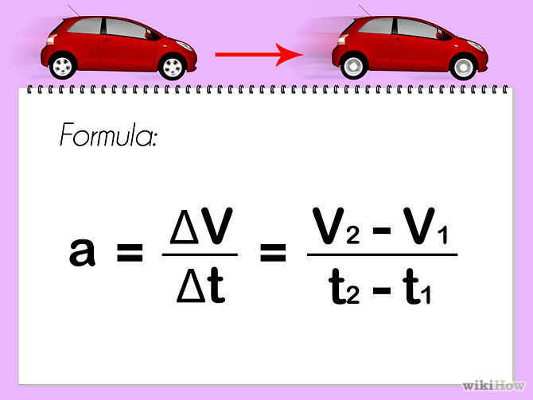
Acceleration

Slide 24
Kinematics
Kinematics is the study of classical mechanics which describes the motion of points, bodies (objects) and systems of bodies (groups of objects) without consideration of the causes of motion. The term is the English version of A.M. Ampère's cinématique, which he constructed from the Greek κίνημα kinema "movement, motion", derived from κινεῖν kinein "to move".
The study of kinematics is often referred to as the geometry of motion.

Slide 25
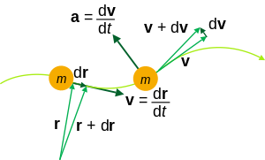
Kinematics

Slide 26
Classical mechanics
Classical mechanics and quantum mechanics are the two major sub-fields of mechanics. Classical mechanics is concerned with the set of physical laws describing the motion of bodies under the action of a system of forces. The study of the motion of bodies is an ancient one, making classical mechanics one of the oldest and largest subjects in science, engineering and technology. It is also widely known as Newtonian mechanics.

Slide 27
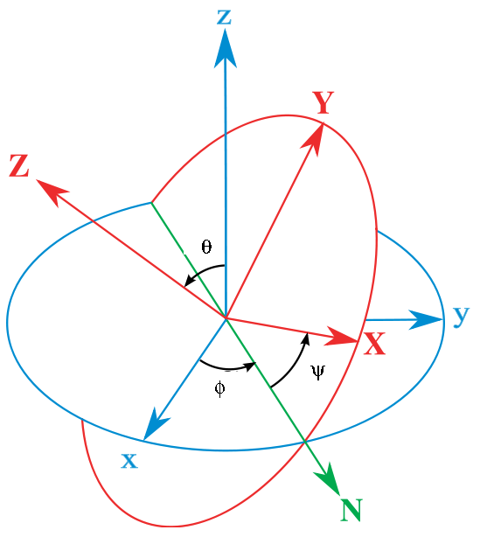
Classical mechanics

Slide 28
Motion
Motion is a change in position of an object with respect to time and its reference point. Motion is typically described in terms of displacement, direction, velocity, acceleration, and time. Motion is observed by attaching a frame of reference to a body and measuring its change in position relative to that frame.
If the position of a body is not changing with the time with respect to a given frame of reference the body is said to be at rest, motionless, immobile, stationary, or to have constant (time-invariant) position. An object's motion cannot change unless it is acted upon by a force, as described by Newton's first law. Momentum is a quantity which is used for measuring motion of an object. An object's momentum is directly related to the object's mass and velocity, and the total momentum of all objects in an isolated system (one not affected by external forces) does not change with time, as described by the law of conservation of momentum. The study of motion deals with (1) The study of motion of solids (mechanics). (2) study of motion of fluids (fluid mechanics)

Slide 29

Motion

Slide 30
Vector
Euclidean vector, a geometric entity endowed with magnitude and direction as well as a positive-definite inner product; an element of a Euclidean vector space. In physics, euclidean vectors are used to represent physical quantities that have both magnitude and direction, such as force, in contrast to scalar quantities, which have no direction.

Slide 31
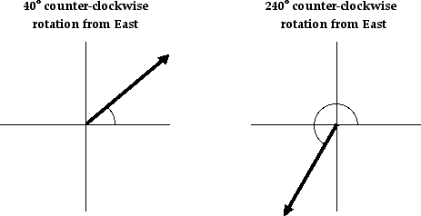
Vector

Slide 32
Scalar
A scalar is a one-dimensional physical quantity, i.e. one that can be described by a single real number (sometimes signed, often with units), unlike (or as a special case of) vectors, tensors, etc. which are described by several numbers which characterize magnitude and direction. Formally, a scalar is unchanged by coordinate system rotations or reflections (in Newtonian mechanics), or by Lorentz transformations or space-time translations (in relativity). A related concept is a pseudoscalar, which is invariant under proper rotations but (like a pseudovector) flips sign under improper rotations. The concept of a scalar in physics is essentially the same as in mathematics.
An example of a scalar quantity is temperature: the temperature at a given point is a single number. Velocity, on the other hand, is a vector quantity: velocity in three-dimensional space is specified by three values; in a Cartesian coordinate system the values are the speeds relative to each coordinate axis.

Slide 33
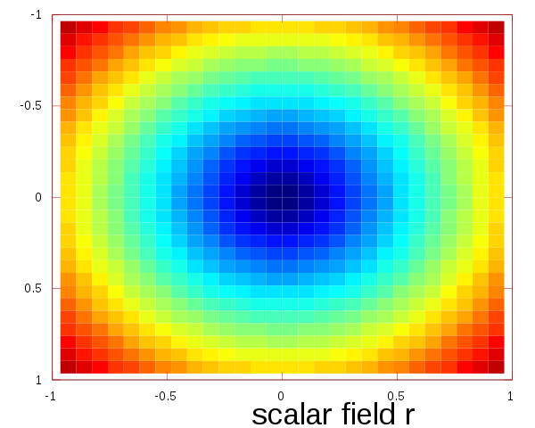
Scalar

Slide 34
Inertia
Inertia is the resistance of any physical object to any change in its state of motion, including changes to its speed and direction. It is the tendency of objects to keep moving in a straight line at constant velocity. The principle of inertia is one of the fundamental principles of classical physics that are used to describe the motion of objects and how they are affected by applied forces. Inertia comes from the Latin word, iners, meaning idle, sluggish. Inertia is one of the primary manifestations of mass, which is a quantitative property of physical systems. Isaac Newton defined inertia as his first law in his Philosophiæ Naturalis Principia Mathematica.

Slide 35

Inertia

Slide 36
Projectile Motion
Projectile motion is a form of motion in which an object or particle (called a projectile) is thrown near the earth's surface, and it moves along a curved path under the action of gravity only. The only force of significance that acts on the object is gravity, which acts downward to cause a downward acceleration. There are no horizontal forces needed to maintain the horizontal motion – consistent with the concept of inertia.

Slide 37
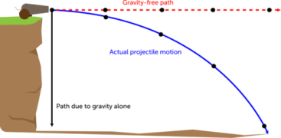
Projectile Motion

Slide 38
Circular motion
Circular motion is a movement of an object along the circumference of a circle or rotation along a circular path. It can be uniform, with constant angular rate of rotation (and constant speed), or non-uniform with a changing rate of rotation. The rotation around a fixed axis of a three-dimensional body involves circular motion of its parts. The equations of motion describe the movement of the center of mass of a body.
Examples of circular motion include: an artificial satellite orbiting the Earth at constant height, a stone which is tied to a rope and is being swung in circles, a car turning through a curve in a race track, an electron moving perpendicular to a uniform magnetic field, and a gear turning inside a mechanism.
Since the object's velocity vector is constantly changing direction, the moving object is undergoing acceleration by a centripetal force in the direction of the center of rotation. Without this acceleration, the object would move in a straight line, according to Newton's laws of motion.

Slide 39
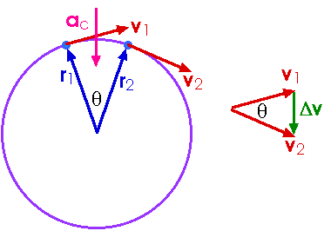
Circular motion

Slide 40
Newton's laws of motion
Newton's laws of motion are three physical laws that together laid the foundation for classical mechanics. They describe the relationship between a body and the forces acting upon it, and its motion in response to said forces. They have been expressed in several different ways over nearly three centuries, and can be summarized as follows:
First law: When viewed in an inertial reference frame, an object either remains at rest or continues to move at a constant velocity, unless acted upon by an external force.
Second law: . The vector sum of the forces F on an object is equal to the mass m of that object multiplied by the acceleration vector a of the object.
Third law: When one body exerts a force on a second body, the second body simultaneously exerts a force equal in magnitude and opposite in direction on the first body.

Slide 41
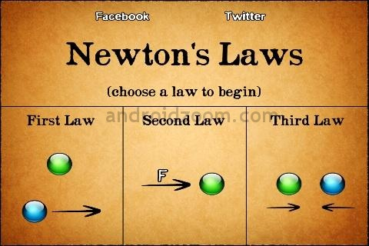
Newton's laws of motion

Slide 42
Dynamics
Dynamics is a branch of physics (specifically classical mechanics) concerned with the study of forces and torques and their effect on motion. Isaac Newton defined the fundamental physical laws which govern dynamics in physics, especially his second law of motion.

Slide 43
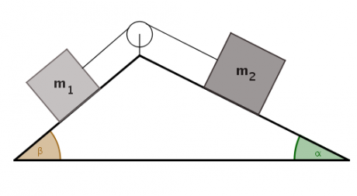
Dynamics

Slide 44
Force
A force is any interaction which tends to change the motion of an object. In other words, a force can cause an object with mass to change its velocity (which includes to begin moving from a state of rest), i.e., to accelerate. Force can also be described by intuitive concepts such as a push or a pull. A force has both magnitude and direction, making it a vector quantity. It is measured in the SI unit of newtons and represented by the symbol F.

Slide 45
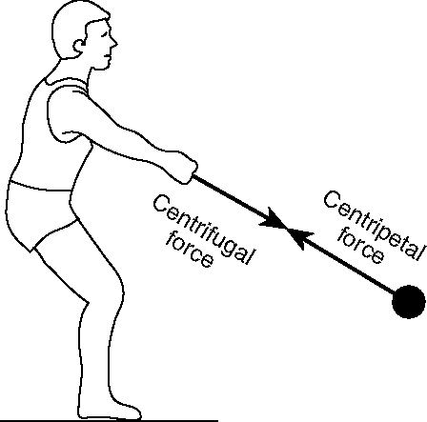
Force

Slide 46
Torque
Torque, moment or moment of force is the tendency of a force to rotate an object about an axis, fulcrum, or pivot. Just as a force is a push or a pull, a torque can be thought of as a twist to an object. Mathematically, torque is defined as the cross product of the lever-arm distance vector and the force vector, which tends to produce rotation.
Loosely speaking, torque is a measure of the turning force on an object such as a bolt or a flywheel. For example, pushing or pulling the handle of a wrench connected to a nut or bolt produces a torque (turning force) that loosens or tightens the nut or bolt.

Slide 47
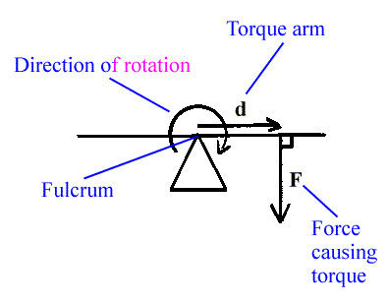
Torque

Slide 48
Moment of inertia
Moment of inertia is the mass property of a rigid body that determines the torque needed for a desired angular acceleration about an axis of rotation. Moment of inertia depends on the shape of the body and may be different around different axes of rotation. A larger moment of inertia around a given axis requires more torque to increase the rotation, or to stop the rotation, of a body about that axis. Moment of inertia depends on the amount and distribution of its mass, and can be found through the sum of moments of inertia of the masses making up the whole object, under the same conditions. For example, if m_{a} + m_{b} = m_{c}, then I_{a} + I_{b} = I_{c}. In classical mechanics, moment of inertia may also be called mass moment of inertia, rotational inertia, polar moment of inertia, or the angular mass.

Slide 49
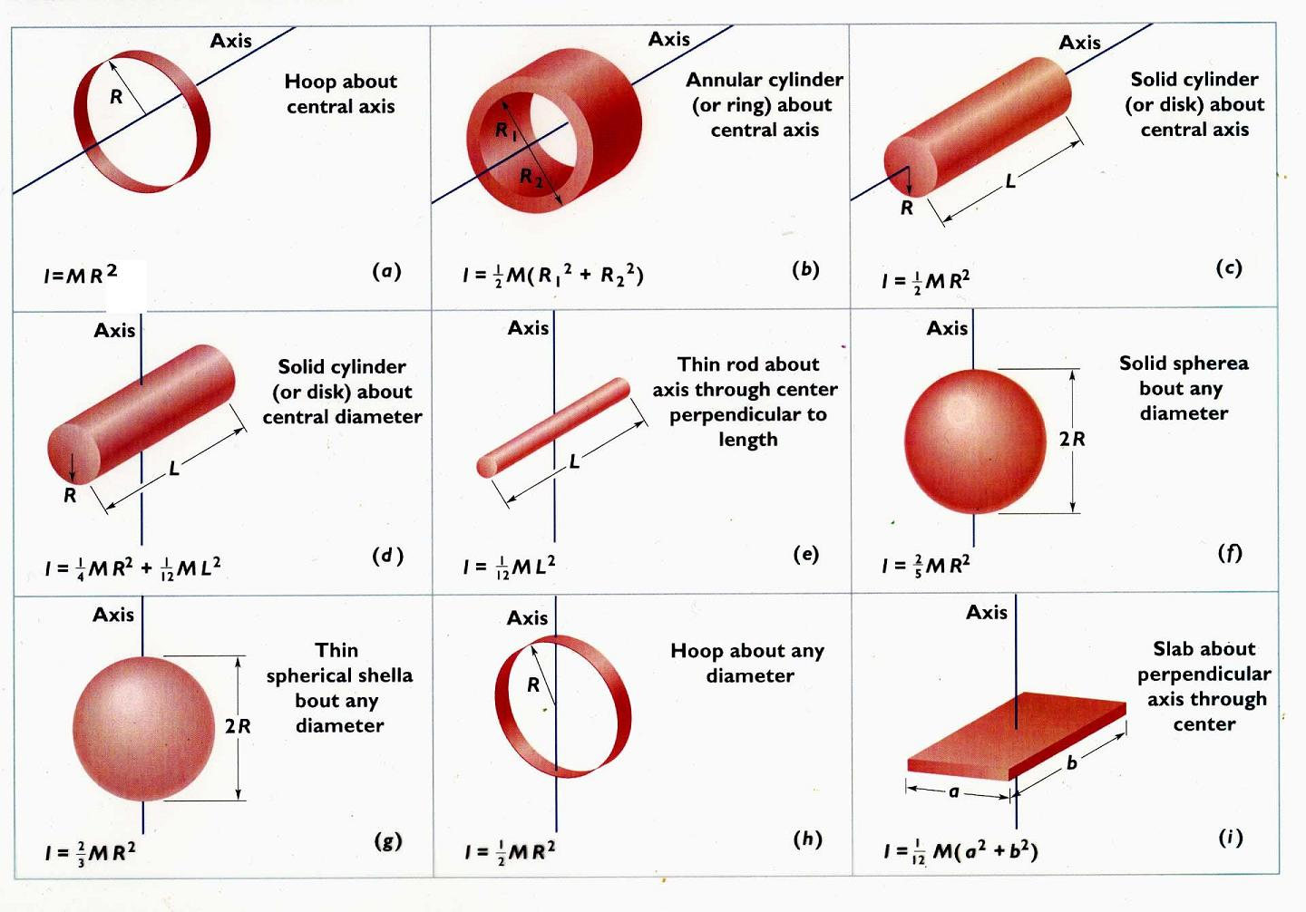
Moment of inertia

Slide 50
Rigid body
A rigid body is an idealization of a solid body in which deformation is neglected. In other words, the distance between any two given points of a rigid body remains constant in time regardless of external forces exerted on it. Even though such an object cannot physically exist due to relativity, objects can normally be assumed to be perfectly rigid if they are not moving near the speed of light.
In classical mechanics a rigid body is usually considered as a continuous mass distribution, while in quantum mechanics a rigid body is usually thought of as a collection of point masses. For instance, in quantum mechanics molecules (consisting of the point masses: electrons and nuclei) are often seen as rigid bodies (see classification of molecules as rigid rotors).

Slide 51
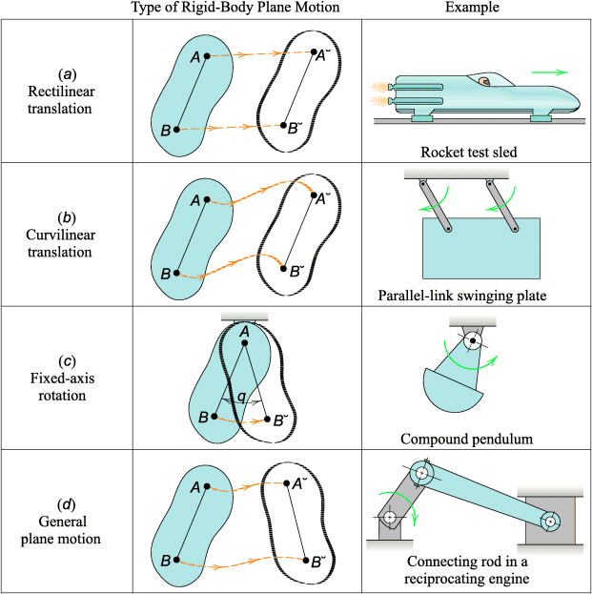
Rigid body

Slide 52
Tensor
Tensors are geometric objects that describe linear relations between vectors, scalars, and other tensors. Elementary examples of such relations include the dot product, the cross product, and linear maps. Vectors and scalars themselves are also tensors. A tensor can be represented as a multi-dimensional array of numerical values. The order (also degree) of a tensor is the dimensionality of the array needed to represent it, or equivalently, the number of indices needed to label a component of that array. For example, a linear map can be represented by a matrix (a 2-dimensional array) and therefore is a 2nd-order tensor. A vector can be represented as a 1-dimensional array and is a 1st-order tensor. Scalars are single numbers and are thus 0th-order tensors. It is very important not to confuse dimensions of the array with dimensions of the underlying vector space.

Slide 53
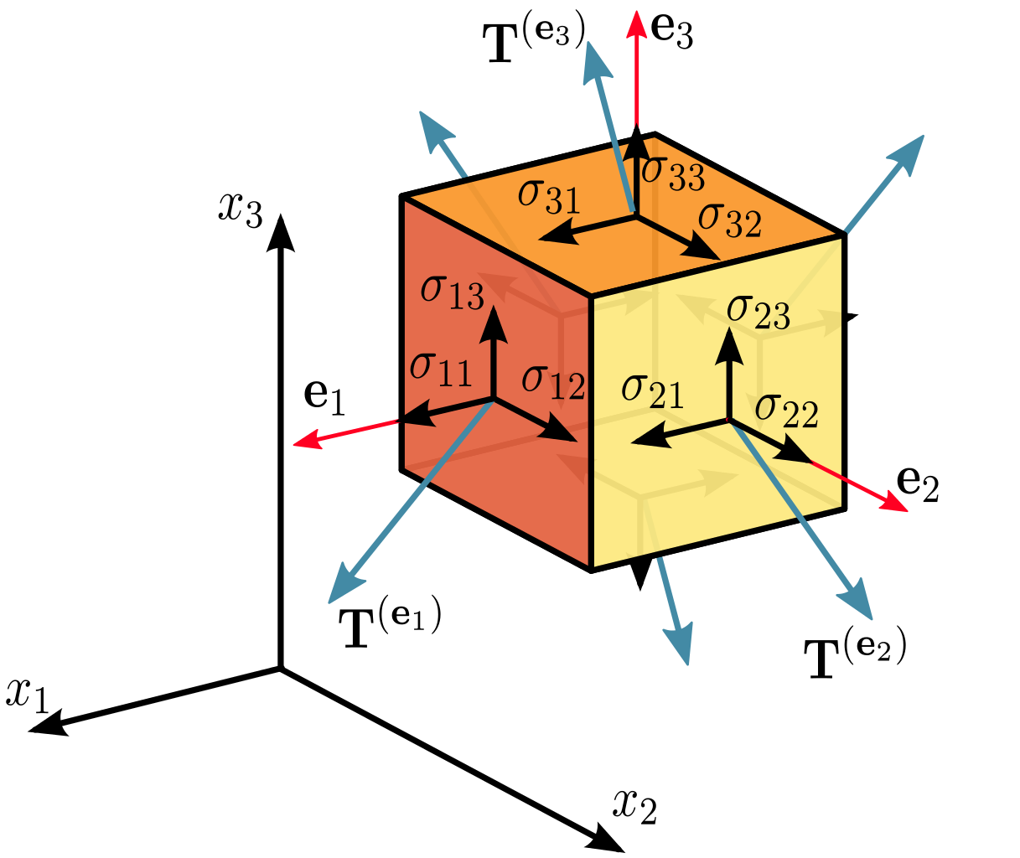
Tensor

Slide 54
Solid mechanics
Solid mechanics is the branch of continuum mechanics that studies the behavior of solid materials, especially their motion and deformation under the action of forces, temperature changes, phase changes, and other external or internal agents.
Solid mechanics is fundamental for civil, nuclear, and mechanical engineering, for geology, and for many branches of physics such as materials science. It has specific applications in many other areas, such as understanding the anatomy of living beings, and the design of dental prostheses and surgical implants. One of the most common practical applications of solid mechanics is the Euler-Bernoulli beam equation. Solid mechanics extensively uses tensors to describe stresses, strains, and the relationship between them.

Slide 55
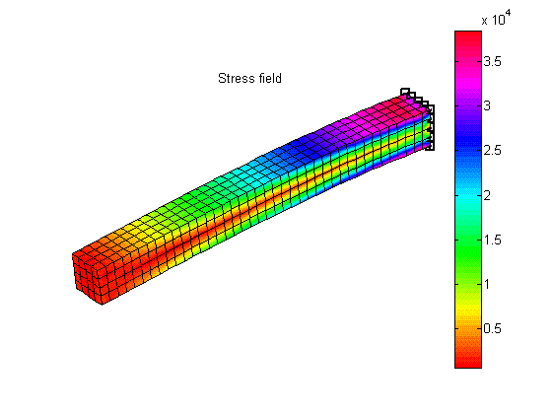
Solid mechanics

Slide 56
Fluid mechanics
Fluid mechanics is the branch of physics that studies fluids (liquids, gases, and plasmas) and the forces on them. Fluid mechanics can be divided into fluid statics, the study of fluids at rest; fluid kinematics, the study of fluids in motion; and fluid dynamics, the study of the effect of forces on fluid motion. It is a branch of continuum mechanics, a subject which models matter without using the information that it is made out of atoms, that is, it models matter from a macroscopic viewpoint rather than from a microscopic viewpoint. Fluid mechanics, especially fluid dynamics, is an active field of research with many unsolved or partly solved problems. Fluid mechanics can be mathematically complex, and can best be solved by numerical methods, typically using computers. A modern discipline, called computational fluid dynamics (CFD), is devoted to this approach to solving fluid mechanics problems. Particle image velocimetry, an experimental method for visualizing and analyzing fluid flow, also takes advantage of the highly visual nature of fluid flow.

Slide 57
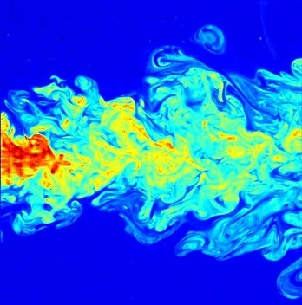
Fluid mechanics

Slide 58
Temperature
A temperature is a numerical measure of hot and cold. Its measurement is by detection of heat radiation, particle velocity, kinetic energy, or most commonly, by the bulk behavior of a thermometric material. It may be calibrated in any of various temperature scales, Celsius, Fahrenheit, Kelvin, etc.

Slide 59
Thermodynamics
Thermodynamics is a branch of physics concerned with heat and temperature and their relation to energy and work. It defines macroscopic variables, such as internal energy, entropy, and pressure, that partly describe a body of matter or radiation. It states that the behavior of those variables is subject to general constraints, that are common to all materials, not the peculiar properties of particular materials. These general constraints are expressed in the four laws of thermodynamics. Thermodynamics describes the bulk behavior of the body, not the microscopic behaviors of the very large numbers of its microscopic constituents, such as molecules. Its laws are explained by statistical mechanics, in terms of the microscopic constituents.

Slide 60
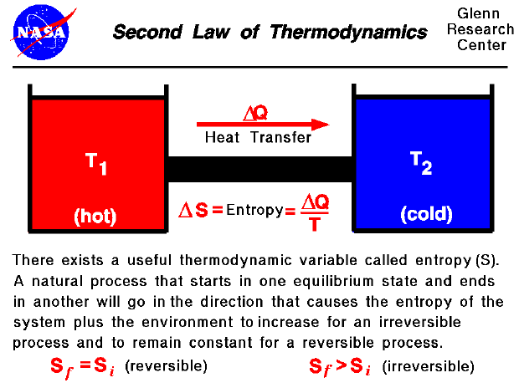
Thermodynamics

