Slide 1
Physics 1
Definitions
Importance of physics
Everyday life physics
Relation of physics to other fields
History of physics
Theories, models, principles and laws
Measurements
Kinematics
Exercises
Bibliography

Slide 2
No mistakes, right decisions
It is all about making no mistakes and right decisions

Slide 3
Patterns and invariants
It is all about patterns and invariants

Slide 4
What is physics?
Physics (from Ancient Greek: “knowledge of nature”) is the natural science that involves the study of matter and its motion through space and time, along with related concepts such as energy and force. More broadly, it is the general analysis of nature, conducted in order to understand how the universe behaves.
Physics structure: Mechanics, thermodynamics, electromagnetism, photonics, relativity, atomic and nuclear physics

Slide 5
Why is physics important?
Parallel universes,
worm holes,
twin paradox,
teleportation,
gadgets,
quantum computers,
navigation,
military applications,
etc.

Slide 6
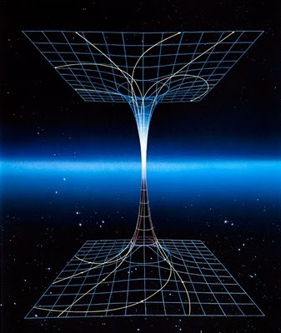
Parallel universes

Slide 7
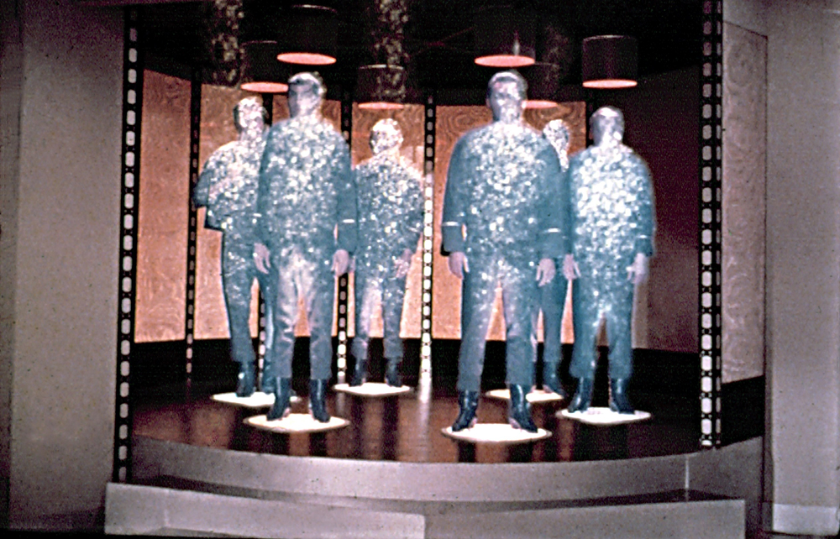
teleportation

Slide 8
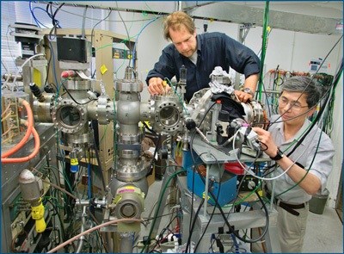
quantum computer

Slide 9
Fusion power
Fusion power is the energy generated by nuclear fusion processes. In fusion reactions, two light atomic nuclei fuse to form a heavier nucleus (in contrast with fission power). In doing so they release a comparatively large amount of energy arising from the binding energy due to the strong nuclear force which is manifested as an increase in temperature of the reactants. Fusion power is a primary area of research in plasma physics.
The term is commonly used to refer to potential commercial production of net usable power from a fusion source, similar to the usage of the term "steam power". The leading designs for controlled fusion research use magnetic (tokamak design) or inertial (laser) confinement of a plasma. Both approaches are still under development and are years away from commercial operation in which heat from the fusion reaction is used to operate a steam turbine which drives electrical generators, as in existing fossil fuel and nuclear fission power stations.

Slide 10
Higgs boson
The Higgs boson or Higgs particle is an elementary particle in the Standard Model of Particle physics. Its main relevance is that it is the smallest possible excitation of the Higgs field – a field that unlike the more familiar electromagnetic field cannot be "turned off", but instead takes a constant value almost everywhere. The presence of this field explains why some fundamental particles have mass while the symmetries controlling their interactions should require them to be massless, and why the weak force has a much shorter range than the electromagnetic force.

Slide 11
Everyday life physics
Why are the skies blue,
clouds white, and
sunrise and sunset red? (romantic)
How can airplane and helicopter fly?
Vendor bicycle wrongly designed
Small wheels and wrongly designed bikes

Slide 12
Relation of physics to other fields
Telematics
Food technology and other technologies
Agro-business
mechanics
Biology
Economics
Constructions

Slide 13
History of physics
Ptolemy c. AD 90 – c. 168, was a Greco-Egyptian writer of Alexandria, known as a mathematician, astronomer, etc.
Copernicus (19 February 1473 – 24 May 1543) was a Renaissance mathematician and astronomer who formulated a model of the universe that placed the Sun rather than the Earth at its center.

Slide 14
History of physics: Bruno
Giordano Bruno (1548 – February 17, 1600), was an Italian Dominican friar, philosopher, mathematician, poet, and astrologer. He is celebrated for his cosmological theories, which went even further than the then-novel Copernican model, proposing that the stars were just distant suns surrounded by their own exoplanets, and moreover the possibility that these planets could even foster life of their own (a philosophical position known as cosmic pluralism). He also insisted that the universe is in fact infinite, thus having no celestial body at its "center".

Slide 15
History of physics: Galileo
Galileo Galilei (15 February 1564 – 8 January 1642), often known mononymously as Galileo, was an Italian physicist, mathematician, engineer, astronomer, and philosopher who played a major role in the scientific revolution. His achievements include improvements to the telescope and consequent astronomical observations and support for Copernicanism. Galileo has been called the "father of modern observational astronomy", the "father of modern physics", the "father of science", and "the Father of Modern Science".

Slide 16
History of physics: Newton
Newton (25 December 1642 – 20 March 1726/7) was an English physicist and mathematician (described in his own day as a "natural philosopher") who is widely recognised as one of the most influential scientists of all time and as a key figure in the scientific revolution. His book Philosophiæ Naturalis Principia Mathematica ("Mathematical Principles of Natural Philosophy"), first published in 1687, laid the foundations for classical mechanics. Newton also made seminal contributions to optics.

Slide 17
History of physics: Einstein
Albert Einstein (14 March 1879 – 18 April 1955) was a German-born theoretical physicist and philosopher of science. He developed the general theory of relativity, one of the two pillars of modern physics (alongside quantum mechanics).^{[2][4]} He is best known in popular culture for his mass–energy equivalence formula E = mc² (which has been dubbed "the world's most famous equation"). He received the 1921 Nobel Prize in Physics "for his services to theoretical physics, and especially for his discovery of the law of the photoelectric effect". The latter was pivotal in establishing quantum theory.

Slide 18
History of physics: Planck
Max Karl Ernst Ludwig Planck, (April 23, 1858 – October 4, 1947) was a German theoretical physicist who originated quantum theory, which won him the Nobel Prize in Physics in 1918.
Planck made many contributions to theoretical physics, but his fame rests primarily on his role as originator of the quantum theory. This theory revolutionized human understanding of atomic and subatomic processes, just as Albert Einstein’s theory of relativity revolutionized the understanding of space and time. Together they constitute the fundamental theories of 20th-century physics.

Slide 19
History of physics: Schrödinger
Erwin Rudolf Josef Alexander Schrödinger (12 August 1887 – 4 January 1961), sometimes written as Erwin Schrodinger or Erwin Schroedinger, was a Nobel Prize-winning Austrian physicist who developed a number of fundamental results in the field of quantum theory, which formed the basis of wave mechanics: he formulated the wave equation (stationary and time-dependent Schrödinger equation) and revealed the identity of his development of the formalism and matrix mechanics. Schrödinger proposed an original interpretation of the physical meaning of the wave function and in subsequent years repeatedly criticized the conventional Copenhagen interpretation of quantum mechanics (using e.g. the paradox of Schrödinger's cat).

Slide 20
History of physics: Dirac
Paul Adrien Maurice Dirac (8 August 1902 – 20 October 1984) was an English theoretical physicist who made fundamental contributions to the early development of both quantum mechanics and quantum electrodynamics. He was the Lucasian Professor of Mathematics at the University of Cambridge, a member of the Center for Theoretical Studies, University of Miami, and spent the last decade of his life at Florida State University.
Among other discoveries, he formulated the Dirac equation, which describes the behavior of fermions and predicted the existence of antimatter. Dirac shared the Nobel Prize in Physics for 1933 with Erwin Schrödinger, "for the discovery of new productive forms of atomic theory". He also did work that forms the basis of modern attempts to reconcile general relativity with quantum mechanics.
He was regarded by his friends and colleagues as unusual in character. Albert Einstein said of him, "This balancing on the dizzying path between genius and madness is awful". His mathematical brilliance, however, means he is regarded as one of the most significant physicists of the 20th century.

Slide 21
Theories
Theory is a contemplative and rational type of abstract or generalizing thinking, or the results of such thinking. Depending on the context, the results might for example include generalized explanations of how nature works. The word has its roots in ancient Greek, but in modern use it has taken on several different related meanings.
A scientific theory is a well-substantiated explanation of some aspect of the natural world that is acquired through the scientific method and repeatedly tested and confirmed through observation and experimentation. As with most (if not all) forms of scientific knowledge, scientific theories are inductive in nature and aim for predictive power and explanatory force.

Slide 22
Laws
A scientific law is a statement based on repeated experimental observations that describes some aspect of the universe. A scientific law always applies under the same conditions, and implies that there is a causal relationship involving its elements. Factual and well-confirmed statements like "Mercury is liquid at standard temperature and pressure" are considered too specific to qualify as scientific laws. A central problem in the philosophy of science, going back to David Hume, is that of distinguishing causal relationships (such as those implied by laws) from principles that arise due to constant conjunction.
Accuracy of physical laws is very high.

Slide 23
Principle
A principle is a law or rule that has to be, or usually is to be followed, or can be desirably followed, or is an inevitable consequence of something, such as the laws observed in nature or the way that a system is constructed. The principles of such a system are understood by its users as the essential characteristics of the system, or reflecting system's designed purpose, and the effective operation or use of which would be impossible if any one of the principles was to be ignored.
Examples of principles:
Descriptive comprehensive and fundamental law, doctrine, or assumption
Normative rule or code of conduct
Law or fact of nature underlying the working of an artificial device

Slide 24
Model
Model is a simplified representation of reality.

Slide 25
Measurements
It is all about measurements.
There are several base units and all the others are derived from the base ones.

Slide 26
Accuracy and precision
Accuracy and precision are defined in terms of systematic and random errors. The more common definition associates accuracy with systematic errors and precision with random errors. Another definition, advanced by ISO, associates trueness with systematic errors and precision with random errors, and defines accuracy as the combination of both trueness and precision.

Slide 27
Normal distribution
The normal distribution is a very commonly occurring continuous probability distribution—a function that tells the probability that any real observation will fall between any two real limits or real numbers, as the curve approaches zero on either side. Normal distributions are extremely important in statistics and are often used in the natural and social sciences for real-valued random variables whose distributions are not known.

Slide 28
Systematic errors
Systematic errors are biases in measurement which lead to the situation where the mean of many separate measurements differs significantly from the actual value of the measured attribute. All measurements are prone to systematic errors, often of several different types. Sources of systematic error may be imperfect calibration of measurement instruments (zero error), changes in the environment which interfere with the measurement process and sometimes imperfect methods of observation can be either zero error or percentage error. For example, consider an experimenter taking a reading of the time period of a pendulum swinging past a fiducial mark: If their stop-watch or timer starts with 1 second on the clock then all of their results will be off by 1 second (zero error). If the experimenter repeats this experiment twenty times (starting at 1 second each time), then there will be a percentage error in the calculated average of their results; the final result will be slightly larger than the true period. Distance measured by radar will be systematically overestimated if the slight slowing down of the waves in air is not accounted for. Incorrect zeroing of an instrument leading to a zero error is an example of systematic error in instrumentation.

Slide 29
Random errors
Random errors are errors in measurement that lead to measurable values being inconsistent when repeated measures of a constant attribute or quantity are taken. The word random indicates that they are inherently unpredictable, and have null expected value, namely, they are scattered about the true value, and tend to have null arithmetic mean when a measurement is repeated several times with the same instrument. All measurements are prone to random error.

Slide 30
Absolute, relative and percentage errors
One commonly distinguishes between the relative error and the absolute error. The absolute error is the magnitude of the difference between the exact value and the approximation. The relative error is the absolute error divided by the magnitude of the exact value. The percent error is the relative error expressed in terms of per 100.

Slide 31
Uncertainty
Uncertainty is a term used in subtly different ways in a number of fields, including philosophy, physics, statistics, economics, finance, insurance, psychology, sociology, engineering, and information science. It applies to predictions of future events, to physical measurements that are already made, or to the unknown. Uncertainty arises in partially observable and/or stochastic environments, as well as due to ignorance and/or indolence.

Slide 32
Significant figures
The significant figures of a number are those digits that carry meaning contributing to its precision.

Slide 33
Scientific notation or standard index form numbers
Scientific notation (commonly referred to as "standard form" or "standard index form") is a way of writing numbers that are too big or too small to be conveniently written in decimal form. Scientific notation has a number of useful properties and is commonly used in calculators and by scientists, mathematicians and engineers.

Slide 34
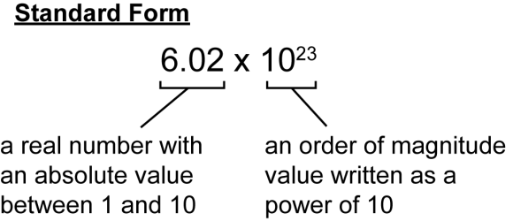
Scientific notation or standard index form numbers

Slide 35
SI units
The International System of Units (abbreviated SI from French: Le Système International d'Unités) is the modern form of the metric system and is the world's most widely used system of measurement, used in both everyday commerce and science. It comprises a coherent system of units of measurement built around seven base units, 22 named and an indeterminate number of unnamed coherent derived units, and a set of prefixes that act as decimal-based multipliers. It is part of the International System of Quantities.

Slide 36
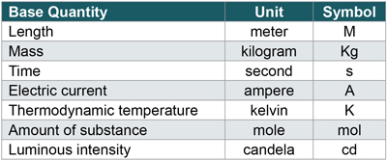
Base SI units

Slide 37
Kinematics
Find displacement, velocity and acceleration when you are given the equation of motion.

Slide 38
Games:
Pendulum,
Bernoulli principle,
handover problem

Slide 39
Exercises: Introduction
1. Define physics.
2. List the main branches of physics.
3. Why is physics important?
4. How do we use physics in everyday life?
5. How is physics related to other fields?
6. Briefly explain the history of physics.
7. Define physical theories, laws, principles and models with examples.

Slide 40
Exercises: Measurements
8. Explain measurements, units, errors and uncertainty.
9. List the basic units of physics.
10. Show that at is measured in velocity units.
11. Derive Volt from basic units.
12. Calculate the errors for different cases.

Slide 41
Exercises: significant figures
13. Determine the number of significant figures in each of these measured quantities:
a. 0.0072
b. 3,000,000
c. 8.0

Slide 42
Exercises: Creativity in physics
14. How can creativity be achieved in physics?

Slide 43
Bibliography:
[Textbooks] http://physics15.weebly.com/
[WikiPedia] http://en.wikipedia.org
[Google] https://www.google.com

