Slide 1
11 Lecture in physics
Geometric optics
Mirrors
Lenses
Prisms
Wave optics
Optical instruments

Slide 2
Geometrical optics
Geometrical optics, or ray optics, describes light propagation in terms of "rays". The "ray" in geometric optics is an abstraction, or "instrument", which can be used to approximately model how light will propagate. Light rays are defined to propagate in a rectilinear path as they travel in a homogeneous medium. Rays bend (and may split in two) at the interface between two dissimilar media, may curve in a medium where the refractive index changes, and may be absorbed and reflected. Geometrical optics provides rules, which may depend on the color (wavelength) of the ray, for propagating these rays through an optical system. This is a significant simplification of optics that fails to account for optical effects such as diffraction and interference. It is an excellent approximation when the wavelength is very small compared with the size of structures with which the light interacts. Geometric optics can be used to describe the geometrical aspects of imaging, including optical aberrations.

Slide 3
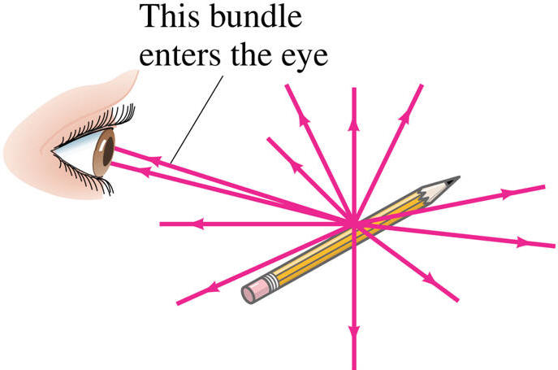
Ray model of light

Slide 4
Optical systems:
Real images
Virtual images

Slide 5
Reflection
Reflection is the change in direction of a wavefront at an interface between two different media so that the wavefront returns into the medium from which it originated. Common examples include the reflection of light, sound and water waves. The law of reflection says that for specular reflection the angle at which the wave is incident on the surface equals the angle at which it is reflected. Mirrors exhibit specular reflection.

Slide 6
mirror
In order to understand mirrors, we first must understand light. The law of reflection says that when a ray of light hits a surface, it bounces in a certain way, like a tennis ball thrown against a wall. The incoming angle, called the angle of incidence, is always equal to the angle leaving the surface, or the angle of reflection. When light hits a surface at a low angle -- like on a lake at sunset -- it bounces off at the same low angle and hits your eyes full blast, rather than obliquely as when the sun sits overhead. This is why the sun's glare during the evening and morning is so much more intense than during the rest of the day.

Slide 7
Plane mirror

Slide 8
Spherical mirror

Slide 9
Focal length of spherical mirror
F = R/2

Slide 10
Mirror Magnification
m = h_{i}/h_{o} = -d_{i}/d_{o}

Slide 11
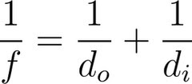
Mirror equation

Slide 12
Antennas

Slide 13
Tasks
A man 175 cm tall stands in front of a vertical plane mirror. His eyes are 10 cm bellow the top of his head. What are the sizes and the best location of the smallest possible mirror so that he can see his entire body?
Do these depend on his distance from the mirror? Why? How?

Slide 14
Tasks
12. If the image in the mirror is straight and magnified, what mirror is that?
13. Does the mirror equation hold for the plane mirror? Explain.

Slide 15
Tasks
19.i. Convex rearview mirror: An external rearview car mirror is convex with a radius of curvature of 16 m. Determine the location of the image and its magnification for an object 10 m from the mirror.
19.ii. View up from under water: Describe what a person would see who looked up at the world from beneath the perfectly smooth surface of a lake or swimming pool.

Slide 16
Refraction
Refraction is the change in direction of a wave due to a change in its transmission medium.

Slide 17
Refraction (continued)
Refraction is essentially a surface phenomenon. The phenomenon is mainly in governance to the law of conservation of energy and momentum. Due to change of medium, the phase velocity of the wave is changed but its frequency remains constant. This is most commonly observed when a wave passes from one medium to another at any angle other than 0° from the normal. Refraction of light is the most commonly observed phenomenon, but any type of wave can refract when it interacts with a medium, for example when sound waves pass from one medium into another or when water waves move into water of a different depth. Refraction is described by Snell's law.

Slide 18
Refraction (continued)
In general, the incident wave is partially refracted and partially reflected; the details of this behavior are described by the Fresnel equations.

Slide 19
Index of refraction
In optics the refractive index or index of refraction n of an optical medium is a dimensionless number that describes how light, or any other radiation, propagates through that medium.
It is defined as n = c/v,
where c is the speed of light in vacuum and v is the speed of light in the substance. For example, the refractive index of water is 1.33, meaning that light travels 1.33 times faster in a vacuum than it does in water.

Slide 20
Snell Law
Snell's law (also known as the Snell–Descartes law and the law of refraction) is a formula used to describe the relationship between the angles of incidence and refraction, when referring to light or other waves passing through a boundary between two different isotropic media, such as water, glass and air.

Slide 21
Snell Law (continued)
In optics, the law is used in ray tracing to compute the angles of incidence or refraction, and in experimental optics to find the refractive index of a material. The law is also satisfied in metamaterials, which allow light to be bent "backward" at a negative angle of refraction with a negative refractive index.

Slide 22
Snell Law (continued)
Although named after Dutch astronomer Willebrord Snellius (1580–1626), the law was first accurately described by the scientist Ibn Sahl at the Baghdad court in 984. In the manuscript On Burning Mirrors and Lenses, Sahl used the law to derive lens shapes that focus light with no geometric aberrations.

Slide 23
Snell Law (continued)
Snell's law states that the ratio of the sines of the angles of incidence and refraction is equivalent to the ratio of phase velocities in the two media, or equivalent to the reciprocal of the ratio of the indices of refraction:
sin A₁/sin A₂ = v₁/v₂ = n₂/n₁

Slide 24
Total internal reflection
Total internal reflection is a phenomenon that happens when a propagating wave strikes a medium boundary at an angle larger than a particular critical angle with respect to the normal to the surface. If the refractive index is lower on the other side of the boundary and the incident angle is greater than the critical angle, the wave cannot pass through and is entirely reflected. The critical angle is the angle of incidence above which the total internal reflection occurs. This is particularly common as an optical phenomenon, where light waves are involved, but it occurs with many types of waves, such as electromagnetic waves in general or sound waves.

Slide 25
Total internal reflection (continued)
When a wave crosses a boundary between different materials with different kinds of refractive indices, the wave will be partially refracted at the boundary surface, and partially reflected. However, if the angle of incidence is greater (i.e. the direction of propagation or ray is closer to being parallel to the boundary) than the critical angle – the angle of incidence at which light is refracted such that it travels along the boundary – then the wave will not cross the boundary and instead be totally reflected back internally. This can only occur when the wave in a medium with a higher refractive index (n₁) hits its surface that's in contact with a medium of lower refractive index (n₂). For example, it will occur with light hitting air from glass, but not when hitting glass from air.

Slide 26
Total internal reflection (continued)
sin A = n₂/n₁

Slide 27
Fiber optics
An optical fiber (or optical fibre) is a flexible, transparent fiber made of extruded glass (silica) or plastic, slightly thicker than a human hair. It can function as a waveguide, or “light pipe”,^{[1]} to transmit light between the two ends of the fiber.^{[2]} The field of applied science and engineering concerned with the design and application of optical fibers is known as fiber optics.

Slide 28
Fiber optics (continued)
Optical fibers are widely used in fiber-optic communications, where they permit transmission over longer distances and at higher bandwidths (data rates) than wire cables. Fibers are used instead of metal wires because signals travel along them with less loss and are also immune to electromagnetic interference. Fibers are also used for illumination, and are wrapped in bundles so that they may be used to carry images, thus allowing viewing in confined spaces. Specially designed fibers are used for a variety of other applications, including sensors and fiber lasers.

Slide 29
Fiber optics (continued)
Optical fibers typically include a transparent core surrounded by a transparent cladding material with a lower index of refraction. Light is kept in the core by total internal reflection. This causes the fiber to act as a waveguide. Fibers that support many propagation paths or transverse modes are called multi-mode fibers (MMF), while those that only support a single mode are called single-mode fibers (SMF). Multi-mode fibers generally have a wider core diameter, and are used for short-distance communication links and for applications where high power must be transmitted. Single-mode fibers are used for most communication links longer than 1,000 meters (3,300 ft).

Slide 30
Fiber optics (continued)
Joining lengths of optical fiber is more complex than joining electrical wire or cable. The ends of the fibers must be carefully cleaved, and then carefully spliced together with the cores perfectly aligned. A mechanical splice holds the ends of the fibers together mechanically, while fusion splicing uses heat to fuse the ends of the fibers together. Special optical fiber connectors for temporary or semi-permanent connections are also available.

Slide 31
Higher frequency helps transmitting more information, making internet faster, etc.

Slide 32
Lenses

Slide 33
Thin lenses

Slide 34
Ray tracing

Slide 35
Lens Equation
A common Gaussian form of the lens equation is shown below. This is the form used in most introductory textbooks. A form using the Cartesian sign convention is often used in more advanced texts because of advantages with multiple-lens systems and more complex optical instruments. Either form can be used with positive or negative lenses and predicts the formation of both real and virtual images. Does not apply to thick lenses.

Slide 36
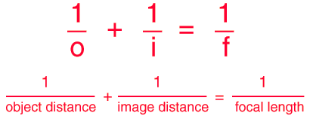
Lens equation

Slide 37
Magnification of Lens
m = h_{i}/h_{o} = -d_{i}/d_{o}

Slide 38
Optical power
Optical power (also referred to as dioptric power, refractive power, focusing power, or convergence power) is the degree to which a lens, mirror, or other optical system converges or diverges light. It is equal to the reciprocal of the focal length of the device: P = 1/f.^{[1]} High optical power corresponds to short focal length. The SI unit for optical power is the inverse metre (m⁻¹), which is commonly called the dioptre.
Converging lenses have positive optical power, while diverging lenses have negative power. When a lens is immersed in a refractive medium, its optical power and focal length change.

Slide 39
Combinations of lenses

Slide 40
Lensmaker Equation
The focal length of a lens in air can be calculated from the lensmaker's equation

Slide 41
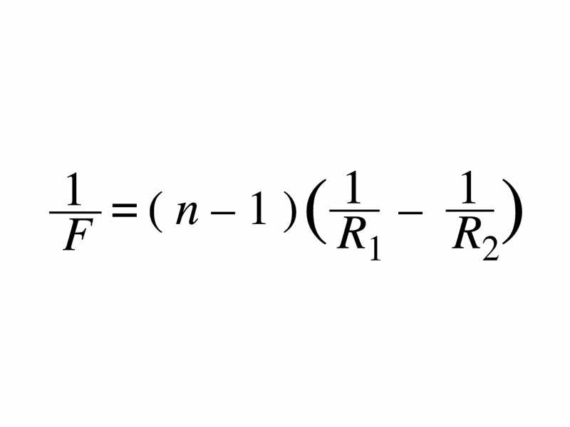
Lensmaker Equation (continued)

Slide 42
Tasks
19.iii. Light traveling in air strikes a glass surface with n = 1.48. For what range of angles will total internal reflection occur?
19.iv. Image formed by converging lens: What is the position and the size of the image of a 7.6-cm-high flower placed 1 m from a +50-mm-focal-length camera lens?

Slide 43
Tasks
Diverging lens: Where must a small insect be placed if a 25-cm-focal-length diverging lens is to form a virtual image 20 cm in front of the lens?

Slide 44
Tasks
Calculating f for converging lens: A convex meniscus lens is made from glass with n = 1.5. The radius of curvature of convex surface is 22.4 cm and that of the concave surface is 46.2 cm. What is the focal length?

Slide 45
Tasks
21. Explain total internal reflection and fiber optics.
22. Draw the rays for the lenses. Write the equation of a lens.
23. Explain combination of lenses.

Slide 46
Tasks
24. Give the Lensmaker equation.
15. Define the index of refraction.
16. What is the speed of light in a diamond? v = 0.413c
17. Give Snell law.

Slide 47
Tasks
The light passes from medium n = 1.3 to medium n = 1.5, is the light bent toward or away from the perpendicular to the interface?

Slide 48
Wave nature of light

Slide 49
Waves vs. particles

Slide 50
Huygens principles

Slide 51
Huygens principle of diffraction

Slide 52
Huygens principle of refraction

Slide 53
Interference

Slide 54
Young double slit experiment

Slide 55
Visible spectrum and dispersion

Slide 56
Diffraction by single slit or disk

Slide 57
Diffraction grating

Slide 58
Spectrometer

Slide 59
Spectroscopy

Slide 60
Interference by thin film

Slide 61
Michelson interferometer

Slide 62
Polarization

Slide 63
Liquid crystal display

Slide 64
Scattering of light by atmosphere

Slide 65
Tasks
25. Explain the wave – particle duality for light.
26. Describe the Huygens principle.
27. Give the Double Slit interference experiment of Young.
28. Explain coherency of light.

Slide 66
Tasks
29. Describe diffraction.
30. Explain spectrometer and spectroscopy.
31. Describe thin film interference.
32. Explain Michelson interferometer.
33. Describe polarization.

Slide 67
Optical instrument
An optical instrument either processes light waves to enhance an image for viewing, or analyzes light waves (or photons) to determine one of a number of characteristic properties.

Slide 68
Cameras, film and digital

Slide 69
f-stop
In optics, the f-number (sometimes called focal ratio, f-ratio, f-stop, or relative aperture) of an optical system is the ratio of the lens's focal length to the diameter of the entrance pupil. It is a dimensionless number that is a quantitative measure of lens speed, and an important concept in photography. The number is commonly notated using a hooked f, i.e. f/N, where N is the f-number.

Slide 70
Simple Magnifier
The simple magnifier achieves angular magnification by permitting the placement of the object closer to the eye than the eye could normally focus. The standard close focus distance is taken as 25 cm.

Slide 71
Angular magnification
Magnification is the process of enlarging something only in appearance, not in physical size. This enlargement is quantified by a calculated number also called "magnification". When this number is less than one, it refers to a reduction in size, sometimes called "minification" or "de-magnification".
Typically, magnification is related to scaling up visuals or images to be able to see more detail, increasing resolution, using microscope, printing techniques, or digital processing. In all cases, the magnification of the image does not change the perspective of the image.

Slide 72
Eye

Slide 73
Corrective lenses

Slide 74
Lens aberration
In an ideal optical system, all rays of light from a point in the object plane would converge to the same point in the image plane, forming a clear image. The influences which cause different rays to converge to different points are called aberrations.

Slide 75
Spherical aberration
Spherical aberration is an optical effect observed in an optical device (lens, mirror, etc.) that occurs due to the increased refraction of light rays when they strike a lens or a reflection of light rays when they strike a mirror near its edge, in comparison with those that strike nearer the centre. It signifies a deviation of the device from the norm, i.e., it results in an imperfection of the produced image.

Slide 76
Chromatic aberration
In optics, chromatic aberration (CA, also called achromatism, chromatic distortion, and spherochromatism) is a type of distortion in which there is a failure of a lens to focus all colors to the same convergence point. It occurs because lenses have different refractive indices for different wavelengths of light (the dispersion of the lens). The refractive index decreases with increasing wavelength.
Chromatic aberration manifests itself as "fringes" of color along boundaries that separate dark and bright parts of the image, because each color in the optical spectrum cannot be focused at a single common point. Since the focal length f of a lens is dependent on the refractive index n, different wavelengths of light will be focused on different positions.

Slide 77
Magnifying glass

Slide 78
Telescope
A telescope is an instrument that aids in the observation of remote objects by collecting electromagnetic radiation (such as visible light). The first known practical telescopes were invented in the Netherlands at the beginning of the 17th century, using glass lenses. They found use in terrestrial applications and astronomy.
Within a few decades, the reflecting telescope was invented, which used mirrors. In the 20th century many new types of telescopes were invented, including radio telescopes in the 1930s and infrared telescopes in the 1960s. The word telescope now refers to a wide range of instruments detecting different regions of the electromagnetic spectrum, and in some cases other types of detectors.
The word "telescope" (from the Greek τῆλε, tele "far" and σκοπεῖν, skopein "to look or see"; τηλεσκόπος, teleskopos "far-seeing") was coined in 1611 by the Greek mathematician Giovanni Demisiani for one of Galileo Galilei's instruments presented at a banquet at the Accademia dei Lincei. In the Starry Messenger, Galileo had used the term "perspicillum".

Slide 79
Microscope
A microscope (from the Ancient Greek: μικρός, mikrós, "small" and σκοπεῖν, skopeîn, "to look" or "see") is an instrument used to see objects that are too small for the naked eye. The science of investigating small objects using such an instrument is called microscopy. Microscopic means invisible to the eye unless aided by a microscope.

Slide 80
Microscope (continued)
There are many types of microscopes. The most common (and the first to be invented) is the optical microscope, which uses light to image the sample. Other major types of microscopes are the electron microscope (both the transmission electron microscope and the scanning electron microscope), the ultramicroscope, and the various types of scanning probe microscope.

Slide 81
Microscope (continued)
On October 8, 2014, the Nobel Prize in Chemistry was awarded to Eric Betzig, William Moerner and Stefan Hell for "the development of super-resolved fluorescence microscopy," which brings "optical microscopy into the nanodimension".

Slide 82
Aberrations of lenses and mirrors

Slide 83
Optical resolution
Optical resolution describes the ability of an imaging system to resolve detail in the object that is being imaged.
An imaging system may have many individual components including a lens and recording and display components. Each of these contributes to the optical resolution of the system, as will the environment in which the imaging is done.

Slide 84
Limit of resolution

Slide 85
Circular apertures

Slide 86
Resolutions

Slide 87
X-ray
X-radiation (composed of X-rays) is a form of electromagnetic radiation. Most X-rays have a wavelength in the range of 0.01 to 10 nanometers, corresponding to frequencies in the range 30 petahertz to 30 exahertz

Slide 88
X-ray (continued)
X-ray wavelengths are shorter than those of UV rays and typically longer than those of gamma rays. In many languages, X-radiation is referred to with terms meaning Röntgen radiation, after Wilhelm Röntgen, who is usually credited as its discoverer, and who had named it X-radiation to signify an unknown type of radiation. Spelling of X-ray(s) in the English language includes the variants x-ray(s), xray(s) and X ray(s).

Slide 89
Tomography

Slide 90
computed tomography
X-ray computed tomography (x-ray CT) is a technology that uses computer-processed x-rays to produce tomographic images (virtual 'slices') of specific areas of the scanned object, allowing the user to see inside without cutting. Digital geometry processing is used to generate a three-dimensional image of the inside of an object from a large series of two-dimensional radiographic images taken around a single axis of rotation. Medical imaging is the most common application of x-ray CT. Its cross-sectional images are used for diagnostic and therapeutic purposes in various medical disciplines. The rest of this article discusses medical-imaging x-ray CT; industrial applications of x-ray CT are discussed at industrial computed tomography scanning.

Slide 91
Tasks
34. Explain the workings of a digital camera, microscope and telescope.
35. Explain optical resolution and apertures.

Slide 92
Tasks
A spy satellite camera can recognize 3 cm objects from the altitude of 100 km. If diffraction was the only limitation (the wave length Lambda = 500 nm), determine what diameter lens the camera has.

Slide 93
Quantum physics

Slide 94
Black body

Slide 95
Quantum number
Quantum numbers describe values of conserved quantities in the dynamics of a quantum system. In the case of quantum numbers of electrons, they can be defined as "The sets of numerical values which give acceptable solutions to the Schrödinger wave equation for the Hydrogen atom". Perhaps the most important aspect of quantum mechanics is the quantization of observable quantities, since quantum numbers are discrete sets of integers or half-integers, although they could approach infinity in some cases. This is distinguished from classical mechanics where the values can range continuously. Quantum numbers often describe specifically the energy levels of electrons in atoms, but other possibilities include angular momentum, spin, etc. Any quantum system can have one or more quantum numbers; it is thus difficult to list all possible quantum numbers.

Slide 96
Plank’s hypothesis
In 1900 Max Planck proposed a formula for the intensity curve which did fit the experimental data quite well. He then set out to find a set of assumptions -- a model -- that would produce his formula. Instead of allowing energy to be continuously distributed among all frequencies, Planck's model required that the energy in the atomic vibrations of frequency f was some integer times a small, minimum, discrete energy E = hf

Slide 97
de Broglie hypothesis
All matter can exhibit wave-like behaviour. For example a beam of electrons can be diffracted just like a beam of light or a water wave. Matter waves are a central part of the theory of quantum mechanics, an example of wave–particle duality. The concept that matter behaves like a wave is also referred to as the de Broglie hypothesis (/dəˈbrɔɪ/) due to having been proposed by Louis de Broglie in 1924. Matter waves are often referred to as de Broglie waves.

Slide 98
Schrödinger equation
In quantum mechanics, the Schrödinger equation is a partial differential equation that describes how the quantum state of a physical system changes with time. It was formulated in late 1925, and published in 1926, by the Austrian physicist Erwin Schrödinger.

Slide 99
Dirac equation
In particle physics, the Dirac equation is a relativistic wave equation derived by British physicist Paul Dirac in 1928. In its free form, or including electromagnetic interactions, it describes all spin-½ massive particles, for which parity is a symmetry, such as electrons and quarks, and is consistent with both the principles of quantum mechanics and the theory of special relativity, and was the first theory to account fully for special relativity in the context of quantum mechanics.

Slide 100
Dirac equation (continued)
It accounted for the fine details of the hydrogen spectrum in a completely rigorous way. The equation also implied the existence of a new form of matter, antimatter, hitherto unsuspected and unobserved, and actually predated its experimental discovery. It also provided a theoretical justification for the introduction of several-component wave functions in Pauli's phenomenological theory of spin; the wave functions in the Dirac theory are vectors of four complex numbers (known as bispinors), two of which resemble the Pauli wavefunction in the non-relativistic limit, in contrast to the Schrödinger equation which described wave functions of only one complex value. Moreover, in the limit of zero mass, the Dirac equation reduces to the Weyl equation.

Slide 101
Dirac equation (continued)
Although Dirac did not at first fully appreciate the importance of his results, the entailed explanation of spin as a consequence of the union of quantum mechanics and relativity—and the eventual discovery of the positron—represent one of the great triumphs of theoretical physics. This accomplishment has been described as fully on a par with the works of Newton, Maxwell, and Einstein before him. In the context of quantum field theory, the Dirac equation is reinterpreted to describe quantum fields corresponding to spin-½ particles.

Slide 102
Tasks
Estimate how many visible light photons a 100-W light bulb emits per second. The efficiency of the bulb is 3%, the rest of the energy goes to heat.

Slide 103
Tasks
Photon momentum and force: 10¹⁹ photons emitted per second from 100-W light bulb are focused on the peace of black paper and absorbed. Calculate the momentum of one photon and estimate the force all these photons can exert on the paper.

Slide 104
Tasks
Photosynthesis: Nine photons are needed to transform one molecule of CO₂ to the carbohydrate and O₂. The light wavelength is 700 nm. The inverse chemical reaction releases energy of 5 eV/ molecule of CO₂. How efficient is the photosynthesis process?

