Slide 1
Physics of
Nikola Tesla

Slide 2
Biography
Controversy
Theories
Equations
Achievements
Legacy

Slide 3
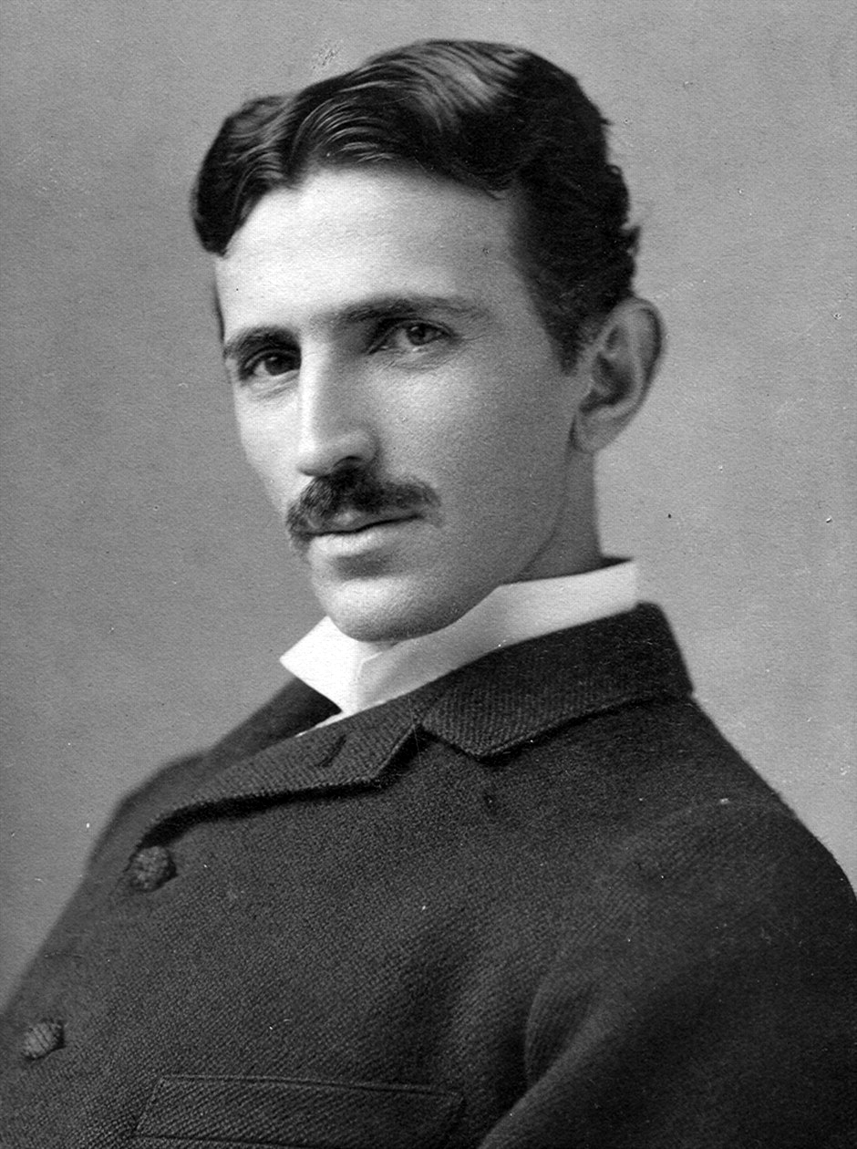

Slide 4
Biography

Slide 5
Nikola Tesla (10 July 1856 –
7 January 1943) was a Serbian American inventor, electrical engineer, mechanical engineer, physicist, and futurist best known for his contributions to the design of the modern alternating current (AC) electricity supply system.

Slide 6
Tesla gained experience in telephony and electrical engineering before immigrating to the United States in 1884 to work for Thomas Edison in New York City. He soon struck out on his own with financial backers, setting up laboratories and companies to develop a range of electrical devices. His patented AC induction motor and transformer were licensed by George Westinghouse, who also hired Tesla for a short time as a consultant. His work in the formative years of electric power development was involved in a corporate alternating current/direct current "War of Currents" as well as various patent battles.

Slide 7
Tesla went on to pursue his ideas of wireless lighting and electricity distribution in his high-voltage, high-frequency power experiments in New York and Colorado Springs, and made early (1893) pronouncements on the possibility of wireless communication with his devices. He tried to put these ideas to practical use in his ill-fated attempt at intercontinental wireless transmission, which was his unfinished Wardenclyffe Tower project. In his lab he also conducted a range of experiments with mechanical oscillators/generators, electrical discharge tubes, and early X-ray imaging. He also built a wireless controlled boat, one of the first ever exhibited.

Slide 8
Tesla was renowned for his achievements and showmanship, eventually earning him a reputation in popular culture as an archetypal "mad scientist". His patents earned him a considerable amount of money, much of which was used to finance his own projects with varying degrees of success. He lived most of his life in a series of New York hotels, through his retirement. He died on 7 January 1943. His work fell into relative obscurity after his death, but in 1960 the General Conference on Weights and Measures named the SI unit of magnetic flux density the tesla in his honor. There has been a resurgence in interest in Tesla in popular culture since the 1990s.

Slide 9
Physics

Slide 10
Newton's laws
Newton's laws of motion are three physical laws that, together, laid the foundation for classical mechanics. They describe the relationship between a body and the forces acting upon it, and its motion in response to those forces. They have been expressed in several different ways, over nearly three centuries, and can be summarized as follows.

Slide 11
First law
When viewed in an inertial reference frame, an object either remains at rest or continues to move at a constant velocity, unless acted upon by an external force.

Slide 12
Second law
The vector sum of the external forces F on an object is equal to the mass m of that object multiplied by the acceleration vector a of the object: F = ma.

Slide 13
Third law
When one body exerts a force on a second body, the second body simultaneously exerts a force equal in magnitude and opposite in direction on the first body.

Slide 14
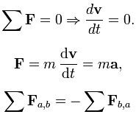
Newton's laws

Slide 15
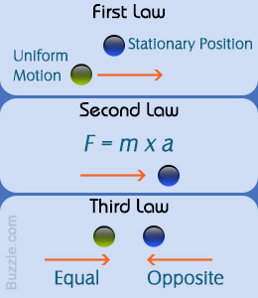
Newton's laws

Slide 16
Alternating current
Alternating current (AC), is an electric current in which the flow of electric charge periodically reverses direction, whereas in direct current (DC, also dc), the flow of electric charge is only in one direction. The abbreviations AC and DC are often used to mean simply alternating and direct, as when they modify current or voltage.
AC is the form in which electric power is delivered to businesses and residences. The usual waveform of alternating current in most electric power circuits is a sine wave. In certain applications, different waveforms are used, such as triangular or square waves. Audio and radio signals carried on electrical wires are also examples of alternating current. These types of alternating current carry information encoded (or modulated) onto the AC signal, such as sound (audio) or images (video).

Slide 17
LC circuit
An LC circuit, also called a resonant circuit, tank circuit, or tuned circuit, is an electric circuit consisting of an inductor, represented by the letter L, and a capacitor, represented by the letter C, connected together. The circuit can act as an electrical resonator, an electrical analogue of a tuning fork, storing energy oscillating at the circuit's resonant frequency.
LC circuits are used either for generating signals at a particular frequency, or picking out a signal at a particular frequency from a more complex signal. They are key components in many electronic devices, particularly radio equipment, used in circuits such as oscillators, filters, tuners and frequency mixers.

Slide 18
LC circuit
An LC circuit is an idealized model since it assumes there is no dissipation of energy due to resistance. Any practical implementation of an LC circuit will always include loss resulting from small but non-zero resistance within the components and connecting wires. The purpose of an LC circuit is usually to oscillate with minimal damping, so the resistance is made as low as possible. While no practical circuit is without losses, it is nonetheless instructive to study this ideal form of the circuit to gain understanding and physical intuition. For a circuit model incorporating resistance, see RLC circuit.

Slide 19
Resonance
Resonance is a phenomenon that occurs when a given system is driven by another vibrating system or external force to oscillate with greater amplitude at a specific preferential frequency.

Slide 20
Electrical breakdown
Electrical breakdown or dielectric breakdown is a rapid reduction in the resistance of an electrical insulator when the voltage applied across it exceeds the breakdown voltage. This results in a portion of the insulator becoming electrically conductive. Electrical breakdown may be a momentary event (as in an electrostatic discharge), or may lead to a continuous arc discharge if protective devices fail to interrupt the current in a high power circuit.
Under sufficient electrical stress, electrical breakdown can occur within solids, liquids, gases or vacuum. However, the specific breakdown mechanisms are significantly different for each, particularly in different kinds of dielectric medium.

Slide 21
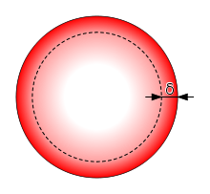
Skin effect

Slide 22
Transformer
A transformer is an electrical device that transfers electrical energy between two or more circuits through electromagnetic induction. Commonly, transformers are used to increase or decrease the voltages of alternating current in electric power applications.
A varying current in the transformer's primary winding creates a varying magnetic flux in the transformer core and a varying magnetic field impinging on the transformer's secondary winding. This varying magnetic field at the secondary winding induces a varying electromotive force (EMF) or voltage in the secondary winding. Making use of Faraday's Law in conjunction with high magnetic permeability core properties, transformers can thus be designed to efficiently change AC voltages from one voltage level to another within power networks.
Since the invention of the first constant potential transformer in 1885, transformers have become essential for the AC transmission, distribution, and utilization of electrical energy. A wide range of transformer designs is encountered in electronic and electric power applications. Transformers range in size from RF transformers less than a cubic centimeter in volume to units interconnecting the power grid weighing hundreds of tons.

Slide 23
Tesla coil
A Tesla coil is an electrical resonant transformer circuit invented by Nikola Tesla around 1891. It is used to produce high-voltage, low-current, high frequency alternating-current electricity. Tesla experimented with a number of different configurations consisting of two, or sometimes three, coupled resonant electric circuits.
Tesla used these coils to conduct innovative experiments in electrical lighting, phosphorescence, X-ray generation, high frequency alternating current phenomena, electrotherapy, and the transmission of electrical energy without wires. Tesla coil circuits were used commercially in sparkgap radio transmitters for wireless telegraphy until the 1920s, and in medical equipment such as electrotherapy and violet ray devices. Today their main use is for entertainment and educational displays, although small coils are still used today as leak detectors for high vacuum systems.

Slide 24
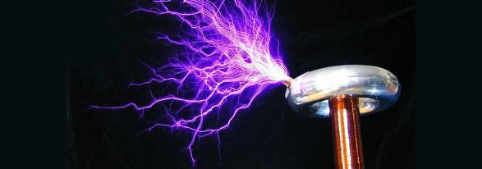
Tesla coil

Slide 25
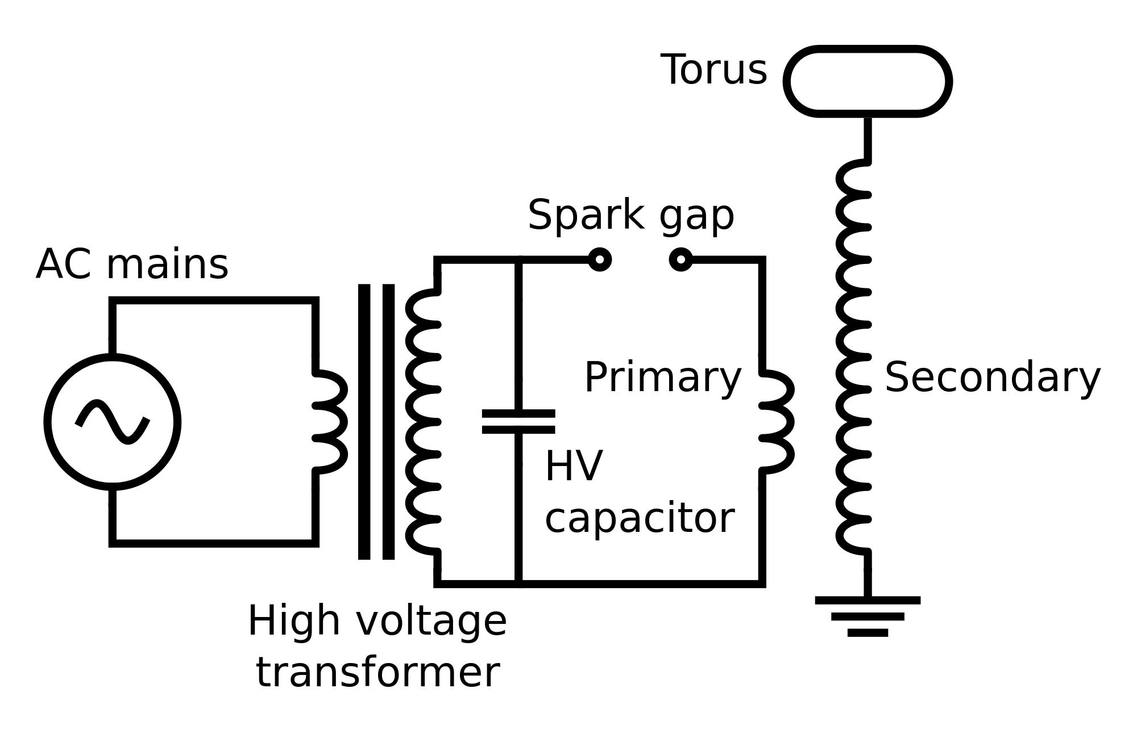
Tesla coil

Slide 26
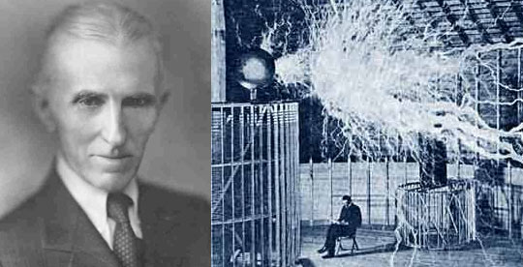

Slide 27
Electroshock weapon
An electroshock weapon is an incapacitant weapon used for incapacitating a person by administering electric shock aimed at disrupting superficial muscle functions and/or causing pain without significantly hurting the subject.
Multiple types of these devices exist differing by the mode of use. Stun guns, batons (or prods), and belts administer an electric shock by direct contact, whereas Tasers (conducted electrical weapons, CEW) fire projectiles that administer the shock through thin flexible wires. Long-range electroshock projectiles, which can be fired from ordinary shotguns and do not need the wires, have been developed as well.

Slide 28
Electric motor
An electric motor is an electrical machine that converts electrical energy into mechanical energy. The reverse of this would be the conversion of mechanical energy into electrical energy and is done by an electric generator.

Slide 29
Electric motor
In normal motoring mode, most electric motors operate through the interaction between an electric motor's magnetic field and winding currents to generate force within the motor. In certain applications, such as in the transportation industry with traction motors, electric motors can operate in both motoring and generating or braking modes to also produce electrical energy from mechanical energy.

Slide 30
Electric motor
Found in applications as diverse as industrial fans, blowers and pumps, machine tools, household appliances, power tools, and disk drives, electric motors can be powered by direct current (DC) sources, such as from batteries, motor vehicles or rectifiers, or by alternating current (AC) sources, such as from the power grid, inverters or generators. Small motors may be found in electric watches. General-purpose motors with highly standardized dimensions and characteristics provide convenient mechanical power for industrial use. The largest of electric motors are used for ship propulsion, pipeline compression and pumped-storage applications with ratings reaching 100 megawatts. Electric motors may be classified by electric power source type, internal construction, application, type of motion output, and so on.

Slide 31
Electric motor
Electric motors are used to produce linear or rotary force (torque), and should be distinguished from devices such as magnetic solenoids and loudspeakers that convert electricity into motion but do not generate usable mechanical powers, which are respectively referred to as actuators and transducers.

Slide 32
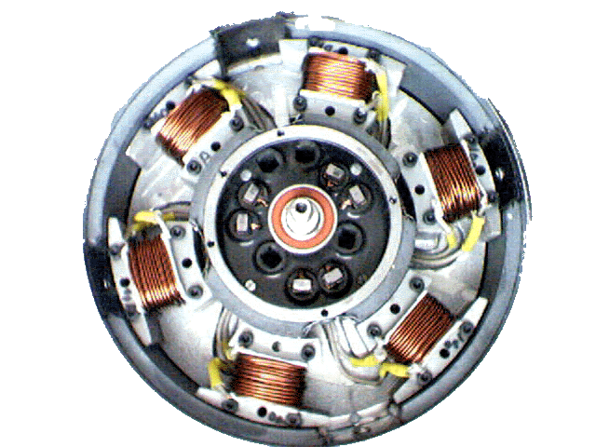
Electric motor

Slide 33
Electro-mechanics:
math similarities:
Resonance;
Gravity and Coulomb laws;
Wave equations for mechanical string and electromagnetic wave

Slide 34
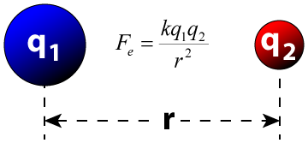
Coulomb's law

Slide 35
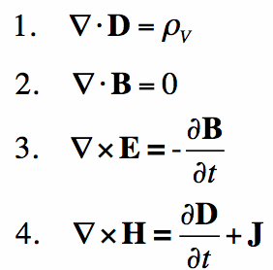
Maxwell's equations

Slide 36
Aether
According to ancient and medieval science, aether also called quintessence, is the material that fills the region of the universe above the terrestrial sphere.

Slide 37
Aether
The concept of aether was used in several theories to explain several natural phenomena, such as the traveling of light and gravity. In the late 19th century, physicists postulated that aether permeated all throughout space, providing a medium through which light could travel in a vacuum, but evidence for the presence of such a medium was not found in the Michelson–Morley experiment.

Slide 38
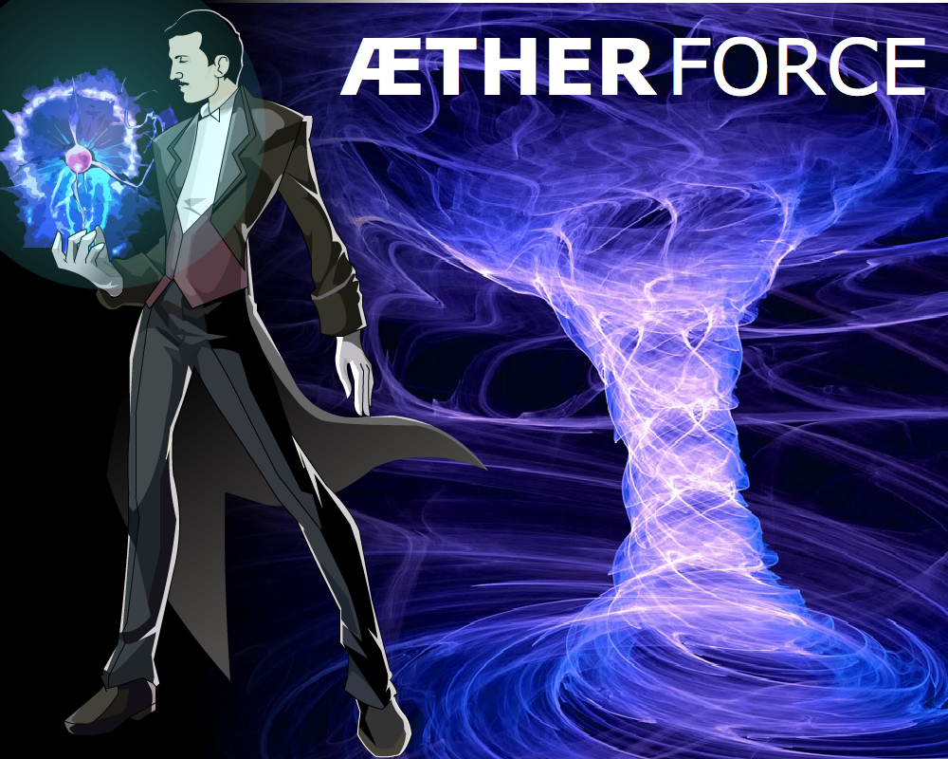
Aether

Slide 39
Vacuum
Vacuum is space void of matter. The word stems from the Latin adjective vacuus for "vacant" or "void". An approximation to such vacuum is a region with a gaseous pressure much less than atmospheric pressure. Physicists often discuss ideal test results that would occur in a perfect vacuum, which they sometimes simply call "vacuum" or free space, and use the term partial vacuum to refer to an actual imperfect vacuum as one might have in a laboratory or in space. In engineering and applied physics on the other hand vacuum refers to any space in which the pressure is lower than atmospheric pressure. The Latin term in vacuo is used to describe an object as being in what would otherwise be a vacuum.

Slide 40
Vacuum
The quality of a partial vacuum refers to how closely it approaches a perfect vacuum. Other things equal, lower gas pressure means higher-quality vacuum. For example, a typical vacuum cleaner produces enough suction to reduce air pressure by around 20%. Much higher-quality vacuums are possible. Ultra-high vacuum chambers, common in chemistry, physics, and engineering, operate below one trillionth (10⁻¹²) of atmospheric pressure (100 nPa), and can reach around 100 particles/cm³.^{[4]} Outer space is an even higher-quality vacuum, with the equivalent of just a few hydrogen atoms per cubic meter on average.

Slide 41
Vacuum
According to modern understanding, even if all matter could be removed from a volume, it would still not be "empty" due to vacuum fluctuations, dark energy, transiting gamma- and cosmic rays, neutrinos, along with other phenomena in quantum physics. In the electromagnetism in the 19th century, vacuum was thought to be filled with a medium called aether. In modern particle physics, the vacuum state is considered the ground state of matter.

Slide 42
Vacuum
Vacuum has been a frequent topic of philosophical debate since ancient Greek times, but was not studied empirically until the 17th century. Evangelista Torricelli produced the first laboratory vacuum in 1643, and other experimental techniques were developed as a result of his theories of atmospheric pressure. A torricellian vacuum is created by filling with mercury a tall glass container closed at one end and then inverting the container into a bowl to contain the mercury.

Slide 43
Vacuum
Vacuum became a valuable industrial tool in the 20th century with the introduction of incandescent light bulbs and vacuum tubes, and a wide array of vacuum technology has since become available. The recent development of human spaceflight has raised interest in the impact of vacuum on human health, and on life forms in general.

Slide 44
Vacuum
0 = 1 – 1
0 = 2 – 2
0 = 98878676 - 98878676
etc.

Slide 45
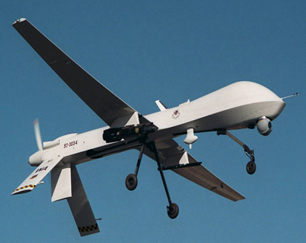
UAV

Slide 46
Laser
A laser is a device that emits light through a process of optical amplification based on the stimulated emission of electromagnetic radiation. The term "laser" originated as an acronym for "light amplification by stimulated emission of radiation". The first laser was built in 1960 by Theodore H. Maiman at Hughes Laboratories, based on theoretical work by Charles Hard Townes and Arthur Leonard Schawlow. A laser differs from other sources of light in that it emits light coherently. Spatial coherence allows a laser to be focused to a tight spot, enabling applications such as laser cutting and lithography. Spatial coherence also allows a laser beam to stay narrow over great distances (collimation), enabling applications such as laser pointers. Lasers can also have high temporal coherence, which allows them to emit light with a very narrow spectrum, i.e., they can emit a single color of light. Temporal coherence can be used to produce pulses of light as short as a femtosecond.
Among their many applications, lasers are used in optical disk drives, laser printers, and barcode scanners; fiber-optic and free-space optical communication; laser surgery and skin treatments; cutting and welding materials; military and law enforcement devices for marking targets and measuring range and speed; and laser lighting displays in entertainment.

Slide 47
Maser
A maser is an acronym for "microwave amplification by stimulated emission of radiation", is a device that produces coherent electromagnetic waves through amplification by stimulated emission. The first maser was built by Charles H. Townes, James P. Gordon, and H. J. Zeiger at Columbia University in 1953. Townes, Nikolay Basov and Alexander Prokhorov were awarded the 1964 Nobel Prize in Physics for theoretical work leading to the maser. Masers are used as the timekeeping device in atomic clocks, and as extremely low-noise microwave amplifiers in radio telescopes and deep space spacecraft communication ground stations.
Contemporary masers can be designed to generate electromagnetic waves at not only microwave frequencies but also radio and infrared frequencies. For this reason Charles Townes suggested replacing "microwave" with the word "molecular" as the first word in the acronym maser.
The laser works by the same principle as the maser, and the maser was the forerunner of the laser, inspiring theoretical work by Townes and Arthur Leonard Schawlow that led to its invention in 1960. When the coherent optical oscillator was first imagined in 1957, it was originally called the "optical maser." This was ultimately changed to laser for "Light Amplification by Stimulated Emission of Radiation." Gordon Gould is credited with creating this acronym in 1957.

Slide 48
Econophysics
Econophysics is an interdisciplinary research field, applying theories and methods originally developed by physicists in order to solve problems in economics, usually those including uncertainty or stochastic processes and nonlinear dynamics. Some of its application to the study of financial markets has also been termed statistical finance referring to its roots in statistical physics.

