Slide 1
Geometric optics
Reflection
Refractive index
Snell's law
Optical power
Lens equation

Slide 2
Reflection
Reflection is the change in direction of a wavefront at an interface between two different media so that the wavefront returns into the medium from which it originated. Common examples include the reflection of light, sound and water waves. The law of reflection says that for specular reflection the angle at which the wave is incident on the surface equals the angle at which it is reflected. Mirrors exhibit specular reflection.

Slide 3
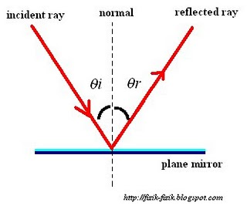
Reflection

Slide 4
Mirror
In order to understand mirrors, we first must understand light. The law of reflection says that when a ray of light hits a surface, it bounces in a certain way, like a tennis ball thrown against a wall. The incoming angle, called the angle of incidence, is always equal to the angle leaving the surface, or the angle of reflection. When light hits a surface at a low angle -- like on a lake at sunset -- it bounces off at the same low angle and hits your eyes full blast, rather than obliquely as when the sun sits overhead. This is why the sun's glare during the evening and morning is so much more intense than during the rest of the day.

Slide 5
Total internal reflection
Total internal reflection is a phenomenon that happens when a propagating wave strikes a medium boundary at an angle larger than a particular critical angle with respect to the normal to the surface. If the refractive index is lower on the other side of the boundary and the incident angle is greater than the critical angle, the wave cannot pass through and is entirely reflected. The critical angle is the angle of incidence above which the total internal reflection occurs. This is particularly common as an optical phenomenon, where light waves are involved, but it occurs with many types of waves, such as electromagnetic waves in general or sound waves.

Slide 6
Total internal reflection (continued)
When a wave crosses a boundary between different materials with different kinds of refractive indices, the wave will be partially refracted at the boundary surface, and partially reflected. However, if the angle of incidence is greater (i.e. the direction of propagation or ray is closer to being parallel to the boundary) than the critical angle – the angle of incidence at which light is refracted such that it travels along the boundary – then the wave will not cross the boundary and instead be totally reflected back internally. This can only occur when the wave in a medium with a higher refractive index (n₁) hits its surface that's in contact with a medium of lower refractive index (n₂). For example, it will occur with light hitting air from glass, but not when hitting glass from air.

Slide 7
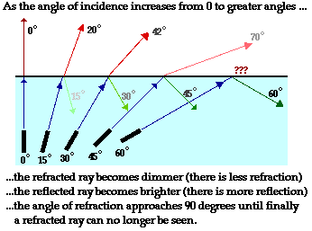
(continued) Total internal reflection

Slide 8
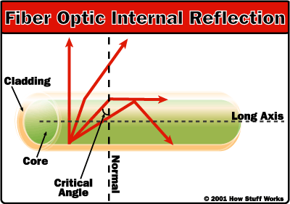
Total internal reflection (continued)

Slide 9
Tasks
A man 175 cm tall stands in front of a vertical plane mirror. His eyes are 10 cm bellow the top of his head. What are the sizes and the best location of the smallest possible mirror so that he can see his entire body?
Do these depend on his distance from the mirror? Why? How?

Slide 10
Refractive index
In optics the refractive index or index of refraction n of an optical medium is a dimensionless number that describes how light, or any other radiation, propagates through that medium.
It is defined as n = c/v,
where c is the speed of light in vacuum and v is the speed of light in the substance. For example, the refractive index of water is 1.33, meaning that light travels 1.33 times faster in a vacuum than it does in water.

Slide 11
Snell's law
Snell's law (also known as the Snell–Descartes law and the law of refraction) is a formula used to describe the relationship between the angles of incidence and refraction, when referring to light or other waves passing through a boundary between two different isotropic media, such as water, glass and air.

Slide 12
Snell's law (continued)
In optics, the law is used in ray tracing to compute the angles of incidence or refraction, and in experimental optics to find the refractive index of a material. The law is also satisfied in metamaterials, which allow light to be bent "backward" at a negative angle of refraction with a negative refractive index.

Slide 13
(continued) Snell's law
Although named after Dutch astronomer Willebrord Snellius (1580–1626), the law was first accurately described by the scientist Ibn Sahl at the Baghdad court in 984. In the manuscript On Burning Mirrors and Lenses, Sahl used the law to derive lens shapes that focus light with no geometric aberrations.

Slide 14
Snell's law (continued)
Snell's law states that the ratio of the sines of the angles of incidence and refraction is equivalent to the ratio of phase velocities in the two media, or equivalent to the reciprocal of the ratio of the indices of refraction:
sin A₁/sin A₂ = v₁/v₂ = n₂/n₁

Slide 15
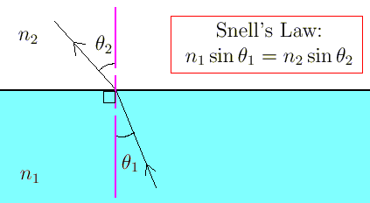
(continued) Snell's law

Slide 16
Optical power
Optical power (also referred to as dioptric power, refractive power, focusing power, or convergence power) is the degree to which a lens, mirror, or other optical system converges or diverges light. It is equal to the reciprocal of the focal length of the device: P = 1/f.^{[1]} High optical power corresponds to short focal length. The SI unit for optical power is the inverse metre (m⁻¹), which is commonly called the dioptre.
Converging lenses have positive optical power, while diverging lenses have negative power. When a lens is immersed in a refractive medium, its optical power and focal length change.

Slide 17
Lens Equation
A common Gaussian form of the lens equation is shown below. This is the form used in most introductory textbooks. A form using the Cartesian sign convention is often used in more advanced texts because of advantages with multiple-lens systems and more complex optical instruments. Either form can be used with positive or negative lenses and predicts the formation of both real and virtual images. Does not apply to thick lenses.

Slide 18
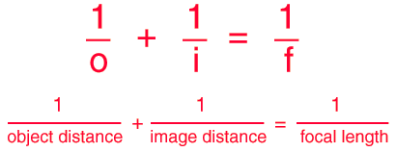
Lens Equation (continued)

Slide 19
Lensmaker's equation
The focal length of a lens in air can be calculated from the lensmaker's equation

Slide 20
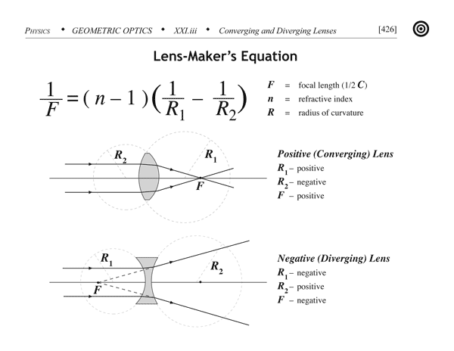
Lensmaker's equation (continued)

