Slide 1
Projectile, energy, black hole, fracture
Projectile
Rotation
Energy
Static equilibrium
Black hole
Elasticity
Plasticity
Fracture
Fluid
Heat

Slide 2
Collisions

Slide 3
Big foot vs small foot
Small foot is more likely to be more accurate and more precise, give less random error and systematic error because small foot can kick more accurately and precisely with respect to centre of mass of soccer ball.
Because of that, Messi is smaller and better than Ronaldo, who is bigger but, in real life, Ronaldo can kick the ball very accurately and precisely. In this case, physics fails but just a little bit.

Slide 4
Big foot vs small foot (continued)
Question:
Is big or small foot better for more accurate and precise kick of soccer ball?
Is Ronaldo or Messi better for that?

Slide 5
Projectile
Question:
Find minimum velocity and corresponding angle of release of projectile to hit the point (s, T).

Slide 6

Projectile (continued)
$x=tvcosA$
$y=tvsinA−\frac{gt^{2}}{2}$
$y=xTanA−\frac{gx^{2}}{2v^{2}}\left(1+{\left(TanA\right)}^{2}\right)$
$v^{2}=\frac{\left(1+{\left(TanA\right)}^{2}\right)gx^{2}}{2\left(y−xTanA\right)}$
$TanA=T$
$v^{2}=\frac{\left(1+T^{2}\right)gx^{2}}{2\left(y−xT\right)}$
$0=\frac{∂\left(v^{2}\right)}{∂T}=\frac{gx^{2}}{2}\left[\frac{\left(1+2T\right)\left(y−xT\right)+\left(1+T^{2}\right)x}{{\left(y−xT\right)}^{2}}\right]=0$
$xT^{2}+\left(x−2y\right)T−\left(x+y\right)=0$
$T_{1,2}=\frac{2y−x∓\sqrt{{\left(x−2y\right)}^{2}+4x\left(x+y\right)}}{2x}$
https://calculus12s.weebly.com/uploads/2/5/3/9/25393482/projectile16.docx

Slide 7
Projectile (continued)
x = 11
y = 2.5
g = 10
T1 = (2 * y - x + Sqr((x - 2 * y) ^ 2 + 4 * x * (x + y))) / (2 * x)
T2 = (2 * y - x - Sqr((x - 2 * y) ^ 2 + 4 * x * (x + y))) / (2 * x)
v1 = Sqr(g * x ^ 2 * (1 + T1 ^ 2) / (2 * (x * T1 - y)))
MsgBox v1
MsgBox Atn(T1) * 180 / (4 * Atn(1))
calculus12s.weebly.com/uploads/2/5/3/9/25393482/velocity4minimum4projectile.txt

Slide 8
Projectile (continued)
Question:
Check correctness of minimum velocity calculation by using x = 0.000000001 and y = 20.

Slide 9
Projectile (continued)
Question:
Calculate minimum velocity for tanA = y/x +1/s
s = 20000000
x = 1
y = 1
g = 10
T1 = 1 / s + y / x
v1 = Sqr(g * x ^ 2 * (1 + T1 ^ 2) / (2 * (x * T1 - y)))
MsgBox v1

Slide 10
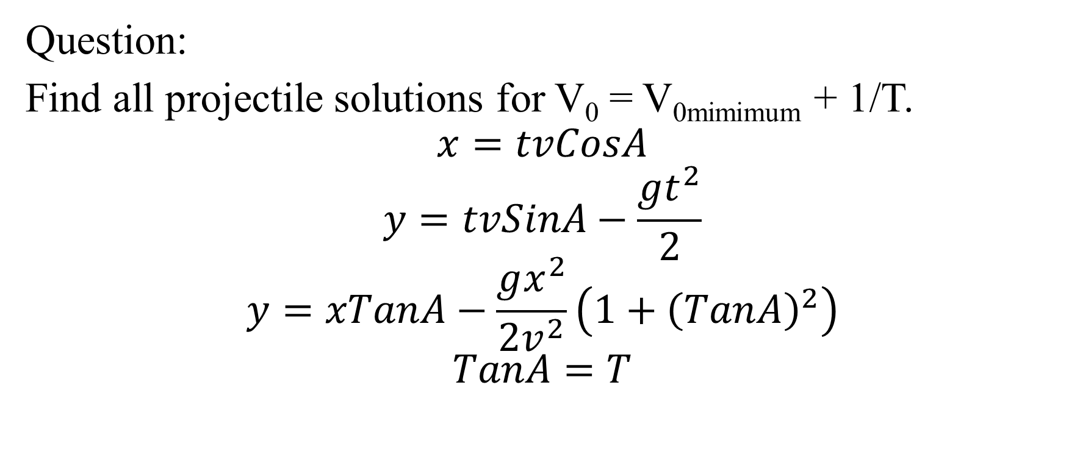
Projectile (continued)
Question:
Find all projectile solutions for V₀ = V_{0mimimum} + 1/T.
$$x=tvCosA$$
$$y=tvSinA−\frac{gt^{2}}{2}$$
$$y=xTanA−\frac{gx^{2}}{2v^{2}}\left(1+{\left(TanA\right)}^{2}\right)$$
$$TanA=T$$

Slide 11

Projectile (continued)
Quadratic equation for T:
$$\frac{gx^{2}}{2V^{2}}T^{2}−xT+y+\frac{gx^{2}}{2V^{2}}=0$$
$$T_{1}=\frac{x+\sqrt{x^{2}−4\frac{gx^{2}}{2V^{2}}\left(y+\frac{gx^{2}}{2V^{2}}\right)}}{gx^{2}}V^{2}$$
$$T_{2}=\frac{x−\sqrt{x^{2}−4\frac{gx^{2}}{2V^{2}}\left(y+\frac{gx^{2}}{2V^{2}}\right)}}{gx^{2}}V^{2}$$
Here V = V₀.

Slide 12
Projectile (continued)
s = 22000005
T = s Mod 100
x = 1
y = 1
g = 10
T1 = (2 * y - x + Sqr((x - 2 * y) ^ 2 + 4 * x * (x + y))) / (2 * x)
T2 = (2 * y - x - Sqr((x - 2 * y) ^ 2 + 4 * x * (x + y))) / (2 * x)
v1 = Sqr(g * x ^ 2 * (1 + T1 ^ 2) / (2 * (x * T1 - y)))
'v2 = Sqr(g * x ^ 2 * (1 + T2 ^ 2) / (2 * (x * T2 - y)))
v = v1 + 1 / T
T1 = v * v * (x + Sqr(x * x - 4 * g * x * x * (y + g * x * x / (2 * v * v)) / (2 * v * v))) / (g * x * x)
T2 = v * v * (x - Sqr(x * x - 4 * g * x * x * (y + g * x * x / (2 * v * v)) / (2 * v * v))) / (g * x * x)
MsgBox Atn(T1) * 180 / (4 * Atn(1))
MsgBox Atn(T2) * 180 / (4 * Atn(1))
https://physics15.weebly.com/uploads/3/0/2/7/30272185/2anglesof1initialvelocity1projectile23sept.txt

Slide 13
Projectile (continued)
To hit the target as quickly as possible, we need to calculate minimum velocity, provide maximum initial velocity, which must be bigger than minimum velocity, chose the smallest angle of release for the maximum initial velocity.
Question:
How can I hit a target as quickly as possible, using projectile?

Slide 14

Projectile (continued)
Question:
Prove that for the projectile
$$D_{MAX}=x_{MAX}=\frac{V_{0}^{2}\sin\left(2A\right)}{g}$$
$$H_{MAX}=y_{MAX}=\frac{V_{0}^{2}{\left(\sin{A}\right)}^{2}}{2g}$$

Slide 15

Projectile (continued)
$$V_{y}=V_{0}\sin{A}−gt$$
$$V_{y}=0$$
$$t_{H}=\frac{V_{0}\sin{A}}{g}$$
$$t_{D}=2t_{H}$$
$$x_{MAX}=D_{MAX}=t_{D}V_{0}\cos{A}$$
$$y_{MAX}=H_{MAX}=t_{D}V_{0}\sin{A}−\frac{gt_{D}^{2}}{2}$$

Slide 16
Angular velocity and linear acceleration
Question:
Find angular velocity and linear acceleration for v = T m/s and R = k meters.
s = 19107012
L = s Mod 10
T = s Mod 100
k = s Mod 10000
v = T
R = k
omega = v / R
a = R * omega ^ 2
MsgBox omega
MsgBox a
https://physics16.weebly.com/uploads/5/9/8/5/59854633/angular_velocity_linear_acceleration2019nov.txt

Slide 17
Angular velocity and linear acceleration (continued)
Question:
Find velocity and acceleration at T degrees latitude. Earth Radius = 6371.009km.
s = 19107016
T = s Mod 100
RE = 6371.009
Pi = 4 * Atn(1)
omegaE = 2 * Pi / 24
Angle = T * Pi / 180
R = RE * Cos(Angle)
v = R * omegaE
a = R * omegaE ^ 2
MsgBox v
MsgBox a
https://physics16.weebly.com/uploads/5/9/8/5/59854633/latitude4velocity4acceleration2019nov.txt

Slide 18
Angular velocity and linear acceleration (continued)
Question:
Find the angular speed and total acceleration for the rotational motion of the material point around the circumference with radius of T meters and constant linear speed of s meters per second.
s = 19107016
T = s Mod 100
R = T
v = s
omega = v / R
MsgBox omega
a = R * omega ^ 2
MsgBox a
https://physics16.weebly.com/uploads/5/9/8/5/59854633/omega_acceleration309task2019.txt

Slide 19
Potential energy
Question:
Find potential energy E = mgh. h = T.
https://en.wikipedia.org/wiki/Potential_energy
s = 19107012
m = s Mod 35
T = s Mod 100
g = 10
h = T
E = m * g * h
MsgBox E

Slide 20

Kinetic energy
Question:
Give kinetic energy $E= \frac{mv^{2}}{2}$. v = T.
https://en.wikipedia.org/wiki/Kinetic_energy
s = 19107012
m = s Mod 35
T = s Mod 100
v = T
E = m * v ^ 2 / 2
MsgBox E

Slide 21
Definitions
Distance is the total movement of object without regard to direction.
Displacement is distance moved in a particular direction.
Mass is the measure of resistance to change in motion (inertial mass).
Gravitational mass is measure of strength of gravitational force.

Slide 22
Definitions (continued)
Speed is a scalar quantity that is equal to how far the object has moved divided by time taken.
Velocity is a quantity that designates how fast and in what direction a point is moving.
Momentum is product of mass of particle and its velocity.
Angular velocity is rotation rate, showing how fast object rotates.

Slide 23
Definitions (continued)
Angular acceleration is the time rate of change of angular velocity.
Moment of inertia is resistance to angular acceleration. J = I = mR²
Angular momentum is moment of inertial times angular velocity.
Acceleration is the rate of change of the velocity of an object with respect to time.

Slide 24
Definitions (continued)
Time is continued sequence of existence and events that occurs in irreversible succession from the part, through the present, into the future.
Torque is measure of force that can cause an object to rotate about an axis.
Question:
Define distance, displacement, time, speed, velocity, liner acceleration, linear momentum, angular velocity, angular acceleration, angular momentum, moment of inertia, force, torque.

Slide 25
Force
Force changes motion of body.
If physics, by nature, forces can be gravitational, electromagnetic, nuclear weak, nuclear strong.
By way of application, forces can be surface forces (friction) and volume forces (gravity, electromagnetism).
Surface force acts across surface element of body.
Volume force acts on all particles of given body.

Slide 26
Static equilibrium
Static equilibrium for material point is when all forces are 0.
Static equilibrium for mechanical system is when all forces are 0 and all torques are 0.
Question
Solve the pulley problem for the case of static equilibrium.

Slide 27
Moment of inertia
Moment of inertia is measure of resistance to change of angular velocity.

Slide 28
Black hole
Black hole is cosmic body with extremely intense gravity, from which even light cannot escape.

Slide 29
Black hole (continued)
Question
Calculate the Schwarzschild radius for the k grams desk.
http://physics16.weebly.com/uploads/5/9/8/5/59854633/radius4schwarzschild.txt

Slide 30
Black hole (continued)
Question
Prove Schwarzschild radius formula from escape velocity expression
$$c=V_{e}=\sqrt{2gR}=\sqrt{\frac{2GMR}{R^{2}}}=\sqrt{\frac{2GM}{R}}$$
$$R=\frac{2GM}{c^{2}}$$
R is radius of black hole of Schwarzschild
G is gravity constant
g is gravity acceleration
M is mass of the object, which is compressed to the size of black hole
V_{e} is escape velocity
c is the speed of light

Slide 31
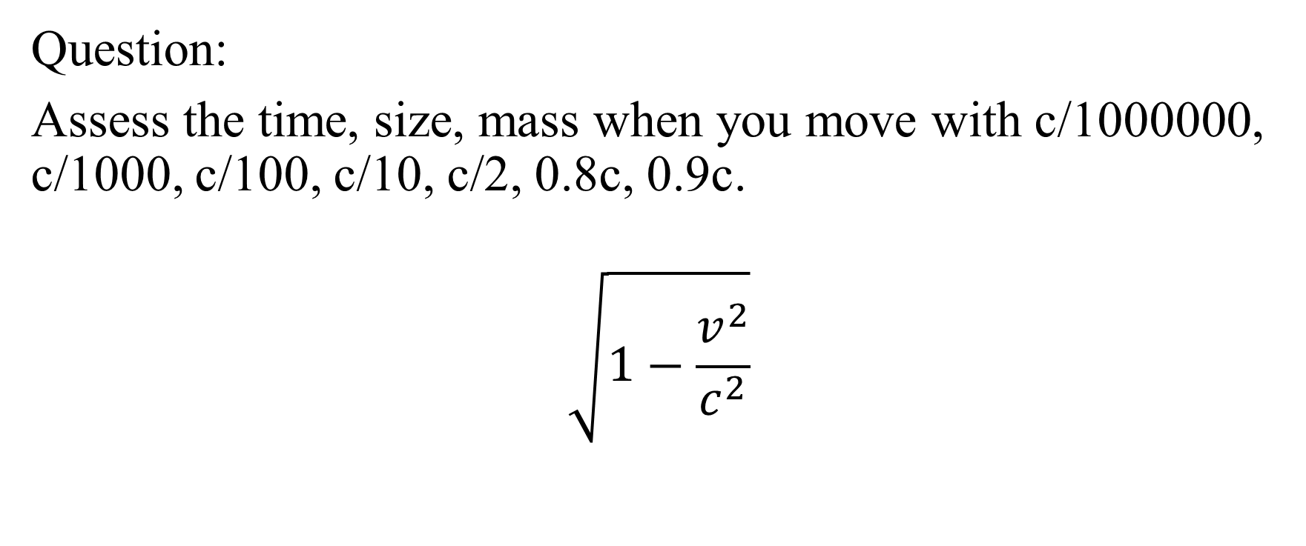
Special relativity
Question:
Assess the time, size, mass when you move with c/1000000, c/1000, c/100, c/10, c/2, 0.8c, 0.9c.
$$\sqrt{1−\frac{v^{2}}{c^{2}}}$$

Slide 32
Special relativity (continued)
c = 300000000
v = c / 1000000
v = c / 1000
v = c / 100
v = c / 10
v = c / 2
v = 0.8 * c
v = 0.9 * c
MsgBox Sqr(1 - v * v / (c * c))

Slide 33
Chaos in classical mechanics
Double pendulum is chaotic.
en.wikipedia.org/wiki/Double_pendulum

Slide 34

Elasticity
Hooks Law
F = kx
Elastic energy: E = 0.5kx².
$$F=\frac{dE}{dx}$$
Electromagnetic nature of friction, elasticity, plasticity, fracture
Elasticity, friction, plasticity, fracture of solids in classical mechanic have electromagnetic causes.

Slide 35
Plasticity
Plastic deformation is irreversible deformation.

Slide 36
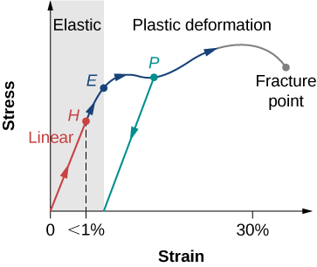
Plasticity (continued)

Slide 37
Fracture
Question:
What must the masses in the simple pulley problem to break the rope if the breaking point of the rope is T Newtons?

Slide 38

Fluid
Pressure = Force/Area
Pressure of fluid at depth h is $ρgh$
h is height or depth
ρ is density
g is gravity acceleration
A is area
V is volume
Proof: Pressure is F/A, pressure = mg/A, m = ρV, V = Ah, ρAhg/A = ρgh

Slide 39

Fluid (continued)
Question:
Prove that pressure of fluid at depth h is $ρgh$

Slide 40
Fluid (continued)
Question:
Calculate fluid pressure p = ρgh. ρ = a; h = T.
https://en.wikipedia.org/wiki/Pressure#Fluid_pressure
s = 19107012
a = s Mod 25
T = s Mod 100
ro = a
g = 10
h = T
p = ro * g * h
MsgBox p

Slide 41

Bernoulli principle
$$ρgh+0.5ρV^{2}=constant$$

Slide 42
Magnus effect
Magnus effect is when, for example, ball curves its trajectory because of rotation of the ball, fluid sticking to the ball because of viscosity, then Bernoulli principle explains why the ball curves its trajectory in soccer, tennis, etc.
Question:
Explain Magnus effect.

Slide 43
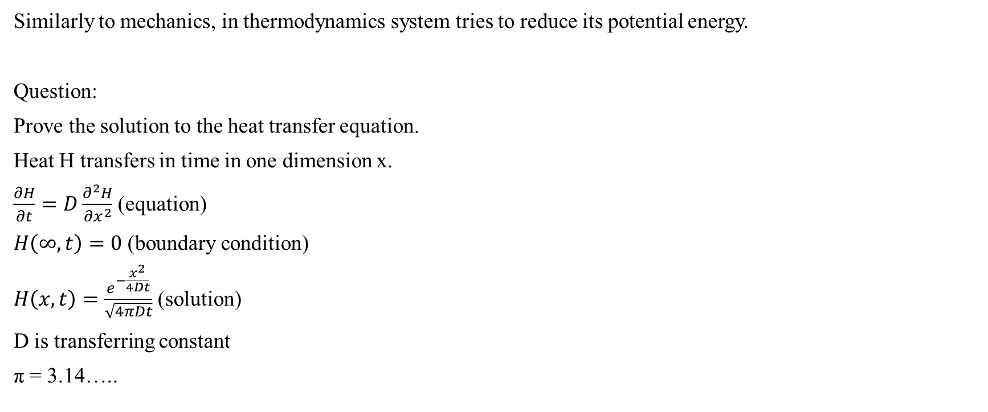
Thermodynamics
Similarly to mechanics, in thermodynamics system tries to reduce its potential energy.
Question:
Prove the solution to the heat transfer equation.
Heat H transfers in time in one dimension x.
$\frac{∂H}{∂t}=D\frac{∂^{2}H}{∂x^{2}}$ (equation)
$H\left(∞,t\right)=0$ (boundary condition)
$H\left(x,t\right)=\frac{e^{−\frac{x^{2}}{4Dt}}}{\sqrt{4πDt}}$ (solution)
D is transferring constant
π = 3.14…..

