Slide 1
Theory of everything

Slide 2
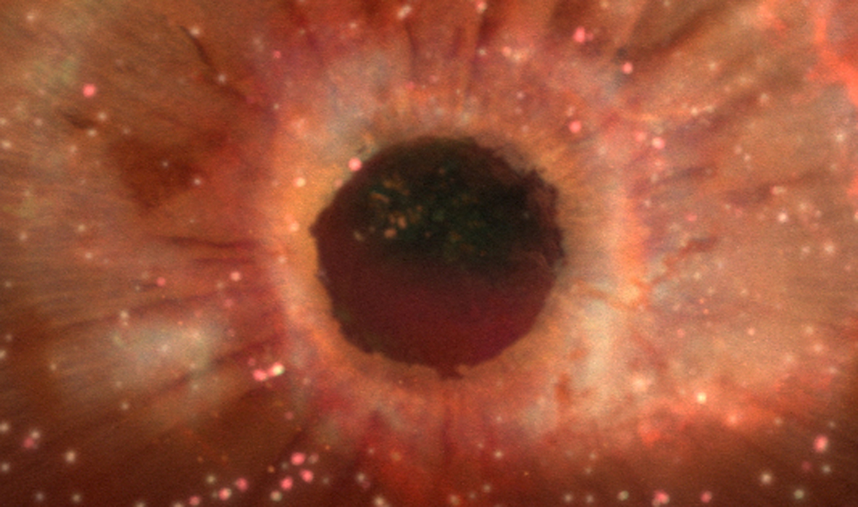

Slide 3
A theory of everything (ToE) or final theory, ultimate theory, or master theory is a hypothetical single, all-encompassing, coherent theoretical framework of physics that fully explains and links together all physical aspects of the universe. Finding a ToE is one of the major unsolved problems in physics. Over the past few centuries, two theoretical frameworks have been developed that, as a whole, most closely resemble a ToE. The two theories upon which all modern physics rests are general relativity (GR) and quantum field theory (QFT). GR is a theoretical framework that only focuses on the force of gravity for understanding the universe in regions of both large-scale and high-mass: stars, galaxies, clusters of galaxies, etc. On the other hand, QFT is a theoretical framework that only focuses on three non-gravitational forces for understanding the universe in regions of both small scale and low mass: sub-atomic particles, atoms, molecules, etc. QFT successfully implemented the Standard Model and unified the interactions (so-called Grand Unified Theory) between the three non-gravitational forces: weak, strong, and electromagnetic force.

Slide 4
Through years of research, physicists have experimentally confirmed with tremendous accuracy virtually every prediction made by these two theories when in their appropriate domains of applicability. In accordance with their findings, scientists also learned that GR and QFT, as they are currently formulated, are mutually incompatible - they cannot both be right. Since the usual domains of applicability of GR and QFT are so different, most situations require that only one of the two theories be used. As it turns out, this incompatibility between GR and QFT is only an apparent issue in regions of extremely small-scale and high-mass, such as those that exist within a black hole or during the beginning stages of the universe (i.e., the moment immediately following the Big Bang). To resolve this conflict, a theoretical framework revealing a deeper underlying reality, unifying gravity with the other three interactions, must be discovered to harmoniously integrate the realms of GR and QFT into a seamless whole: a single theory that, in principle, is capable of describing all phenomena. In pursuit of this goal, quantum gravity has recently become an area of active research.

Slide 5
Over the past few decades, a single explanatory framework, called "string theory", has emerged that may turn out to be the ultimate theory of the universe. Many physicists believe that, at the beginning of the universe (up to 10⁻⁴³ seconds after the Big Bang), the four fundamental forces were once a single fundamental force. Unlike most (if not all) other theories, string theory may be on its way to successfully incorporating each of the four fundamental forces into a unified whole. According to string theory, every particle in the universe, at its most microscopic level (Planck length), consists of varying combinations of vibrating strings (or strands) with preferred patterns of vibration. String theory claims that it is through these specific oscillatory patterns of strings that a particle of unique mass and force charge is created (that is to say, the electron is a type of string that vibrates one way, while the up-quark is a type of string vibrating another way, and so forth).

Slide 6
Initially, the term theory of everything was used with an ironic connotation to refer to various overgeneralized theories. For example, a grandfather of Ijon Tichy — a character from a cycle of Stanisław Lem's science fiction stories of the 1960s — was known to work on the "General Theory of Everything". Physicist John Ellis claims to have introduced the term into the technical literature in an article in Nature in 1986. Over time, the term stuck in popularizations of theoretical physics research.

