Slide 1
Quantum computing, teleportation, cryptography
Computing
Teleportation
Cryptography

Slide 2
Quantum computing
Quantum computing studies theoretical computation systems (quantum computers) that make direct use of quantum-mechanical phenomena, such as superposition and entanglement, to perform operations on data. Quantum computers are different from digital computers based on transistors.

Slide 3
Quantum computing (continued)
Whereas digital computers require data to be encoded into binary digits (bits), each of which is always in one of two definite states (0 or 1), quantum computation uses qubits (quantum bits), which can be in superpositions of states.

Slide 4
Quantum computing (continued)
A theoretical model is the quantum Turing machine, also known as the universal quantum computer. Quantum computers share theoretical similarities with non-deterministic and probabilistic computers; one example is the ability to be in more than one state simultaneously.

Slide 5
Quantum computing (continued)
The field of quantum computing was first introduced by Yuri Manin in 1980 and Richard Feynman in 1982. A quantum computer with spins as quantum bits was also formulated for use as a quantum space–time in 1968.

Slide 6
Quantum computing (continued)
As of 2015, the development of actual quantum computers is still in its infancy, but experiments have been carried out in which quantum computational operations were executed on a very small number of qubits.

Slide 7
Quantum computing (continued)
Both practical and theoretical research continues, and many national governments and military funding agencies support quantum computing research to develop quantum computers for civilian, business, trade, gaming and national security purposes, such as cryptanalysis.

Slide 8
Quantum computing (continued)
Large-scale quantum computers will be able to solve certain problems much more quickly than any classical computer using the best currently known algorithms, like integer factorization using Shor's algorithm or the simulation of quantum many-body systems.

Slide 9
Quantum computing (continued)
There exist quantum algorithms, such as Simon's algorithm, that run faster than any possible probabilistic classical algorithm. Given sufficient computational resources, however, a classical computer could be made to simulate any quantum algorithm, as quantum computation does not violate the Church–Turing thesis.

Slide 10
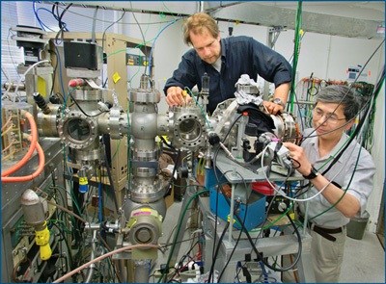
Quantum computing (continued)

Slide 11
Quantum teleportation
Quantum teleportation is a process by which quantum information (e.g. the exact state of an atom or photon) can be transmitted (exactly, in principle) from one location to another, with the help of classical communication and previously shared quantum entanglement between the sending and receiving location.

Slide 12
Quantum teleportation (continued)
Because it depends on classical communication, which can proceed no faster than the speed of light, it cannot be used for superluminal transport or communication of classical bits. It also cannot be used to make copies of a system, as this violates the no-cloning theorem.

Slide 13
Quantum teleportation (continued)
Although the name is inspired by the teleportation commonly used in fiction, current technology provides no possibility of anything resembling the fictional form of teleportation.

Slide 14
Quantum teleportation (continued)
While it is possible to teleport one or more qubits of information between two (entangled) atoms, this has not yet been achieved between molecules or anything larger.

Slide 15
Quantum teleportation (continued)
One may think of teleportation either as a kind of transportation, or as a kind of communication; it provides a way of transporting a qubit from one location to another, without having to move a physical particle along with it.

Slide 16
Quantum teleportation (continued)
The seminal paper first expounding the idea was published by C. H. Bennett, G. Brassard, C. Crépeau, R. Jozsa, A. Peres and W. K. Wootters in 1993.

Slide 17
Quantum teleportation (continued)
Since then, quantum teleportation has been realized in various physical systems. Presently, the record distance for quantum teleportation is 143 km (89 mi) with photons, and 21 m with material systems.

Slide 18
Quantum teleportation (continued)
In August 2013, the achievement of "fully deterministic" quantum teleportation, using a hybrid technique, was reported.

Slide 19
Quantum teleportation (continued)
On 29 May 2014, scientists announced a reliable way of transferring data by quantum teleportation. Quantum teleportation of data had been done before but with highly unreliable methods.

Slide 20
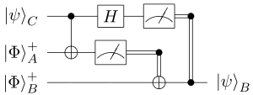
Quantum teleportation (continued)

Slide 21
Quantum cryptography
Quantum cryptography describes the use of quantum mechanical effects (in particular quantum communication and quantum computation) to perform cryptographic tasks or to break cryptographic systems.

Slide 22
Quantum cryptography (continued)
Well-known examples of quantum cryptography are the use of quantum communication to exchange a key securely (quantum key distribution) and the hypothetical use of quantum computers that would allow the breaking of various popular public-key encryption and signature schemes (e.g., RSA and ElGamal).

Slide 23
Quantum cryptography (continued)
The advantage of quantum cryptography lies in the fact that it allows the completion of various cryptographic tasks that are proven or conjectured to be impossible using only classical (i.e. non-quantum) communication (see below for examples). For example, quantum mechanics guarantees that measuring quantum data disturbs that data; this can be used to detect eavesdropping in quantum key distribution.

Slide 24
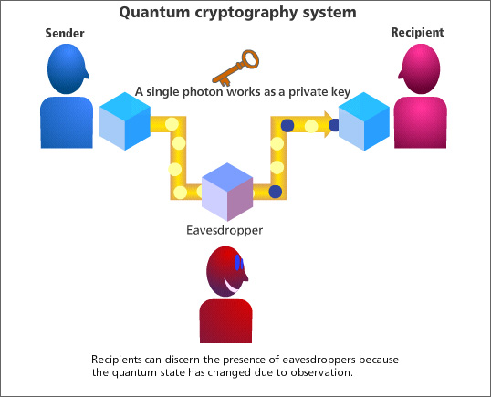
Quantum cryptography (continued)

