Slide 1
4 Lecture in physics
Mechanics:
Circular motion
Oscillations
Waves
Least action principle
Thermodynamics:
Irreversibility
Entropy
Temperature, pressure, volume
Ideal gas
Real gas

Slide 2
Debate
Debate competitions are 10% of our scores
Register today
Use your knowledge of physics in the debate

Slide 3
Missed:
Thread failure in rotational motion trajectory (for telematics students)
Mistake in harmonic oscillator
f*f=k/m,
x = A cos (f*t)
T=2π$\sqrt{\frac{m}{k}}$
T=2π$\sqrt{\frac{L}{g}}$
Pendulum equations
Angular momentum through moment of inertia and angular velocity

Slide 4
Moment of inertia

Slide 5
Comparison of translation and rotation:
- mass vs. moment of inertia,
- linear momentum vs. angular momentum,
- force vs. torque,
- linear kinetic energy vs. rotational kinetic energy,
- etc.

Slide 6
Relativistic momentum

Slide 7
Mass center vs. gravity center

Slide 8
Kinetic energy at high speeds

Slide 9
Binomial series to prove relativistic kinetic energy expression

Slide 10
Variation principles:
Least action principle
Least constraint principle
Operators
Hamiltonian
Lagrangian
Poisson brackets

Slide 11
Chain lines

Slide 12
Stability

Slide 13
Viscosity

Slide 14
Magnus effect

Slide 15
Explosions move the matter up due to the pressure difference

Slide 16
Waves

Slide 17
Earthquake

Slide 18
Echo

Slide 19
Damping

Slide 20
Standing waves

Slide 21
Doppler effect

Slide 22
Interference

Slide 23
Refraction

Slide 24
Diffraction

Slide 25
Transverse and longitudinal waves

Slide 26
Sonic boom
A sonic boom is the sound associated with the shock waves created by an object traveling through the air faster than the speed of sound. Sonic booms generate enormous amounts of sound energy, sounding much like an explosion. The crack of a supersonic bullet passing overhead is an example of a sonic boom in miniature.

Slide 27
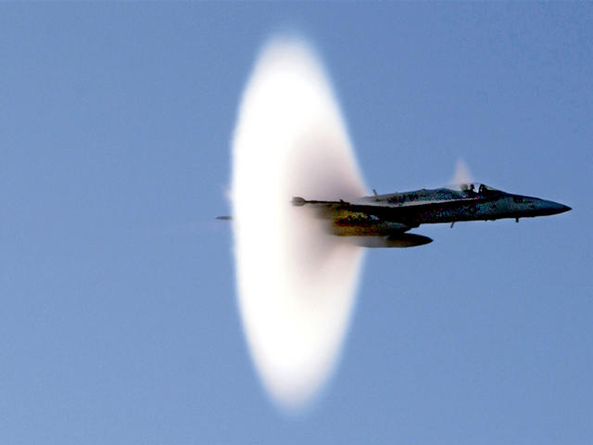
Sonic boom

Slide 28
Quantum protection of information due to the uncertainty principle

Slide 29
Irreversible deformations:
Plasticity,
creep,
viscosity

Slide 30
Links to thermodynamics:
Statistical mechanics
Irreversibility and conservation as the links between mechanics and thermodynamics
One way function is computer science is similar to the 2d Law of Thermodynamics
Mixing colors is easy but separating is almost impossible

Slide 31
Temperature,
pressure,
volume

Slide 32
Thermal expansion

Slide 33
Thermal stresses

Slide 34
Entropy

Slide 35
Avogadro’s number

Slide 36
Ideal gas

Slide 37
Distribution of speeds
The Maxwell–Boltzmann distribution or Maxwell speed distribution describes particle speeds in idealized gases where the particles move freely inside a stationary container without interacting with one another, except for very brief collisions in which they exchange energy and momentum with each other or with their thermal environment. Particle in this context refers to gaseous atoms or molecules, and the system of particles is assumed to have reached thermodynamic equilibrium.

Slide 38
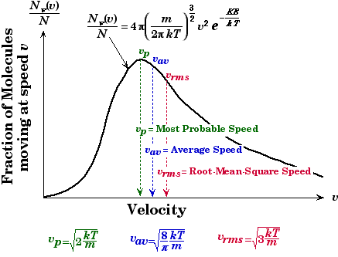
Distribution of speeds

Slide 39
Phases changes

Slide 40
Vapor pressure and humidity

Slide 41
Boiling

Slide 42
Convection

Slide 43
Conduction

Slide 44
Evaporation

Slide 45
Law of thermodynamics

Slide 46
Irreversibly smashed cup

Slide 47
Heat engines

Slide 48
Carnot engine

Slide 49
Order to disorder

Slide 50
Time’s arrow

Slide 51
Statistical interpretation of entropy and Second Law

Slide 52
Brownian motion

Slide 53
Diffusion

Slide 54
Computing thermodynamics

Slide 55
The principle of the least energy expenditure says that any natural system tries to get to a state with the smallest potential energy.

Slide 56
Debate
Debate competitions are 10% of our scores
Register today
Use your knowledge of physics in the debate

