Slide 1
15 Lecture in physics
Take home exam
1 revision paper
Tutorials
communication

Slide 2
Take home exam in physics has the deadline 5 January 2015.

Slide 3
Email me once a week.

Slide 4
Write how many times you attended tutorials.

Slide 5
Going through the revision paper

Slide 6
Revision for the Final Exam

Slide 7
Electromagnetism

Slide 8
Faraday's law of induction
Faraday's law of induction is a basic law of electromagnetism predicting how a magnetic field will interact with an electric circuit to produce an electromotive force (EMF)—a phenomenon called electromagnetic induction. It is the fundamental operating principle of transformers, inductors, and many types of electrical motors, generators and solenoids.
The Maxwell–Faraday equation is a generalization of Faraday's law, and forms one of Maxwell's equations.

Slide 9
Maxwell's equations
Maxwell's equations are a set of partial differential equations that, together with the Lorentz force law, form the foundation of classical electrodynamics, classical optics, and electric circuits. These fields in turn underlie modern electrical and communications technologies. Maxwell's equations describe how electric and magnetic fields are generated and altered by each other and by charges and currents. They are named after the Scottish physicist and mathematician James Clerk Maxwell, who published an early form of those equations between 1861 and 1862.
The equations have two major variants. The "microscopic" set of Maxwell's equations uses total charge and total current, including the complicated charges and currents in materials at the atomic scale; it has universal applicability but may be unfeasible to calculate. The "macroscopic" set of Maxwell's equations defines two new auxiliary fields that describe large-scale behavior without having to consider these atomic scale details, but it requires the use of parameters characterizing the electromagnetic properties of the relevant materials.
The term "Maxwell's equations" is often used for other forms of Maxwell's equations. For example, space-time formulations are commonly used in high energy and gravitational physics. These formulations, defined on space-time rather than space and time separately, are manifestly compatible with special and general relativity. In quantum mechanics and analytical mechanics, versions of Maxwell's equations based on the electric and magnetic potentials are preferred.
Since the mid-20th century, it has been understood that Maxwell's equations are not exact laws of the universe, but are a classical approximation to the more accurate and fundamental theory of quantum electrodynamics. In most cases, though, quantum deviations from Maxwell's equations are immeasurably small. Exceptions occur when the particle nature of light is important or for very strong electric fields.

Slide 10
Telecommunication

Slide 11
Modulation
In electronics and telecommunications, modulation is the process of varying one or more properties of a periodic waveform, called the carrier signal, with a modulating signal that typically contains information to be transmitted.

Slide 12
Modulation (continued)
In telecommunications, modulation is the process of conveying a message signal, for example a digital bit stream or an analog audio signal, inside another signal that can be physically transmitted. Modulation of a sine waveform transforms a baseband message signal into a passband signal.

Slide 13
Modulation (continued)
A modulator is a device that performs modulation. A demodulator (sometimes detector or demod) is a device that performs demodulation, the inverse of modulation. A modem (from modulator–demodulator) can perform both operations.

Slide 14
Modulation (continued)
The aim of digital modulation is to transfer a digital bit stream over an analog bandpass channel, for example over the public switched telephone network (where a bandpass filter limits the frequency range to 300–3400 Hz), or over a limited radio frequency band.

Slide 15
Modulation (continued)
The aim of analog modulation is to transfer an analog baseband (or lowpass) signal, for example an audio signal or TV signal, over an analog bandpass channel at a different frequency, for example over a limited radio frequency band or a cable TV network channel.

Slide 16
Modulation (continued)
Analog and digital modulation facilitate frequency division multiplexing (FDM), where several low pass information signals are transferred simultaneously over the same shared physical medium, using separate passband channels (several different carrier frequencies).

Slide 17
Modulation (continued)
The aim of digital baseband modulation methods, also known as line coding, is to transfer a digital bit stream over a baseband channel, typically a non-filtered copper wire such as a serial bus or a wired local area network.

Slide 18
Modulation (continued)
The aim of pulse modulation methods is to transfer a narrowband analog signal, for example a phone call over a wideband baseband channel or, in some of the schemes, as a bit stream over another digital transmission system.

Slide 19
Modulation (continued)
In music synthesizers, modulation may be used to synthesise waveforms with an extensive overtone spectrum using a small number of oscillators. In this case the carrier frequency is typically in the same order or much lower than the modulating waveform. See for example frequency modulation synthesis or ring modulation synthesis.

Slide 20
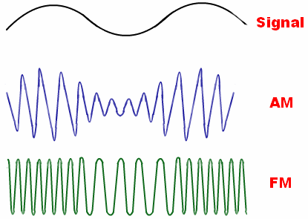
Modulation (continued)

Slide 21
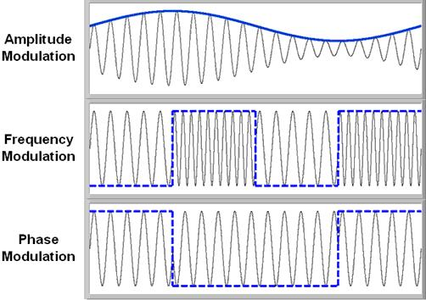
Modulation (continued)

Slide 22
Biophysics

Slide 23
Magnetism

Slide 24
Earth's magnetic field
Earth's magnetic field, also known as the geomagnetic field, is the magnetic field that extends from the Earth's interior to where it meets the solar wind, a stream of charged particles emanating from the Sun. Its magnitude at the Earth's surface ranges from 25 to 65 microtesla (0.25 to 0.65 gauss). Roughly speaking it is the field of a magnetic dipole currently tilted at an angle of about 10 degrees with respect to Earth's rotational axis, as if there were a bar magnet placed at that angle at the center of the Earth. Unlike a bar magnet, however, Earth's magnetic field changes over time because it is generated by a geodynamo (in Earth's case, the motion of molten iron alloys in its outer core).

Slide 25
Earth's magnetic field (continued)
The North and South magnetic poles wander widely, but sufficiently slowly for ordinary compasses to remain useful for navigation. However, at irregular intervals averaging several hundred thousand years, the Earth's field reverses and the North and South Magnetic Poles relatively abruptly switch places. These reversals of the geomagnetic poles leave a record in rocks that are of value to paleomagnetists in calculating geomagnetic fields in the past. Such information in turn is helpful in studying the motions of continents and ocean floors in the process of plate tectonics.

Slide 26
Earth's magnetic field (continued)
The magnetosphere is the region above the ionosphere and extends several tens of thousands of kilometers into space, protecting the Earth from the charged particles of the solar wind and cosmic rays that would otherwise strip away the upper atmosphere, including the ozone layer that protects the Earth from harmful ultraviolet radiation.

Slide 27
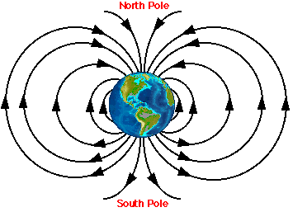
Earth's magnetic field (continued)

Slide 28
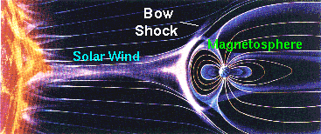
Earth's magnetic field (continued)

Slide 29
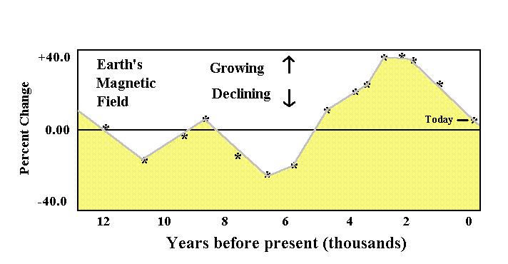
Earth's magnetic field (continued)

Slide 30
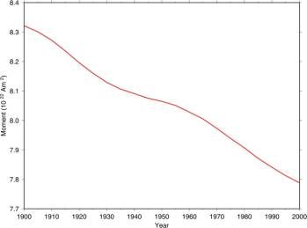
Earth's magnetic field (continued)

Slide 31
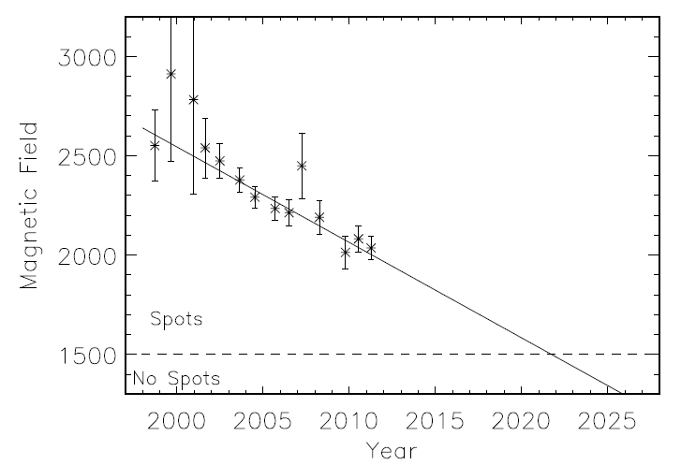
Earth's magnetic field (continued)

Slide 32
Computer physics in magnetism

Slide 33
Magnetic storage

Slide 34
Magnetic storage (continued)
Magnetic storage (or magnetic recording) is the storage of data on a magnetized medium. Magnetic storage uses different patterns of magnetization in a magnetizable material to store data and is a form of non-volatile memory. The information is accessed using one or more read/write heads.

Slide 35
Magnetic storage (continued)
As of 2013, magnetic storage media, primarily hard disks, are widely used to store computer data as well as audio and video signals. In the field of computing, the term magnetic storage is preferred and in the field of audio and video production, the term magnetic recording is more commonly used. The distinction is less technical and more a matter of preference. Other examples of magnetic storage media include floppy disks, magnetic recording tape, and magnetic stripes on credit cards.

Slide 36
Optics

Slide 37
Optical dilatometer
An optical dilatometer is a non-contact device able to measure thermal expansions or sintering kinetics of any kind of materials, unlike traditional push rod dilatometer, it can push up to the dilatometric softening of the specimen. It is a device for measuring changes in the dimensions of a specimen, optically, the achieved resolution can results in greater values than those of a conventional pushrod dilatometer.

Slide 38
Optical dilatometer (continued)
A monochromatic light source, such as a laser, illuminates the specimen. Some of the light is reflected by the specimen and interferes with the incoming light, creating optical interference fringes. As the specimen contracts or expands, there is a proportional movement of the interference fringes, which can be measured using a camera system. The measurement resolution is determined by the wavelength of the light, and is typically 0.5 μm for blue light. Optical dilatometers are used to measure thermal expansion.

Slide 39
Optical dilatometer (continued)
The optical dilatometer is in fact complementary to the traditional higher resolution push rod dilatometer when it comes to measure dimensional changes of materials, as a function of temperature, and no contact between specimen and instrument is required.

Slide 40
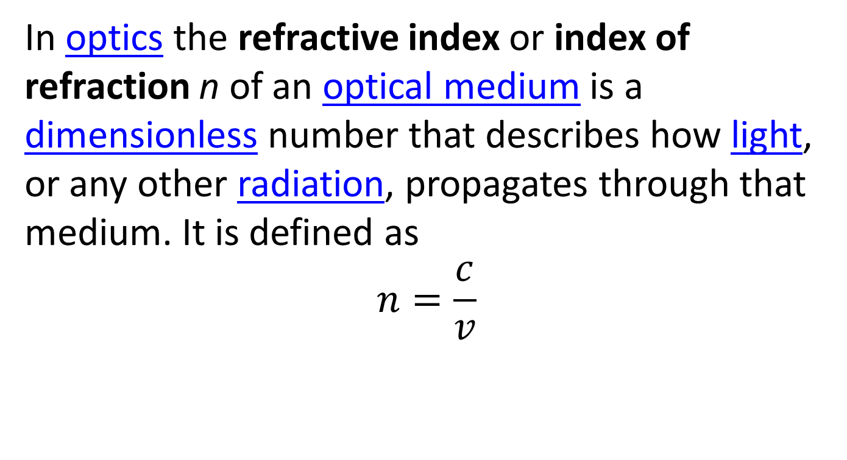
Refractive index
In optics the refractive index or index of refraction n of an optical medium is a dimensionless number that describes how light, or any other radiation, propagates through that medium. It is defined as
$$n=\frac{c}{v}$$

Slide 41
Exercises
What is the speed of light in a diamond?
v = 0.413c

Slide 42
Snell's law
Snell's law (also known as the Snell–Descartes law and the law of refraction) is a formula used to describe the relationship between the angles of incidence and refraction, when referring to light or other waves passing through a boundary between two different isotropic media, such as water, glass and air.

Slide 43
Snell's law (continued)
In optics, the law is used in ray tracing to compute the angles of incidence or refraction, and in experimental optics to find the refractive index of a material. The law is also satisfied in metamaterials, which allow light to be bent "backward" at a negative angle of refraction with a negative refractive index.

Slide 44
Snell's law (continued)
Although named after Dutch astronomer Willebrord Snellius (1580–1626), the law was first accurately described by the scientist Ibn Sahl at the Baghdad court in 984. In the manuscript On Burning Mirrors and Lenses, Sahl used the law to derive lens shapes that focus light with no geometric aberrations.

Slide 45
Diffraction
Diffraction refers to various phenomena which occur when a wave encounters an obstacle or a slit. In classical physics, the diffraction phenomenon is described as the interference of waves according to the Huygens Fresnel principle. These characteristic behaviors are exhibited when a wave encounters an obstacle or a slit that is comparable in size to its wavelength. Similar effects occur when a light wave travels through a medium with a varying refractive index, or when a sound wave travels through a medium with varying acoustic impedance. Diffraction occurs with all waves, including sound waves, water waves, and electromagnetic waves such as visible light, X-rays and radio waves.

Slide 46
Diffraction (continued)
Since physical objects have wave-like properties (at the atomic level), diffraction also occurs with matter and can be studied according to the principles of quantum mechanics. Italian scientist Francesco Maria Grimaldi coined the word "diffraction" and was the first to record accurate observations of the phenomenon in 1660.

Slide 47
Diffraction (continued)
While diffraction occurs whenever propagating waves encounter such changes, its effects are generally most pronounced for waves whose wavelength is roughly comparable to the dimensions of the diffracting object or slit. If the obstructing object provides multiple, closely spaced openings, a complex pattern of varying intensity can result.

Slide 48
Diffraction (continued)
This is due to the addition, or interference, of different parts of a wave that travels to the observer by different paths, where different path lengths result in different phases (see diffraction grating and wave superposition). The formalism of diffraction can also describe the way in which waves of finite extent propagate in free space. For example, the expanding profile of a laser beam, the beam shape of a radar antenna and the field of view of an ultrasonic transducer can all be analyzed using diffraction equations.

Slide 49
Diffraction grating

Slide 50
Diffraction grating (continued)
In optics, a diffraction grating is an optical component with a periodic structure, which splits and diffracts light into several beams travelling in different directions. The directions of these beams depend on the spacing of the grating and the wavelength of the light so that the grating acts as the dispersive element. Because of this, gratings are commonly used in monochromators and spectrometers.

Slide 51
Diffraction grating (continued)
For practical applications, gratings generally have ridges or rulings on their surface rather than dark lines. Such gratings can be either transmissive or reflective. Gratings which modulate the phase rather than the amplitude of the incident light are also produced, frequently using holography.

Slide 52
Diffraction grating (continued)
The principles of diffraction gratings were discovered by James Gregory, about a year after Newton's prism experiments, initially with artifacts such as bird feathers. The first man-made diffraction grating was made around 1785 by Philadelphia inventor David Rittenhouse, who strung hairs between two finely threaded screws. This was similar to notable German physicist Joseph von Fraunhofer's wire diffraction grating in 1821.

Slide 53
Diffraction grating (continued)
Diffraction creates the "rainbow" colors reflected from a compact disc (see Examples, below). A grating has parallel lines, while a CD has a spiral of finely-spaced data tracks. Diffraction colors also appear when one looks at a bright point source through a translucent fine-pitch umbrella-fabric covering. Decorative patterned plastic films based on reflective grating patches are very inexpensive to produce, and are commonplace.

Slide 54
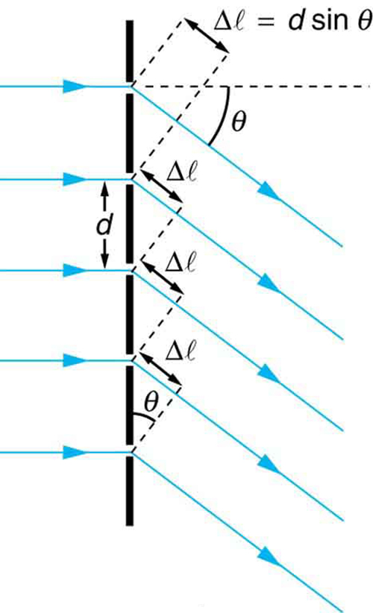
Diffraction grating (continued)

Slide 55
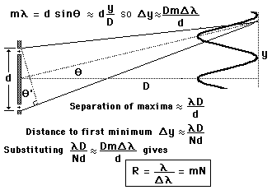
Diffraction grating (continued)

Slide 56
Airy disk
In optics, the Airy disk (or Airy disc) and Airy pattern are descriptions of the best focused spot of light that a perfect lens with a circular aperture can make, limited by the diffraction of light.

Slide 57
Airy disk (continued)
The diffraction pattern resulting from a uniformly-illuminated circular aperture has a bright region in the center, known as the Airy disk which together with the series of concentric bright rings around is called the Airy pattern. Both are named after George Biddell Airy. The disk and rings phenomenon had been known prior to Airy; John Herschel described the appearance of a bright star seen through a telescope under high magnification for an 1828 article on light for the Encyclopedia Metropolitana:
...the star is then seen (in favourable circumstances of tranquil atmosphere, uniform temperature, &c.) as a perfectly round, well-defined planetary disc, surrounded by two, three, or more alternately dark and bright rings, which, if examined attentively, are seen to be slightly coloured at their borders. They succeed each other nearly at equal intervals round the central disc....

Slide 58
Airy disk (continued)
However, Airy wrote the first full theoretical treatment explaining the phenomenon (his 1835 "On the Diffraction of an Object-glass with Circular Aperture").

Slide 59
Airy disk (continued)
Mathematically, the diffraction pattern is characterized by the wavelength of light illuminating the circular aperture, and the aperture's size. The appearance of the diffraction pattern is additionally characterized by the sensitivity of the eye or other detector used to observe the pattern.

Slide 60
Airy disk (continued)
The most important application of this concept is in cameras and telescopes. Owing to diffraction, the smallest point to which a lens or mirror can focus a beam of light is the size of the Airy disk. Even if one were able to make a perfect lens, there is still a limit to the resolution of an image created by this lens. An optical system in which the resolution is no longer limited by imperfections in the lenses but only by diffraction is said to be diffraction limited.
The Airy disk is of importance in physics, optics, and astronomy.

Slide 61
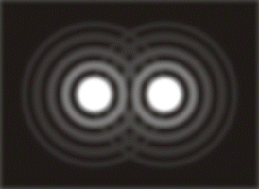
Airy disk (continued)

Slide 62
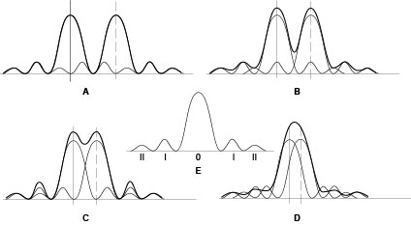
Airy disk (continued)

Slide 63
The Rayleigh Criterion
The Rayleigh criterion is the generally accepted criterion for the minimum resolvable detail - the imaging process is said to be diffraction-limited when the first diffraction minimum of the image of one source point coincides with the maximum of another.

Slide 64
Angular resolution
Angular resolution, or spatial resolution, describes the ability of any image-forming device such as an optical or radio telescope, a microscope, a camera, or an eye, to distinguish small details of an object, thereby making it a major determinant of image resolution.

Slide 65
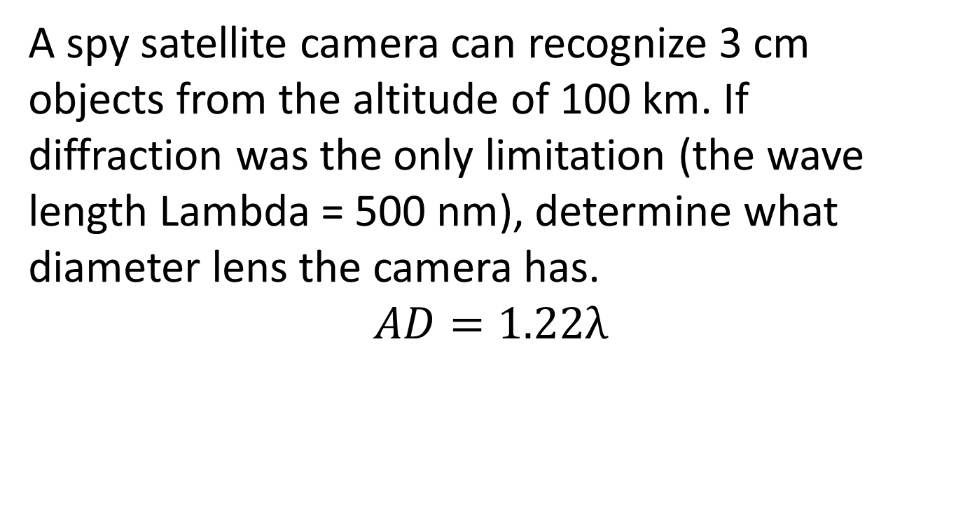
Exercises:
A spy satellite camera can recognize 3 cm objects from the altitude of 100 km. If diffraction was the only limitation (the wave length Lambda = 500 nm), determine what diameter lens the camera has.
$$AD=1.22λ$$

Slide 66
Quantum physics

Slide 67
Schrödinger equation
In quantum mechanics, the Schrödinger equation is a partial differential equation that describes how the quantum state of a physical system changes with time. It was formulated in late 1925, and published in 1926, by the Austrian physicist Erwin Schrödinger.
In classical mechanics, the equation of motion is Newton's second law, (F = ma), used to mathematically predict what the system will do at any time after the initial conditions of the system. In quantum mechanics, the analogue of Newton's law is Schrödinger's equation for a quantum system (usually atoms, molecules, and subatomic particles whether free, bound, or localized). It is not a simple algebraic equation, but in general a linear partial differential equation, describing the time-evolution of the system's wave function (also called a "state function").
The concept of a wavefunction is a fundamental postulate of quantum mechanics. Schrödinger's equation is also often presented as a separate postulate, but some authors assert it can be derived from symmetry principles. Generally, "derivations" of the SE demonstrate its mathematical plausibility for describing wave–particle duality.
In the standard interpretation of quantum mechanics, the wave function is the most complete description that can be given to a physical system. Solutions to Schrödinger's equation describe not only molecular, atomic, and subatomic systems, but also macroscopic systems, possibly even the whole universe. The Schrödinger equation, in its most general form, is consistent with either classical mechanics or special relativity, but the original formulation by Schrödinger himself was non-relativistic.
The Schrödinger equation is not the only way to make predictions in quantum mechanics - other formulations can be used, such as Werner Heisenberg's matrix mechanics, and Richard Feynman's path integral formulation.

Slide 68
Dirac equation
In particle physics, the Dirac equation is a relativistic wave equation derived by British physicist Paul Dirac in 1928. In its free form, or including electromagnetic interactions, it describes all spin-½ massive particles, for which parity is a symmetry, such as electrons and quarks, and is consistent with both the principles of quantum mechanics and the theory of special relativity, and was the first theory to account fully for special relativity in the context of quantum mechanics.
It accounted for the fine details of the hydrogen spectrum in a completely rigorous way. The equation also implied the existence of a new form of matter, antimatter, hitherto unsuspected and unobserved, and actually predated its experimental discovery. It also provided a theoretical justification for the introduction of several-component wave functions in Pauli's phenomenological theory of spin; the wave functions in the Dirac theory are vectors of four complex numbers (known as bispinors), two of which resemble the Pauli wavefunction in the non-relativistic limit, in contrast to the Schrödinger equation which described wave functions of only one complex value. Moreover, in the limit of zero mass, the Dirac equation reduces to the Weyl equation.
Although Dirac did not at first fully appreciate the importance of his results, the entailed explanation of spin as a consequence of the union of quantum mechanics and relativity—and the eventual discovery of the positron—represent one of the great triumphs of theoretical physics. This accomplishment has been described as fully on a par with the works of Newton, Maxwell, and Einstein before him. In the context of quantum field theory, the Dirac equation is reinterpreted to describe quantum fields corresponding to spin-½ particles.

Slide 69
Pauli exclusion principle

Slide 70
Exercises
Write the ground states configurations for Li and Na. List all quantum numbers for each electron. Show that Pauli Exclusion Principle works.

Slide 71
Exercises (continued)
Photosynthesis: Nine photons are needed to transform one molecule of CO₂ to the carbohydrate and O₂. The light wavelength is 700 nm. The inverse chemical reaction releases energy of 5 eV/ molecule of CO₂. How efficient is the photosynthesis process?

Slide 72
Exercises (continued)
Which of the following electron configurations are possible and which are not
1s²2s²2p⁶3s³;
1s²2s²2p⁶3s²3p⁶4s²;
1s²2s²2p⁶2d¹?

Slide 73
Do the matter waves exist?

Slide 74
Wave function meaning

Slide 75
Wave function (continued)
A wave function or wavefunction (also named a state function) in quantum mechanics describes the quantum state of a system of one or more particles, and contains all the information about the system considered in isolation.

Slide 76
Wave function (continued)
Quantities associated with measurements, such as the average momentum of a particle, are derived from the wavefunction by mathematical operations that describe its interaction with observational devices. Thus it is a central entity in quantum mechanics.

Slide 77
Wave function (continued)
The most common symbols for a wave function are the Greek letters ψ or Ψ (lower-case and capital psi). The Schrödinger equation determines how the wave function evolves over time, that is, the wavefunction is the solution of the Schrödinger equation.

Slide 78
Wave function (continued)
The wave function behaves qualitatively like other waves, like water waves or waves on a string, because the Schrödinger equation is mathematically a type of wave equation. This explains the name "wave function", and gives rise to wave–particle duality.

Slide 79
Wave function (continued)
The wave of the wave function, however, is not a wave in physical space; it is a wave in an abstract mathematical "space", and in this respect it differs fundamentally from water waves or waves on a string.

Slide 80
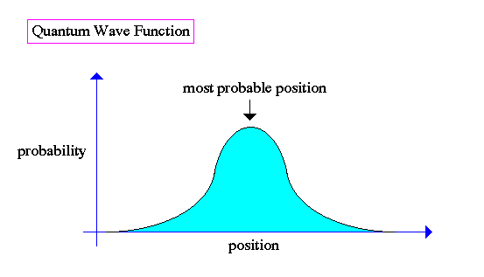
Wave function (continued)

Slide 81
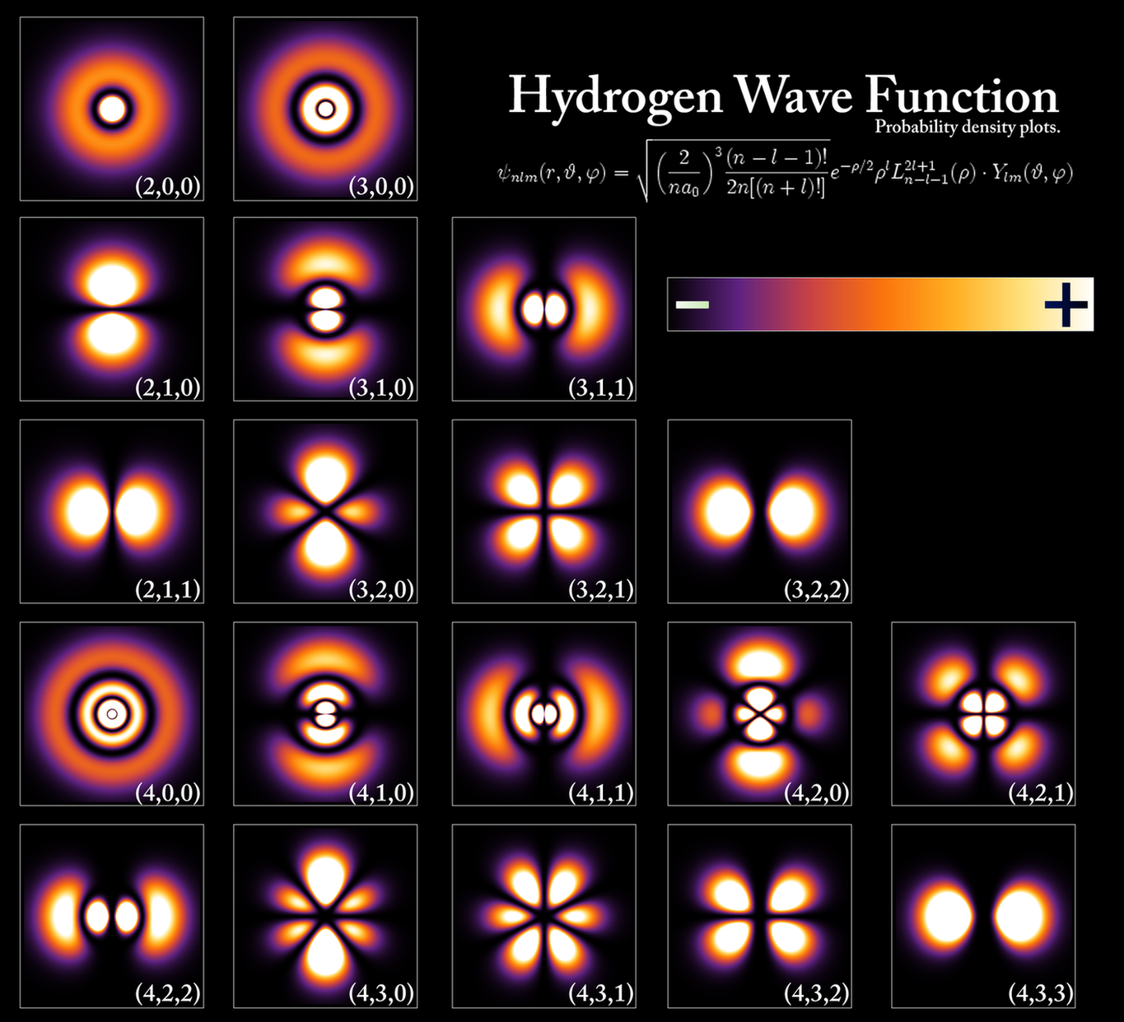
Wave function (continued)

Slide 82
Atomic clock

Slide 83
Atomic clock (continued)
An atomic clock is a clock device that uses an electronic transition frequency in the microwave, optical, or ultraviolet region of the electromagnetic spectrum of atoms as a frequency standard for its timekeeping element. Atomic clocks are the most accurate time and frequency standards known, and are used as primary standards for international time distribution services, to control the wave frequency of television broadcasts, and in global navigation satellite systems such as GPS.

Slide 84
Atomic clock (continued)
The principle of operation of an atomic clock is not based on nuclear physics, but rather on atomic physics and using the microwave signal that electrons in atoms emit when they change energy levels. Early atomic clocks were based on masers at room temperature. Currently, the most accurate atomic clocks first cool the atoms to near absolute zero temperature by slowing them with lasers and probing them in atomic fountains in a microwave-filled cavity. An example of this is the NIST-F1 atomic clock, one of the U.S.'s national primary time and frequency standards.

Slide 85
Atomic clock (continued)
The accuracy of an atomic clock depends on two factors. The first factor is temperature of the sample atoms—colder atoms move much more slowly, allowing longer probe times. The second factor is the frequency and intrinsic width of the electronic transition. Higher frequencies and narrow lines increase the precision.

Slide 86
Atomic clock (continued)
National standards agencies in most industrialised and semi-industrialised countries maintain an accuracy of 10⁻⁹ seconds per day (approximately 1 part in 10¹⁴), and a precision set by the radio transmitter pumping the maser. These clocks collectively define a continuous and stable time scale, International Atomic Time (TAI). For civil time, another time scale is disseminated, Coordinated Universal Time (UTC). UTC is derived from TAI, but approximately synchronised, by using leap seconds, to UT1, which is based on actual rotations of the Earth with respect to the solar time.

Slide 87
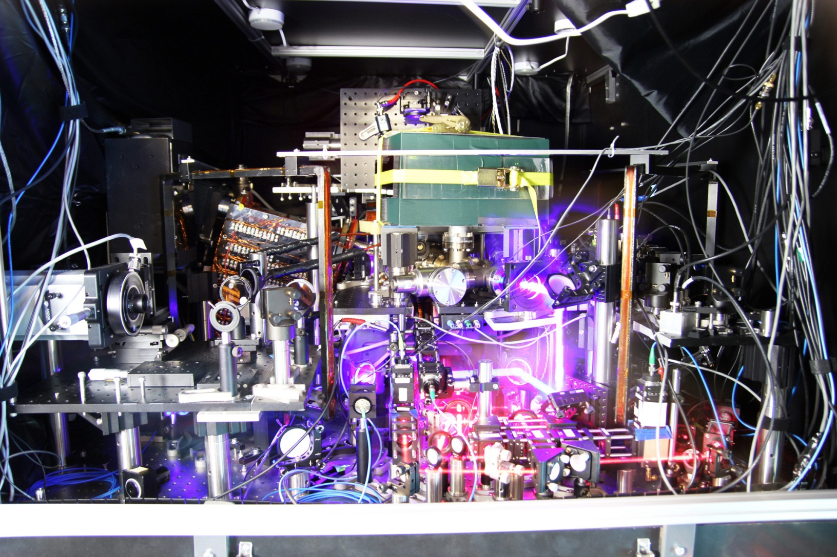
Atomic clock (continued)

Slide 88
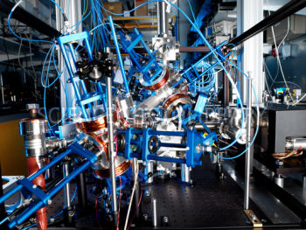
Atomic clock (continued)

Slide 89
Laser

Slide 90
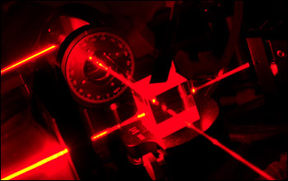
Laser (continued)

Slide 91
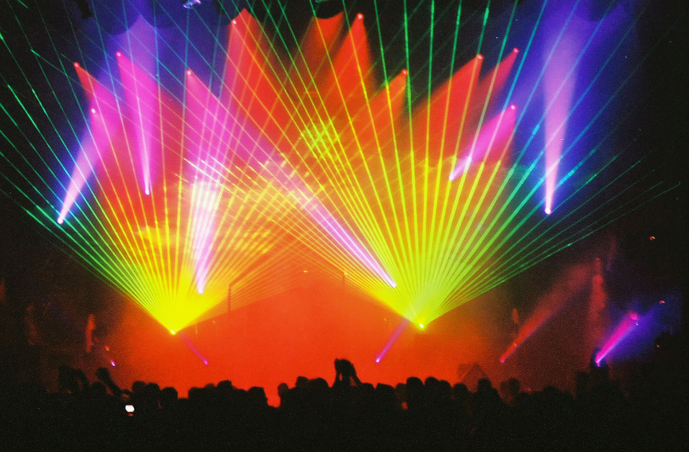
Laser (continued)

Slide 92
Laser (continued)
A laser is a device that emits light through a process of optical amplification based on the stimulated emission of electromagnetic radiation. The term "laser" originated as an acronym for "light amplification by stimulated emission of radiation".A laser differs from other sources of light because it emits light coherently. Spatial coherence allows a laser to be focused to a tight spot, enabling applications like laser cutting and lithography. Spatial coherence also allows a laser beam to stay narrow over long distances (collimation), enabling applications such as laser pointers.

Slide 93
Laser (continued)
Lasers can also have high temporal coherence which allows them to have a very narrow spectrum, i.e., they only emit a single color of light. Temporal coherence can be used to produce pulses of light—as short as a femtosecond.

Slide 94
Laser (continued)
Lasers have many important applications. They are used in common consumer devices such as optical disk drives, laser printers, and barcode scanners. Lasers are used for both fiber-optic and free-space optical communication. They are used in medicine for laser surgery and various skin treatments, and in industry for cutting and welding materials. They are used in military and law enforcement devices for marking targets and measuring range and speed. Laser lighting displays use laser light as an entertainment medium.

Slide 95
Quantum entanglement
Superposition (configurations interaction, interference, resulting diffraction)

Slide 96
Nuclear physics

Slide 97
Nuclear drop model

Slide 98
The liquid drop model
The liquid drop model in nuclear physics treats the nucleus as a drop of incompressible nuclear fluid. It was first proposed by George Gamow and then developed by Niels Bohr and John Archibald Wheeler. The fluid is made of nucleons (protons and neutrons), which are held together by the strong nuclear force. This is a crude model that does not explain all the properties of the nucleus, but does explain the spherical shape of most nuclei. It also helps to predict the nuclear binding energy.
Mathematical analysis of the theory delivers an equation which attempts to predict the binding energy of a nucleus in terms of the numbers of protons and neutrons it contains. This equation has five terms on its right hand side. These correspond to the cohesive binding of all the nucleons by the strong nuclear force, a surface energy term, the electrostatic mutual repulsion of the protons, an asymmetry term (derivable from the protons and neutrons occupying independent quantum momentum states) and a pairing term (partly derivable from the protons and neutrons occupying independent quantum spin states).

Slide 99
Particle physics

Slide 100
Higgs boson

Slide 101
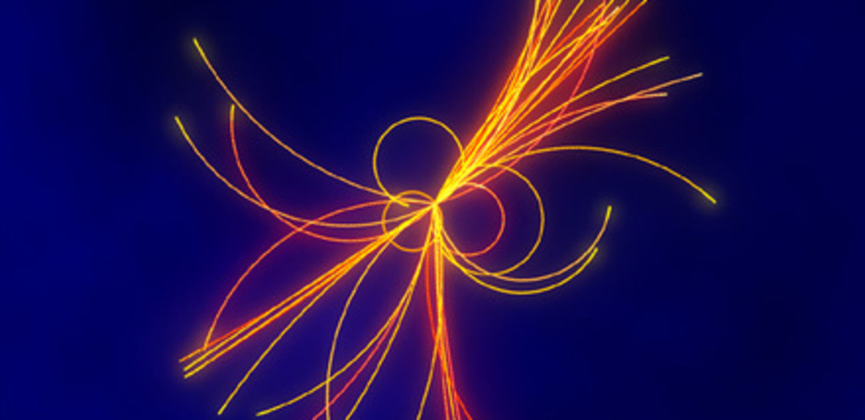
Higgs boson (continued)

Slide 102
Astrophysics

Slide 103
Big Bang

Slide 104
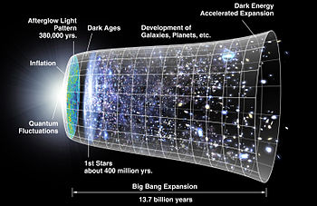
Big Bang (continued)

Slide 105
Aliens

Slide 106
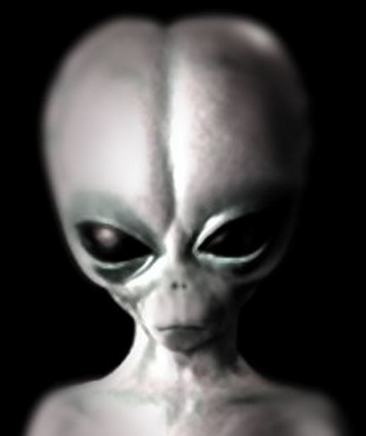
Aliens (continued)

Slide 107
Instructions

Slide 108
Firstly, study those topics of the subject, which are the most relevant to your major, so that you constantly practice what you study and do not forget it.

Slide 109
The influences and role of electromagnetic waves, gravity and nuclear phenomena in the living beings are significant.

Slide 110
Explore the physics of computing.

Slide 111
200 km teleportation give hope to communicate much better through the satellites

Slide 112
Your own code (computer programs) are expected by the people from you, thus, math is very important everywhere.

Slide 113
Let us meet on 5, 6, 7, 8, 9, 12, 13, 14 January 2015, check the web sites.

