Slide 1
10 Lecture in physics
Projects
Magnetism
LRC circuit
Electromagnetic waves
Optics

Slide 2
My mistakes about [T] and [H]

Slide 3
Projects
Seeds subjected to the radiation
Earth magnetic field dynamics
Security optical instruments
Chemical electromagnetism
Quantum chemistry
Books reviews

Slide 4
Electrostatic experiments

Slide 5
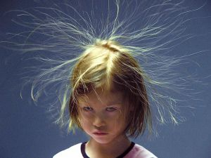
Electrostatic experiments (continued)

Slide 6
Least resistance
Electric current follows the path of the least resistance

Slide 7
Capacitor
A capacitor (originally known as a condenser) is a passive two-terminal electrical component used to store energy electrostatically in an electric field. The forms of practical capacitors vary widely, but all contain at least two electrical conductors (plates) separated by a dielectric (i.e. insulator). The conductors can be thin films, foils or sintered beads of metal or conductive electrolyte, etc. The "nonconducting" dielectric acts to increase the capacitor's charge capacity. A dielectric can be glass, ceramic, plastic film, air, vacuum, paper, mica, oxide layer etc. Capacitors are widely used as parts of electrical circuits in many common electrical devices. Unlike a resistor, an ideal capacitor does not dissipate energy. Instead, a capacitor stores energy in the form of an electrostatic field between its plates.

Slide 8
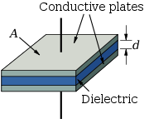
Capacitor (continued)

Slide 9
Inductor
An inductor, also called a coil or reactor, is a passive two-terminal electrical component which resists changes in electric current passing through it. It consists of a conductor such as a wire, usually wound into a coil. When a current flows through it, energy is stored temporarily in a magnetic field in the coil. When the current flowing through an inductor changes, the time-varying magnetic field induces a voltage in the conductor, according to Faraday’s law of electromagnetic induction, which opposes the change in current that created it.

Slide 10
Magnetic pole

Slide 11
Magnetic field
A magnetic field is the magnetic influence of electric currents and magnetic materials. The magnetic field at any given point is specified by both a direction and a magnitude (or strength); as such it is a vector field.

Slide 12
Tesla (unit)
The tesla (symbol T) is the SI derived unit of magnetic flux density, commonly denoted as B. One tesla is equal to one weber per square metre, and it was named in 1960 in honour of Nikola Tesla. The strongest fields encountered from permanent magnets are from Halbach spheres which can be over 4.5 T. The strongest field trapped in a superconductor in a lab as of July 2014 is 17.6 T. The record magnetic field has been produced by scientists at the Los Alamos National Laboratory campus of the National High Magnetic Field Laboratory, the world's first 100 Tesla non-destructive magnetic field.
The unit was announced during the Conférence Générale des Poids et Mesures in 1960.

Slide 13
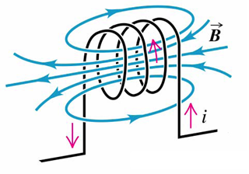
Inductor (continued)

Slide 14
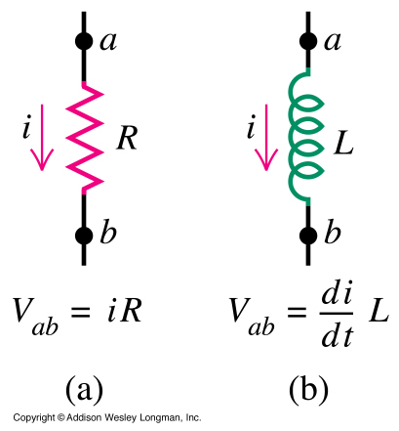
(continued) Inductor

Slide 15
Ampère's law
In classical electromagnetism, Ampère's circuital law, discovered by André-Marie Ampère in 1826, relates the integrated magnetic field around a closed loop to the electric current passing through the loop. James Clerk Maxwell derived it again using hydrodynamics in his 1861 paper On Physical Lines of Force and it is now one of the Maxwell equations, which form the basis of classical electromagnetism.

Slide 16
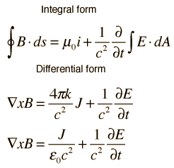
Ampère's law (continued)

Slide 17
Magnetism
Magnetism is a class of physical phenomena that are mediated by magnetic fields. Electric currents and the fundamental magnetic moments of elementary particles give rise to a magnetic field, which acts on other currents and magnetic moments. All materials are influenced to some extent by a magnetic field. The most familiar effect is on permanent magnets, which have persistent magnetic moments caused by ferromagnetism. Most materials do not have permanent moments. Some are attracted to a magnetic field (paramagnetism); others are repulsed by a magnetic field (diamagnetism); others have a much more complex relationship with an applied magnetic field (spin glass behavior and antiferromagnetism). Substances that are negligibly affected by magnetic fields are known as non-magnetic substances. They include copper, aluminium, gases, and plastic. Pure oxygen exhibits magnetic properties when cooled to a liquid state.

Slide 18
Magnetism (continued)
The magnetic state (or phase) of a material depends on temperature (and other variables such as pressure and the applied magnetic field) so that a material may exhibit more than one form of magnetism depending on its temperature, etc.

Slide 19
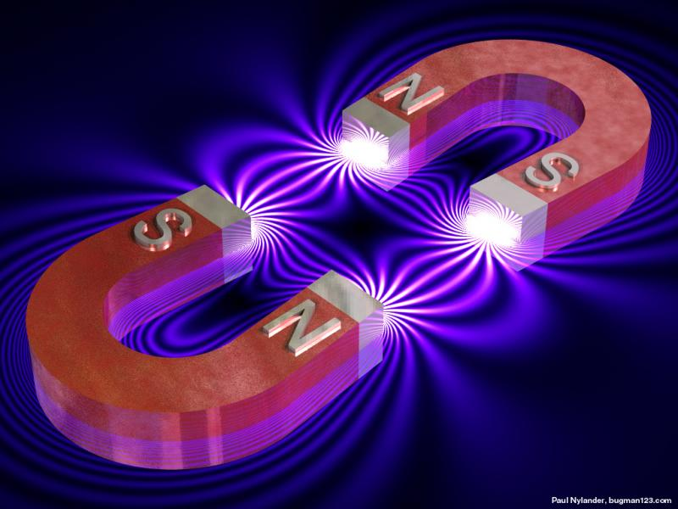
(continued) Magnetism

Slide 20
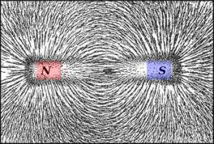
Magnetism (continued)

Slide 21
Solenoid
A solenoid (from the French solénoïde, derived in turn from the Greek solen "pipe, channel" + combining form of Greek eidos "form, shape") is a coil wound into a tightly packed helix. The term was invented by French physicist André-Marie Ampère to designate a helical coil.

Slide 22
Solenoid (continued)
In physics, the term refers specifically to a long, thin loop of wire, often wrapped around a metallic core, which produces a uniform magnetic field in a volume of space (where some experiment might be carried out) when an electric current is passed through it. A solenoid is a type of electromagnet when the purpose is to generate a controlled magnetic field. If the purpose of the solenoid is instead to impede changes in the electric current, a solenoid can be more specifically classified as an inductor rather than an electromagnet. Not all electromagnets and inductors are solenoids; for example, the first electromagnet, invented in 1824, had a horseshoe rather than a cylindrical solenoid shape.

Slide 23
(continued) Solenoid
In engineering, the term may also refer to a variety of transducer devices that convert energy into linear motion. The term is also often used to refer to a solenoid valve, which is an integrated device containing an electromechanical solenoid which actuates either a pneumatic or hydraulic valve, or a solenoid switch, which is a specific type of relay that internally uses an electromechanical solenoid to operate an electrical switch; for example, an automobile starter solenoid, or a linear solenoid, which is an electromechanical solenoid.

Slide 24
Electromagnet
An electromagnet is a type of magnet in which the magnetic field is produced by electric current. The magnetic field disappears when the current is turned off. Electromagnets usually consist of a large number of closely spaced turns of wire that create the magnetic field. The wire turns are often wound around a magnetic core made from a ferromagnetic or ferrimagnetic material such as iron; the magnetic core concentrates the magnetic flux and makes a more powerful magnet.

Slide 25
Electromagnet (continued)
The main advantage of an electromagnet over a permanent magnet is that the magnetic field can be quickly changed by controlling the amount of electric current in the winding. However, unlike a permanent magnet that needs no power, an electromagnet requires a continuous supply of electrical energy to maintain a magnetic field.

Slide 26
(continued) Electromagnet
Electromagnets are widely used as components of other electrical devices, such as motors, generators, relays, loudspeakers, hard disks, MRI machines, scientific instruments, and magnetic separation equipment. Electomagnets are also employed in industry for picking up and moving heavy iron objects such as scrap iron and steel.

Slide 27
Ampère's force law
In magnetostatics, the force of attraction or repulsion between two current-carrying wires (see first figure below) is often called Ampère's force law. The physical origin of this force is that each wire generates a magnetic field, as defined by the Biot–Savart law, and the other wire experiences a magnetic force as a consequence, as defined by the Lorentz force.

Slide 28
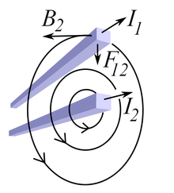
Ampère's force (continued)

Slide 29
Lorentz force
In physics, particularly electromagnetism, the Lorentz force is the combination of electric and magnetic force on a point charge due to electromagnetic fields.

Slide 30

Lorentz force (continued)

Slide 31
F = qvB sinA

Slide 32
Example:
Electron’s path in a uniform magnetic field:
An electron travels at 2 × 10⁷ m/s in a plane perpendicular to a uniform 0.01T magnetic field. Describe its path quantitatevely.

Slide 33
Torque on a current loop
A current-carrying loop exposed to a magnetic field experiences a torque, which can be used to power a motor.

Slide 34
Torque:
T = NIAB sin a

Slide 35
Example:
A circular coil of wire has a diameter of 20cm and contains 10 loops. The current in each loop is 3A, and the coil is placed into 2T external magnetic field. Determine the maximum and minimum torque exerted on the coil by the field.

Slide 36
Magnetic moment
The magnetic moment of a magnet is a quantity that determines the torque it will experience in an external magnetic field. A loop of electric current, a bar magnet, an electron, a molecule, and a planet all have magnetic moments.
The magnetic moment may be considered to be a vector having a magnitude and direction. The direction of the magnetic moment points from the south to north pole of the magnet. The magnetic field produced by the magnet is proportional to its magnetic moment. More precisely, the term magnetic moment normally refers to a system's magnetic dipole moment, which produces the first term in the multipole expansion of a general magnetic field. The dipole component of an object's magnetic field is symmetric about the direction of its magnetic dipole moment, and decreases as the inverse cube of the distance from the object.

Slide 37
Galvanometer
A galvanometer is a type of sensitive ammeter: an instrument for detecting electric current. It is an analog electromechanical actuator that produces a rotary deflection of some type of pointer in response to electric current flowing through its coil in a magnetic field.

Slide 38
Galvanometer (continued)
Galvanometers were the first instruments used to detect and measure electric currents. Sensitive galvanometers were used to detect signals from long submarine cables, and to discover the electrical activity of the heart and brain. Some galvanometers use a solid pointer on a scale to show measurements, other very sensitive types use a miniature mirror and a beam of light to provide mechanical amplification of low level signals. Initially a laboratory instrument relying on the Earth's own magnetic field to provide restoring force for the pointer, galvanometers were developed into compact, rugged, sensitive portable instruments essential to the development of electrotechnology. A type of galvanometer that records measurements permanently is the chart recorder. The term has expanded to include use of the same mechanism in recording, positioning, and servomechanism equipment.

Slide 39
Mass spectrometry
Mass spectrometry (MS) is an analytical chemistry technique that helps identify the amount and type of chemicals present in a sample by measuring the mass-to-charge ratio and abundance of gas-phase ions.

Slide 40
Mass spectrometry (continued)
A mass spectrum (plural spectra) is a plot of the ion signal as a function of the mass-to-charge ratio. The spectra are used to determine the elemental or isotopic signature of a sample, the masses of particles and of molecules, and to elucidate the chemical structures of molecules, such as peptides and other chemical compounds. Mass spectrometry works by ionizing chemical compounds to generate charged molecules or molecule fragments and measuring their mass-to-charge ratios.

Slide 41
(continued) Mass spectrometry
In a typical MS procedure, a sample, which may be solid, liquid, or gas, is ionized, for example by bombarding it with electrons. This may cause some of the sample's molecules to break into charged fragments. These ions are then separated according to their mass-to-charge ratio, typically by accelerating them and subjecting them to an electric or magnetic field: ions of the same mass-to-charge ratio will undergo the same amount of deflection.^{[1]} The ions are detected by a mechanism capable of detecting charged particles, such as an electron multiplier. Results are displayed as spectra of the relative abundance of detected ions as a function of the mass-to-charge ratio. The atoms or molecules in the sample can be identified by correlating known masses to the identified masses or through a characteristic fragmentation pattern.

Slide 42
Ferromagnetism
Ferromagnetism is the basic mechanism by which certain materials (such as iron) form permanent magnets, or are attracted to magnets. In physics, several different types of magnetism are distinguished. Ferromagnetism (including ferrimagnetism) is the strongest type: it is the only one that typically creates forces strong enough to be felt, and is responsible for the common phenomena of magnetism encountered in everyday life. Substances respond weakly to magnetic fields with three other types of magnetism, paramagnetism, diamagnetism, and antiferromagnetism, but the forces are usually so weak that they can only be detected by sensitive instruments in a laboratory. An everyday example of ferromagnetism is a refrigerator magnet used to hold notes on a refrigerator door. The attraction between a magnet and ferromagnetic material is "the quality of magnetism first apparent to the ancient world, and to us today".

Slide 43
Ferromagnetism (continued)
Permanent magnets (materials that can be magnetized by an external magnetic field and remain magnetized after the external field is removed) are either ferromagnetic or ferrimagnetic, as are other materials that are noticeably attracted to them. Only a few substances are ferromagnetic. The common ones are iron, nickel, cobalt and most of their alloys, some compounds of rare earth metals, and a few naturally-occurring minerals such as lodestone.

Slide 44
(continued) Ferromagnetism
Ferromagnetism is very important in industry and modern technology, and is the basis for many electrical and electromechanical devices such as electromagnets, electric motors, generators, transformers, and magnetic storage such as tape recorders, and hard disks.

Slide 45
Hysteresis
Hysteresis is the dependence of the output of a system not only on its current input, but also on its history of past inputs. The dependence arises because the history affects the value of an internal state. To predict its future outputs, either its internal state or its history must be known. If a given input alternately increases and decreases, a typical mark of hysteresis is that the output forms a loop as in the figure.

Slide 46
Hysteresis (continued)
Such loops may occur purely because of a dynamic lag between input and output. This effect disappears as the input changes more slowly. This effect meets the description of hysteresis given above, but is often referred to as rate-dependent hysteresis to distinguish it from hysteresis with a more durable memory effect.

Slide 47
(continued) Hysteresis
Hysteresis occurs in ferromagnetic materials and ferroelectric materials, as well as in the deformation of some materials (such as rubber bands and shape-memory alloys) in response to a varying force. In natural systems hysteresis is often associated with irreversible thermodynamic change. Many artificial systems are designed to have hysteresis: for example, in thermostats and Schmitt triggers, hysteresis is used to avoid unwanted rapid switching. Hysteresis has been identified in many other fields, including economics and biology.

Slide 48
Earth's magnetic field
Earth's magnetic field, also known as the geomagnetic field, is the magnetic field that extends from the Earth's interior to where it meets the solar wind, a stream of charged particles emanating from the Sun. Its magnitude at the Earth's surface ranges from 25 to 65 microtesla (0.25 to 0.65 gauss). Roughly speaking it is the field of a magnetic dipole currently tilted at an angle of about 20 degrees with respect to Earth's rotational axis, as if there were a bar magnet placed at that angle at the center of the Earth. Unlike a bar magnet, however, Earth's magnetic field changes over time because it is generated by a geodynamo (in Earth's case, the motion of molten iron alloys in its outer core).

Slide 49
Earth's magnetic field (continued)
The North and South magnetic poles wander widely, but sufficiently slowly for ordinary compasses to remain useful for navigation. However, at irregular intervals averaging several hundred thousand years, the Earth's field reverses and the North and South Magnetic Poles relatively abruptly switch places. These reversals of the geomagnetic poles leave a record in rocks that are of value to paleomagnetists in calculating geomagnetic fields in the past. Such information in turn is helpful in studying the motions of continents and ocean floors in the process of plate tectonics.

Slide 50
(continued) Earth's magnetic field
The magnetosphere is the region above the ionosphere and extends several tens of thousands of kilometers into space, protecting the Earth from the charged particles of the solar wind and cosmic rays that would otherwise strip away the upper atmosphere, including the ozone layer that protects the Earth from harmful ultraviolet radiation.

Slide 51
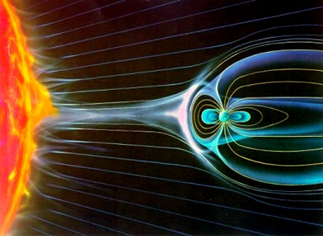
(continued) Earth's magnetic field

Slide 52
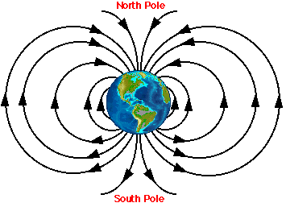
(continued) Earth's magnetic field

Slide 53
Aurora
An aurora is a natural light display in the sky (from the Latin word aurora, "sunrise" or the Roman goddess of dawn), predominantly seen in the high latitude (Arctic and Antarctic) regions. The name ”auroras” is now more commonly used for the linguistic plural ”aurorae” of ”aurora”, so is adopted throughout the main text of this article. Modern style guides recommend that the names of meteorological phenomena, such as aurora borealis, be uncapitalized. Auroras are caused by charged particles, mainly electrons and protons, entering the atmosphere from above causing ionisation and excitation of atmospheric constituents, and consequent optical emissions. Incident protons also produce emissions, and convert to hydrogen atoms by gaining an electron from the atmosphere.

Slide 54
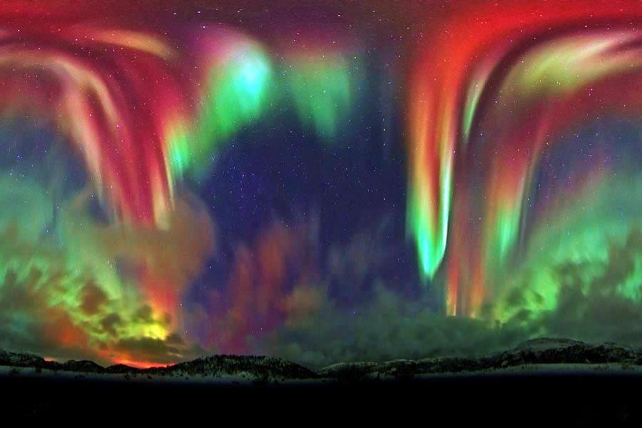
Aurora (continued)

Slide 55
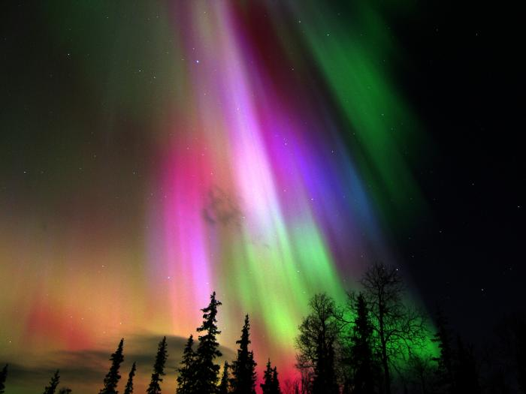
Aurora (continued)

Slide 56
Electromagnetic induction
Electromagnetic induction is the production of an electromotive force across a conductor when it is exposed to a varying magnetic field. It is described mathematically by Faraday's law of induction, named after Michael Faraday who is generally credited with the discovery of induction in 1831.

Slide 57
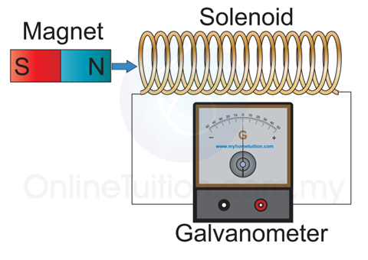
Electromagnetic induction (continued)

Slide 58
Faraday's law of induction
Faraday's law of induction is a basic law of electromagnetism predicting how a magnetic field will interact with an electric circuit to produce an electromotive force (EMF)—a phenomenon called electromagnetic induction. It is the fundamental operating principle of transformers, inductors, and many types of electrical motors, generators and solenoids.
The Maxwell–Faraday equation is a generalization of Faraday's law, and forms one of Maxwell's equations.

Slide 59
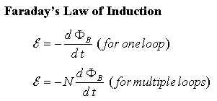
Faraday's law of induction (continued)

Slide 60
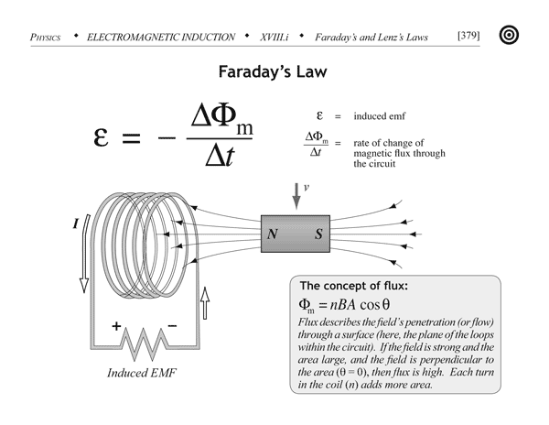
Faraday's law of induction (continued)

Slide 61
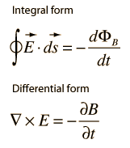
Faraday's law of induction (continued)

Slide 62
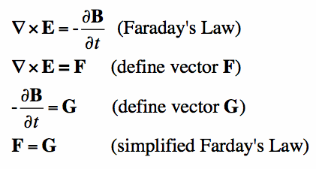
Faraday's law of induction (continued)

Slide 63
Electricity generation
Electricity generation is the process of generating electric power from other sources of primary energy. The fundamental principles of electricity generation were discovered during the 1820s and early 1830s by the British scientist Michael Faraday. His basic method is still used today: electricity is generated by the movement of a loop of wire, or disc of copper between the poles of a magnet.^{[1]} For electric utilities, it is the first process in the delivery of electricity to consumers. The other processes, electricity transmission, distribution, and electrical power storage and recovery using pumped-storage methods are normally carried out by the electric power industry. Electricity is most often generated at a power station by electromechanical generators, primarily driven by heat engines fueled by chemical combustion or nuclear fission but also by other means such as the kinetic energy of flowing water and wind. Other energy sources include solar photovoltaics and geothermal power.

Slide 64
Electricity transmission

Slide 65
Max V, min I for transmission
Electromagnetic field spreads with the speed of light c
Large I would cause large R and losses of energy
Too tick wires are also wasteful: R=rL/A

Slide 66
Example:
Transmission lines:
An average of 120 kW of electric power is sent to a small town from a power plant 10 km away. The transmission lines have the total resistance of 0.4 Ohms. Calculate the power loss if the power is transmitted at:
240 V
24,000 V

Slide 67
Electric motor
An electric motor is an electric machine that converts electrical energy into mechanical energy. The reverse conversion of mechanical energy into electrical energy is done by an electric generator.

Slide 68
Electric motor (continued)
In normal motoring mode, most electric motors operate through the interaction between an electric motor's magnetic field and winding currents to generate force within the motor. In certain applications, such as in the transportation industry with traction motors, electric motors can operate in both motoring and generating or braking modes to also produce electrical energy from mechanical energy.

Slide 69
(continued) Electric motor
Found in applications as diverse as industrial fans, blowers and pumps, machine tools, household appliances, power tools, and disk drives, electric motors can be powered by direct current (DC) sources, such as from batteries, motor vehicles or rectifiers, or by alternating current (AC) sources, such as from the power grid, inverters or generators. Small motors may be found in electric watches. General-purpose motors with highly standardized dimensions and characteristics provide convenient mechanical power for industrial use. The largest of electric motors are used for ship propulsion, pipeline compression and pumped-storage applications with ratings reaching 100 megawatts. Electric motors may be classified by electric power source type, internal construction, application, type of motion output, and so on.

Slide 70
Electric motor (continued)
Electric motors are used to produce linear or rotary force (torque), and should be distinguished from devices such as magnetic solenoids and loudspeakers that convert electricity into motion but do not generate usable mechanical powers, which are respectively referred to as actuators and transducers.

Slide 71
Transformer
A transformer is an electrical device that transfers energy between two or more circuits through electromagnetic induction.

Slide 72
Transformer (continued)
A varying current in the transformer's primary winding creates a varying magnetic flux in the core and a varying magnetic field impinging on the secondary winding. This varying magnetic field at the secondary induces a varying electromotive force (emf) or voltage in the secondary winding. Making use of Faraday's Law in conjunction with high magnetic permeability core properties, transformers can thus be designed to efficiently change AC voltages from one voltage level to another within power networks.

Slide 73
(continued) Transformer
Transformers range in size from RF transformers less than a cubic centimetre in volume to units interconnecting the power grid weighing hundreds of tons. A wide range of transformer designs is encountered in electronic and electric power applications. Since the invention in 1885 of the first constant potential transformer, transformers have become essential for the AC transmission, distribution, and utilization of electrical energy.

Slide 74
Back EMF
The counter-electromotive force also known as back electromotive force (abbreviated counter EMF, or CEMF) is the voltage, or electromotive force, that pushes against the current which induces it. CEMF is the voltage drop in an alternating current (AC) circuit caused by magnetic induction (see Faraday's law of induction, electromagnetic induction, Lenz's Law). For example, the voltage drop across an inductor is due to the induced magnetic field inside the coil, and is equal to the current divided by the impedance of the inductor. The voltage's polarity is at every moment the reverse of the input voltage.

Slide 75
Back EMF (continued)
The term Back electromotive force, or just Back-EMF, is most commonly used to refer to the voltage that occurs in electric motors where there is relative motion between the armature of the motor and the magnetic field from the motor's field magnets, or windings. From Faraday's law, the voltage is proportional to the magnetic field, length of wire in the armature, and the speed of the motor. This effect is not due to the motor's inductance and is a completely separate effect.

Slide 76
(continued) Back EMF
In a motor using a rotating armature in the presence of a magnetic flux, the conductors cut the magnetic field lines as they rotate. This produces a voltage in the coil; the motor is acting like a generator (Faraday's law of induction.) at the same time it is a motor. This voltage opposes the original applied voltage; therefore, it is called "back-electromotive force" (by Lenz's law). With a lower overall voltage across the armature, the current flowing into the motor is reduced. One practical application is to use this phenomenon to indirectly measure motor speed and position since the Back-EMF is proportional to the armature rotational speed.

Slide 77
(continued) Back EMF
In motor control and robotics, the term "Back-EMF" often refers most specifically to actually using the voltage generated by a spinning motor to infer the speed of the motor's rotation for use in better controlling the motor in specific ways.

Slide 78
(continued) Back EMF
To observe the effect of Back-EMF of a motor, one can perform this simple exercise. With an incandescent light on, cause a large motor such as a drill press, saw, air conditional compressor, or vacuum cleaner to start. The light may dim briefly as the motor starts. When the armature is not turning (called locked rotor) there is no Back-EMF and the motor's current draw is quite high. If the motor's starting current is high enough it will pull the line voltage down enough to notice the dimming of the light.

Slide 79
Counter torque

Slide 80
Eddy currents

Slide 81
Alternating current
In alternating current (AC), the flow of electric charge periodically reverses direction. In direct current (DC, also dc), the flow of electric charge is only in one direction. The abbreviations AC and DC are often used to mean simply alternating and direct, as when they modify current or voltage.
AC is the form in which electric power is delivered to businesses and residences. The usual waveform of an AC power circuit is a sine wave. In certain applications, different waveforms are used, such as triangular or square waves. Audio and radio signals carried on electrical wires are also examples of alternating current. In these applications, an important goal is often the recovery of information encoded (or modulated) onto the AC signal.

Slide 82
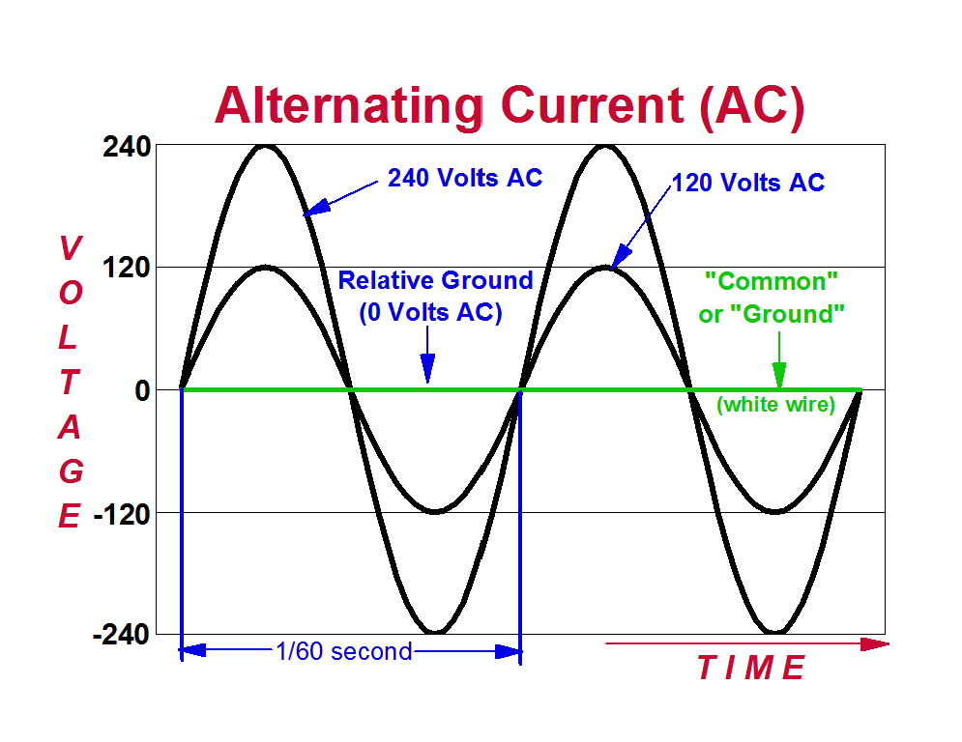
Alternating current (continued)

Slide 83
RLC circuit
An RLC circuit (the letters R, L and C can be in other orders) is an electrical circuit consisting of a resistor, an inductor, and a capacitor, connected in series or in parallel. The RLC part of the name is due to those letters being the usual electrical symbols for resistance, inductance and capacitance respectively. The circuit forms a harmonic oscillator for current and will resonate in a similar way as an LC circuit will. The main difference that the presence of the resistor makes is that any oscillation induced in the circuit will die away over time if it is not kept going by a source. This effect of the resistor is called damping. The presence of the resistance also reduces the peak resonant frequency somewhat. Some resistance is unavoidable in real circuits, even if a resistor is not specifically included as a component. An ideal, pure LC circuit is an abstraction for the purpose of theory.

Slide 84
RLC circuit (continued)
There are many applications for this circuit. They are used in many different types of oscillator circuits. Another important application is for tuning, such as in radio receivers or television sets, where they are used to select a narrow range of frequencies from the ambient radio waves. In this role the circuit is often referred to as a tuned circuit. An RLC circuit can be used as a band-pass filter, band-stop filter, low-pass filter or high-pass filter. The tuning application, for instance, is an example of band-pass filtering. The RLC filter is described as a second-order circuit, meaning that any voltage or current in the circuit can be described by a second-order differential equation in circuit analysis.

Slide 85
(continued) RLC circuit
The three circuit elements can be combined in a number of different topologies. All three elements in series or all three elements in parallel are the simplest in concept and the most straightforward to analyse. There are, however, other arrangements, some with practical importance in real circuits. One issue often encountered is the need to take into account inductor resistance. Inductors are typically constructed from coils of wire, the resistance of which is not usually desirable, but it often has a significant effect on the circuit.

Slide 86
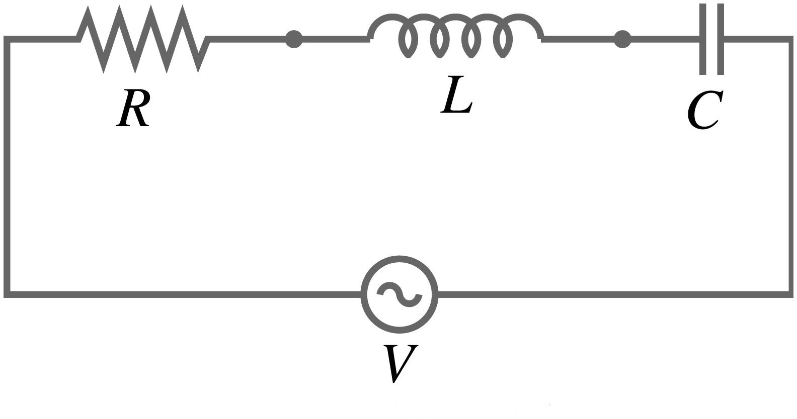
(continued) RLC circuit

Slide 87
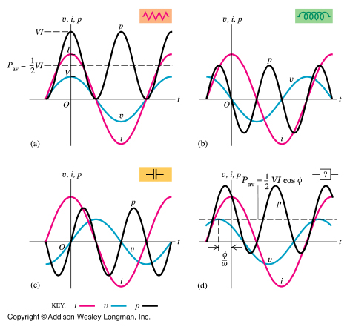
(continued) RLC circuit

Slide 88
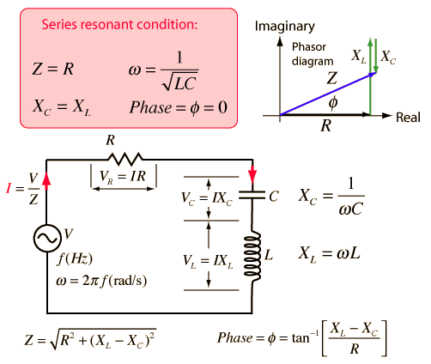
(continued) RLC circuit

Slide 89
Reactance
In electrical and electronic systems, reactance is the opposition of a circuit element to a change of electric current or voltage, due to that element's inductance or capacitance. A built-up electric field resists the change of voltage on the element, while a magnetic field resists the change of current. The notion of reactance is similar to electrical resistance, but they differ in several respects.
An ideal resistor has zero reactance, while ideal inductors and capacitors consist entirely of reactance. The magnitude of the reactance of an inductor is proportional to frequency, while the magnitude of the reactance of a capacitor is inversely proportional to frequency.

Slide 90
Resonanse

Slide 91
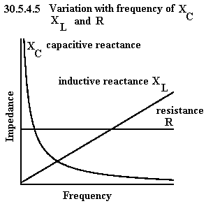
Reactance (continued)

Slide 92
Parallels between mechanical and electrical oscillators

Slide 93
Mechanics | Electromagnetism
D | Q
m | L
V | I
K | 1/C
0.5kD² | 0.5Q²/C
0.5mV² | 0.5LI²

Slide 94
Impedance
Electrical impedance is the measure of the opposition that a circuit presents to a current when a voltage is applied.
In quantitative terms, it is the complex ratio of the voltage to the current in an alternating current (AC) circuit. Impedance extends the concept of resistance to AC circuits, and possesses both magnitude and phase, unlike resistance, which has only magnitude. When a circuit is driven with direct current (DC), there is no distinction between impedance and resistance; the latter can be thought of as impedance with zero phase angle.

Slide 95
Impedance (continued)
It is necessary to introduce the concept of impedance in AC circuits because there are two additional impeding mechanisms to be taken into account besides the normal resistance of DC circuits: the induction of voltages in conductors self-induced by the magnetic fields of currents (inductance), and the electrostatic storage of charge induced by voltages between conductors (capacitance). The impedance caused by these two effects is collectively referred to as reactance and forms the imaginary part of complex impedance whereas resistance forms the real part.

Slide 96
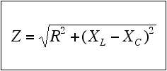
Impedance (continued)

Slide 97
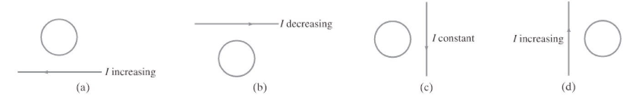
Exercise:
What is the direction of the induced current in the circular loop due to the current shown in each case?

Slide 98
Maxwell's equations
Maxwell's equations are a set of partial differential equations that, together with the Lorentz force law, form the foundation of classical electrodynamics, classical optics, and electric circuits. These fields in turn underlie modern electrical and communications technologies. Maxwell's equations describe how electric and magnetic fields are generated and altered by each other and by charges and currents. They are named after the Scottish physicist and mathematician James Clerk Maxwell, who published an early form of those equations between 1861 and 1862.

Slide 99
(continued) Maxwell's equations
The equations have two major variants. The "microscopic" set of Maxwell's equations uses total charge and total current, including the complicated charges and currents in materials at the atomic scale; it has universal applicability but may be unfeasible to calculate. The "macroscopic" set of Maxwell's equations defines two new auxiliary fields that describe large-scale behavior without having to consider these atomic scale details, but it requires the use of parameters characterizing the electromagnetic properties of the relevant materials.

Slide 100
Maxwell's equations (continued)
The term "Maxwell's equations" is often used for other forms of Maxwell's equations. For example, space-time formulations are commonly used in high energy and gravitational physics. These formulations, defined on space-time rather than space and time separately, are manifestly compatible with special and general relativity. In quantum mechanics and analytical mechanics, versions of Maxwell's equations based on the electric and magnetic potentials are preferred.

Slide 101
(continued) Maxwell's equations
Since the mid-20th century, it has been understood that Maxwell's equations are not exact laws of the universe, but are a classical approximation to the more accurate and fundamental theory of quantum electrodynamics. In most cases, though, quantum deviations from Maxwell's equations are immeasurably small. Exceptions occur when the particle nature of light is important or for very strong electric fields.

Slide 102
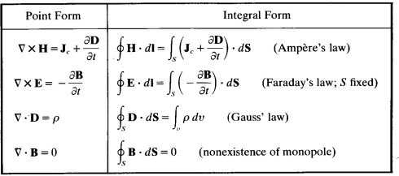
Maxwell's equations (continued)

Slide 103
Solving Maxwell’s Equations

Slide 104
Electricity transmission

Slide 105
Current in on the surface of a conductor

Slide 106
Electromagnetic radiation
Electromagnetic radiation (EM radiation, EMR, or light) is a form of energy released by electromagnetic processes. In physics, all EMR is referred to as "light", but colloquially "light" often refers exclusively to visible light, or collectively to visible, infrared, and ultraviolet light.

Slide 107
Electromagnetic radiation (continued)
Classically, EMR consists of electromagnetic waves, which are synchronized oscillations of electric and magnetic fields that propagate at the speed of light. The oscillations of the two fields are perpendicular to each other and perpendicular to the direction of energy and wave propagation, forming a transverse wave. Electromagnetic waves can be characterized by either the frequency or wavelength of their oscillations to form the electromagnetic spectrum, which includes, in order of increasing frequency and decreasing wavelength: radio waves, microwaves, infrared radiation, visible light, ultraviolet radiation, X-rays and gamma rays.

Slide 108
(continued) Electromagnetic radiation
Electromagnetic waves are produced whenever charged particles are accelerated, and they can subsequently interact with any charged particles. EM waves carry energy, momentum and angular momentum away from their source particle and can impart those quantities to matter with which they interact. EM waves are massless, but they are still affected by gravity. Electromagnetic radiation is associated with those EM waves that are free to propagate themselves ("radiate") without the continuing influence of the moving charges that produced them, because they have achieved sufficient distance from those charges. Thus, EMR is sometimes referred to as the far field. In this language, the near field refers to EM fields near the charges and current that directly produced them, as (for example) with simple magnets, electromagnetic induction and static electricity phenomena.

Slide 109
Electromagnetic radiation (continued)
In the quantum theory of electromagnetism, EMR consists of photons, the elementary particles responsible for all electromagnetic interactions. Quantum effects provide additional sources of EMR, such as the transition of electrons to lower energy levels in an atom and black-body radiation. The energy of an individual photon is quantized and is greater for photons of higher frequency. This relationship is given by Planck's equation E=hν, where E is the energy per photon, ν is the frequency of the photon, and h is Planck's constant. A single gamma ray photon, for example, might carry ~100,000 times the energy of a single photon of visible light.

Slide 110
(continued) Electromagnetic radiation
The effects of EMR upon biological systems (and also to many other chemical systems, under standard conditions) depend both upon the radiation's power and its frequency. For EMR of visible frequencies or lower (i.e., radio, microwave, infrared), the damage done to cells and other materials is determined mainly by power and caused primarily by heating effects from the combined energy transfer of many photons. By contrast, for ultraviolet and higher frequencies (i.e., X-rays and gamma rays), chemical materials and living cells can be further damaged beyond that done by simple heating, since individual photons of such high frequency have enough energy to cause direct molecular damage.

Slide 111
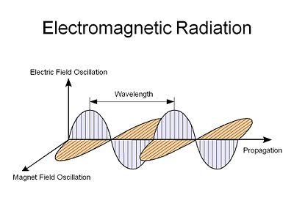
Electromagnetic radiation (continued)

Slide 112
Radio
Radio is the radiation (wireless transmission) of electromagnetic signals through the atmosphere or free space. Information, such as sound, is carried by systematically changing (modulating) some property of the radiated waves, such as their amplitude, frequency, phase, or pulse width. When radio waves strike an electrical conductor, the oscillating fields induce an alternating current in the conductor. The information in the waves can be extracted and transformed back into its original form.

Slide 113
(continued) Radio
Radio systems need a transmitter to modulate (change) some property of the energy produced to impress a signal on it. Some types of modulation include amplitude modulation and frequency modulation. Radio systems also need an antenna to convert electric currents into radio waves, and vice versa. An antenna can be used for both transmitting and receiving. The electrical resonance of tuned circuits in radios allow individual stations to be selected. The electromagnetic wave is intercepted by a tuned receiving antenna. A radio receiver receives its input from an antenna and converts it into a form usable for the consumer, such as sound, pictures, digital data, measurement values, navigational positions, etc. Radio frequencies occupy the range from a 3 kHz to 300 GHz, although commercially important uses of radio use only a small part of this spectrum.

Slide 114
Radio (continued)
A radio communication system sends signals by radio. The radio equipment involved in communication systems includes a transmitter and a receiver, each having an antenna and appropriate terminal equipment such as a microphone at the transmitter and a loudspeaker at the receiver in the case of a voice-communication system.

Slide 115
Geometrical optics
Geometrical optics, or ray optics, describes light propagation in terms of "rays". The "ray" in geometric optics is an abstraction, or "instrument", which can be used to approximately model how light will propagate. Light rays are defined to propagate in a rectilinear path as they travel in a homogeneous medium. Rays bend (and may split in two) at the interface between two dissimilar media, may curve in a medium where the refractive index changes, and may be absorbed and reflected. Geometrical optics provides rules, which may depend on the color (wavelength) of the ray, for propagating these rays through an optical system. This is a significant simplification of optics that fails to account for optical effects such as diffraction and interference. It is an excellent approximation when the wavelength is very small compared with the size of structures with which the light interacts. Geometric optics can be used to describe the geometrical aspects of imaging, including optical aberrations.

Slide 116
Ray model of light

Slide 117
Reflection

Slide 118
Plane mirror

Slide 119
Spherical mirror

Slide 120
Refraction

Slide 121
Index of refraction

Slide 122
Snell Law

Slide 123
Total internal reflection

Slide 124
Fiber optics

Slide 125
Lenses

Slide 126
Thin lenses

Slide 127
Ray tracing

Slide 128
Thin lens equation

Slide 129
Magnification

Slide 130
Combinations of lenses

Slide 131
Lensmaker Equation

Slide 132
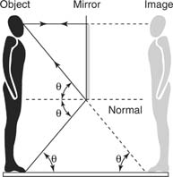
Geometrical optics (continued)

Slide 133
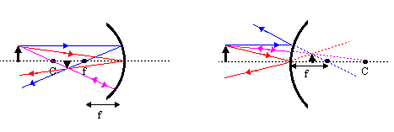
Geometrical optics (continued)

Slide 134
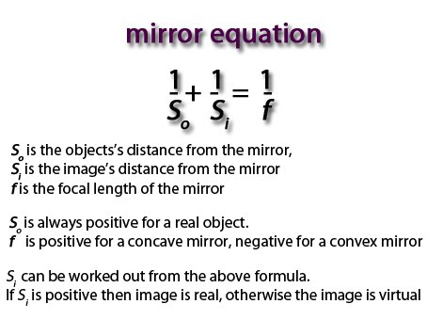
Geometrical optics (continued)

Slide 135
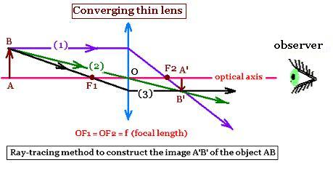
Geometrical optics (continued)

Slide 136
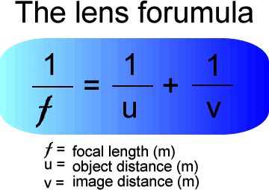

Slide 137
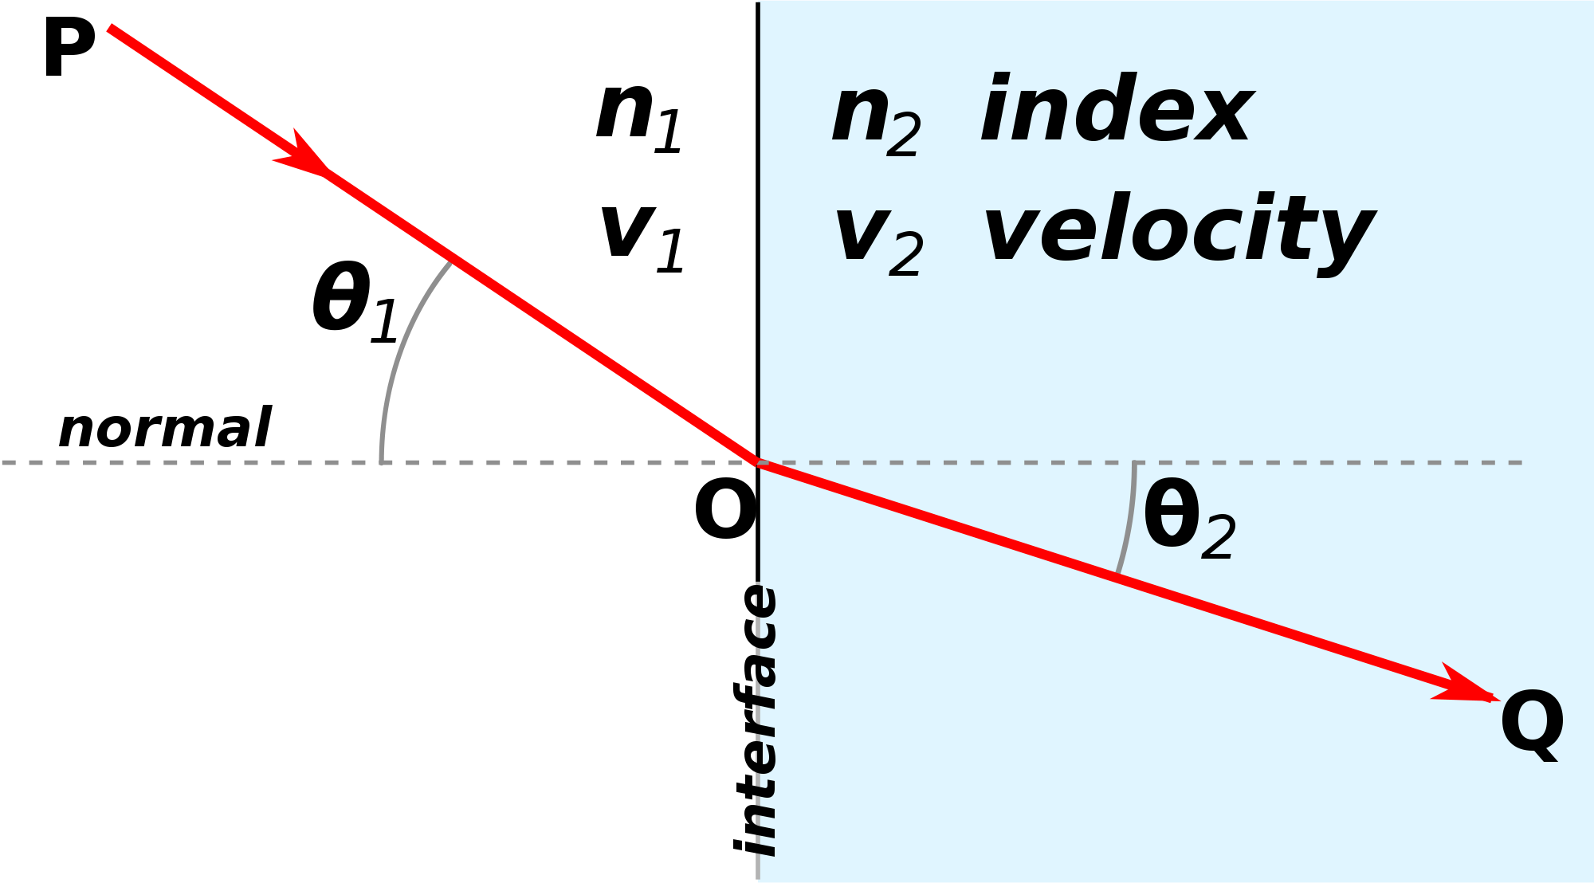
Geometrical optics (continued)

Slide 138
Wave nature of light

Slide 139
Waves vs. particles

Slide 140
Huygens principles

Slide 141
Huygens principle of diffraction

Slide 142
Huygens principle of refraction

Slide 143
Interference

Slide 144
Young double slit experiment

Slide 145
Visible spectrum and dispersion

Slide 146
Diffraction by single slit or disk

Slide 147
Diffraction grating

Slide 148
Spectrometer

Slide 149
Spectroscopy

Slide 150
Interference by thin film

Slide 151
Michelson interferometer

Slide 152
Polarization

Slide 153
Liquid crystal display

Slide 154
Scattering of light by atmosphere

Slide 155
Optical instrument
An optical instrument either processes light waves to enhance an image for viewing, or analyzes light waves (or photons) to determine one of a number of characteristic properties.

Slide 156
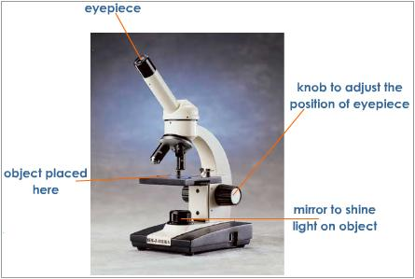
Optical instruments (continued)

Slide 157
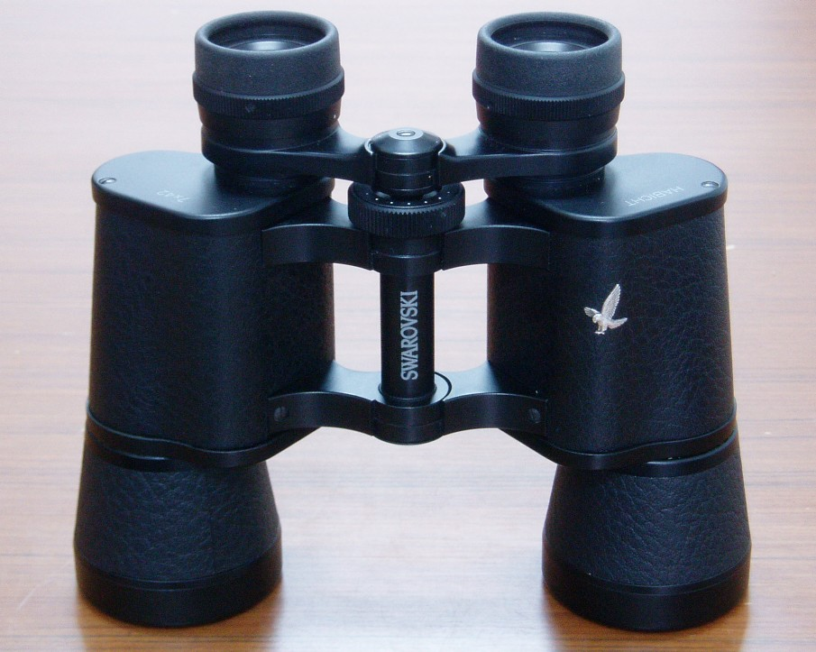
(continued) Optical instruments

Slide 158
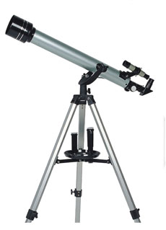
Optical instruments (continued)

Slide 159
Cameras, film and digital

Slide 160
Eye

Slide 161
Corrective lenses

Slide 162
Magnifying glass

Slide 163
Telescope

Slide 164
Microscope

Slide 165
Aberrations of lenses and mirrors

Slide 166
Limit of resolution

Slide 167
Circular apertures

Slide 168
Resolutions

Slide 169
Tomography

Slide 170
Photonics
The science of photonics includes the generation, emission, transmission, modulation, signal processing, switching, amplification, and detection/sensing of light. It covers all technical applications of light over the whole spectrum from ultraviolet over the visible to the near-, mid- and far-infrared. Most applications, however, are in the range of the visible and near infrared light. The term photonics developed as an outgrowth of the first practical semiconductor light emitters invented in the early 1960s and optical fibers developed in the 1970s.

Slide 171
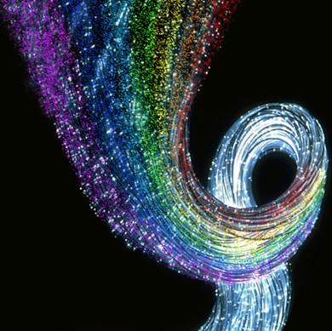
Photonics (continued)

