Slide 1
Inertia, solids, elasticity, sound, thermodynamics, electromagnetism

Slide 2
Inertia
Inertial reference frame moves without acceleration (it includes rotation (centripetal acceleration) and linear acceleration)
Reference frame is coordinate system with clock.

Slide 3
Inertia
Inertial force is fictitious, it is result of reference frame not being inertial.
Some scientists think that inertia forces are the result of attraction of distant stars.

Slide 4
Inertia
During circular rotation with the same speed, we compensate centripetal force with fictitious centrifugal force of inertia.

Slide 5
Inertia
Question:
Explain inertial force.

Slide 6
Solids
Movement of solid is described as movement of its centre of mass and rotation around the centre of mass.

Slide 7
Moment of inertia
The simplest moment of inertia around axis I = mR².
m is mass.
R is distance from mass m to axis of rotation.
For solids moments of inertia are calculated as integrals.

Slide 8
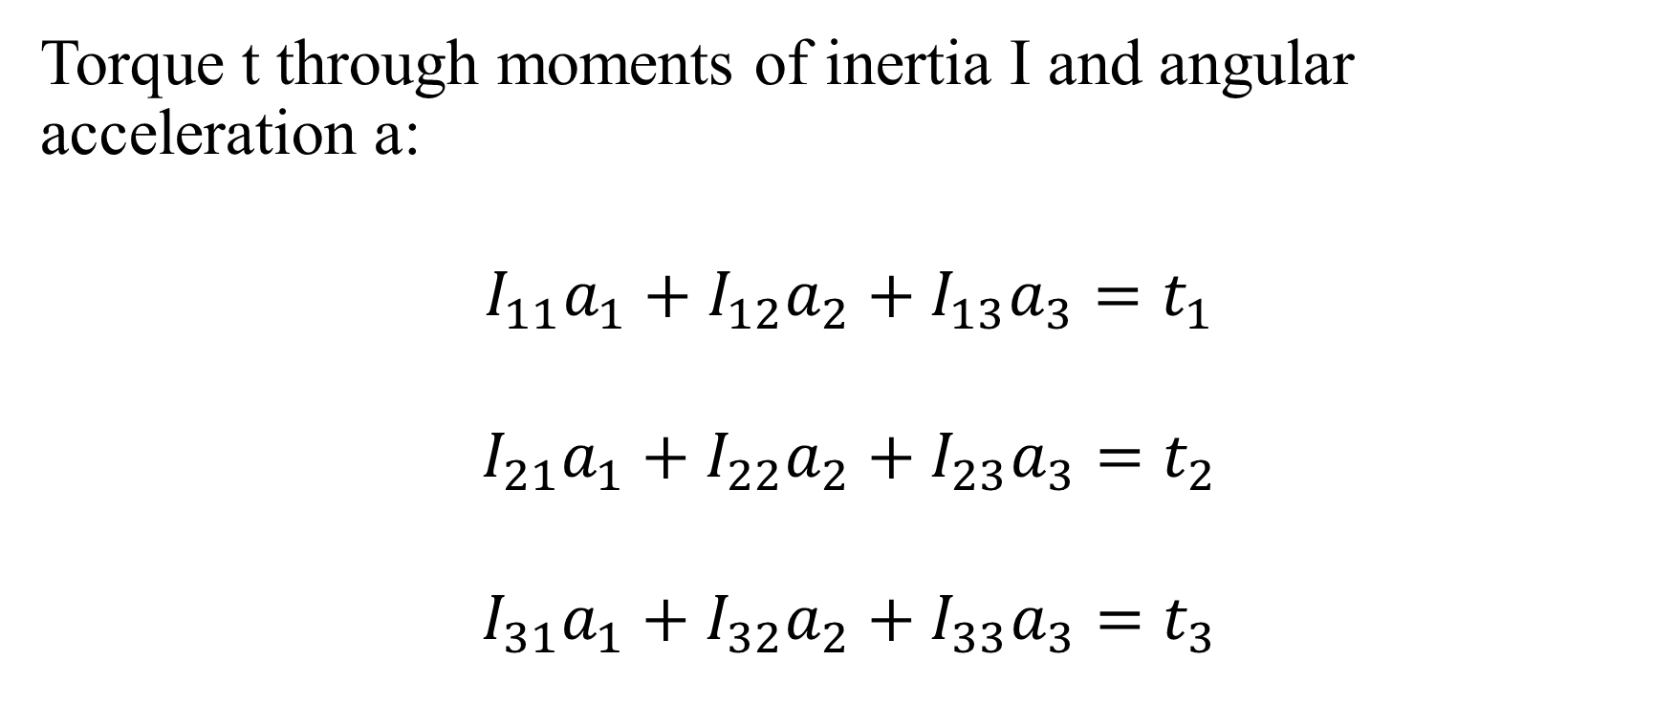
Torque
Torque t through moments of inertia I and angular acceleration a:
$$I_{11}a_{1}+I_{12}a_{2}+I_{13}a_{3}=t_{1}$$
$$I_{21}a_{1}+I_{22}a_{2}+I_{23}a_{3}=t_{2}$$
$$I_{31}a_{1}+I_{32}a_{2}+I_{33}a_{3}=t_{3}$$

Slide 9
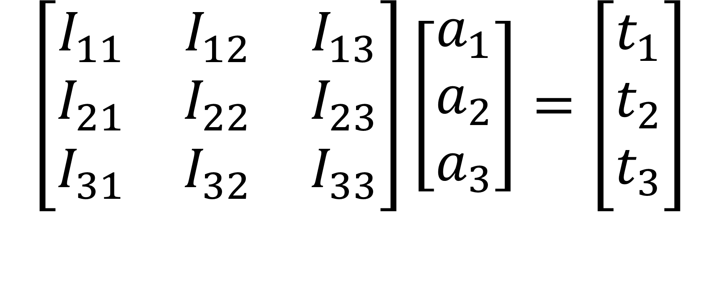
Torque
$$\left[\begin{matrix}I_{11} & I_{12} & I_{13} \\ I_{21} & I_{22} & I_{23} \\ I_{31} & I_{32} & I_{33}\end{matrix}\right]\left[\begin{matrix}a_{1} \\ a_{2} \\ a_{3}\end{matrix}\right]=\left[\begin{matrix}t_{1} \\ t_{2} \\ t_{3}\end{matrix}\right]$$

Slide 10

Torque
$$\sum_{c=1}^{3}{I_{mc}a_{c}=t_{m}}$$
m = 1, 2, 3.

Slide 11
Cramer Rule
We use Cramer Rule
en.wikipedia.org/wiki/Cramer%27s_rule

Slide 12
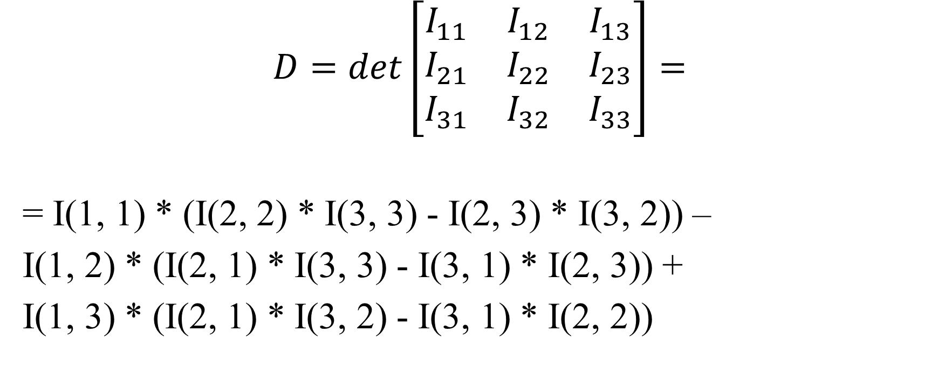
Cramer Rule
$$D=det\left[\begin{matrix}I_{11} & I_{12} & I_{13} \\ I_{21} & I_{22} & I_{23} \\ I_{31} & I_{32} & I_{33}\end{matrix}\right]=$$
= I(1, 1) * (I(2, 2) * I(3, 3) - I(2, 3) * I(3, 2)) –
I(1, 2) * (I(2, 1) * I(3, 3) - I(3, 1) * I(2, 3)) +
I(1, 3) * (I(2, 1) * I(3, 2) - I(3, 1) * I(2, 2))

Slide 13
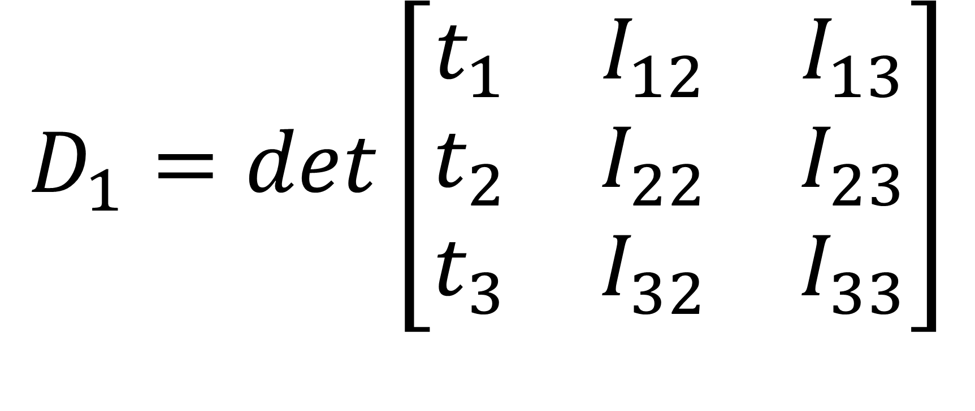
Cramer Rule
$$D_{1}=det\left[\begin{matrix}t_{1} & I_{12} & I_{13} \\ t_{2} & I_{22} & I_{23} \\ t_{3} & I_{32} & I_{33}\end{matrix}\right]$$

Slide 14
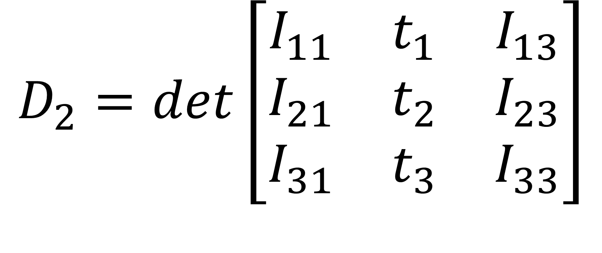
$$D_{2}=det\left[\begin{matrix}I_{11} & t_{1} & I_{13} \\ I_{21} & t_{2} & I_{23} \\ I_{31} & t_{3} & I_{33}\end{matrix}\right]$$

Slide 15
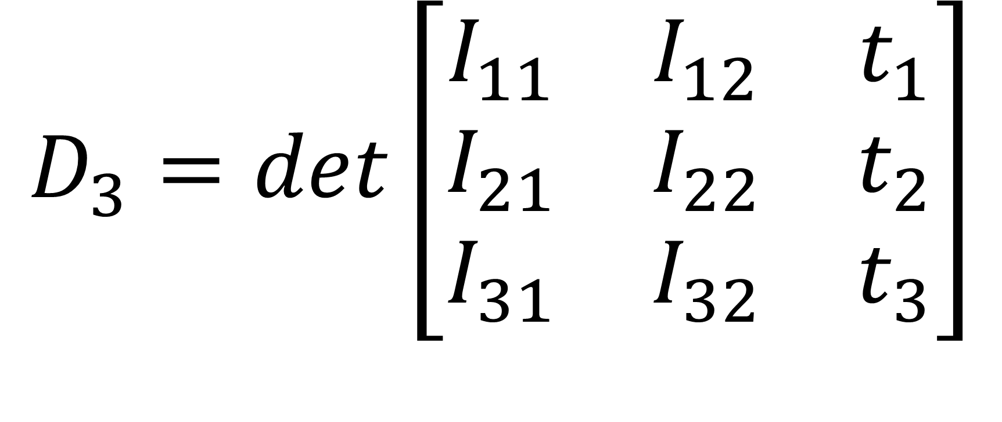
$$D_{3}=det\left[\begin{matrix}I_{11} & I_{12} & t_{1} \\ I_{21} & I_{22} & t_{2} \\ I_{31} & I_{32} & t_{3}\end{matrix}\right]$$

Slide 16

$$a_{1}=\frac{D_{1}}{D}$$

Slide 17

$$a_{2}=\frac{D_{2}}{D}$$

Slide 18
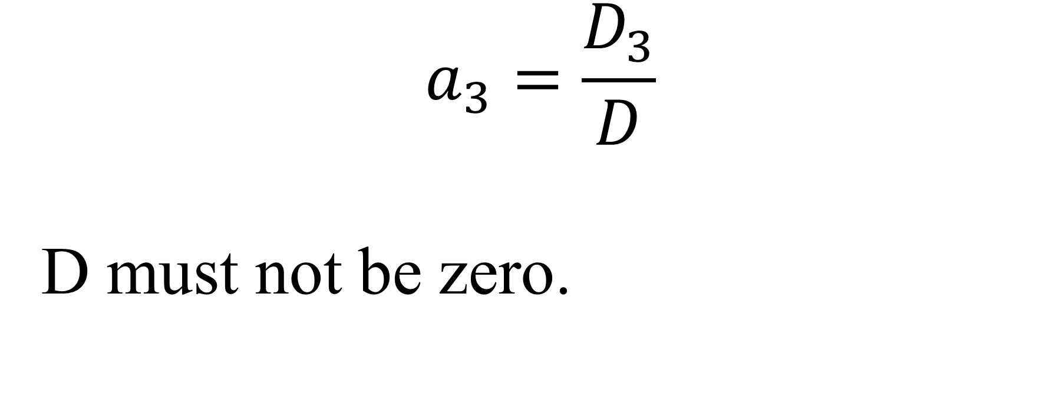
$$a_{3}=\frac{D_{3}}{D}$$
D must not be zero.

Slide 19
Question:
Find torque for given tensor of inertia and angular acceleration.

Slide 20
a1 = s mod 10
a2 = s mod 20
a3 = s mod 30
I11 = s mod 11
I12 = s mod 12
I13 = s mod 13
I21 = s mod 21
I22 = s mod 22
I23 = s mod 23
I31 = s mod 31
I32 = s mod 32
I33 = s mod 33

Slide 21
Dim a(3), I(3, 3), torque(3)
s = 99107088
a(1) = s Mod 10
a(2) = s Mod 20
a(3) = s Mod 30
I(1, 1) = s Mod 11
I(1, 2) = s Mod 12
I(1, 3) = s Mod 13
I(2, 1) = s Mod 21
I(2, 2) = s Mod 22
I(2, 3) = s Mod 23
I(3, 1) = s Mod 31
I(3, 2) = s Mod 32
I(3, 3) = s Mod 33

Slide 22
For c = 1 To 3
torque(c) = 0
For cc = 1 To 3
torque(c) = torque(c) + I(c, cc) * a(cc)
Next cc
MsgBox torque(c)
Next c

Slide 23
Question:
Calculate angular acceleration for given tensor of inertia and torque.

Slide 24
torque(1) = s Mod 10
torque(2) = s Mod 20
torque(3) = s Mod 30

Slide 25
Dim a(3), I(3, 3), torque(3)
s = 99107088
torque(1) = s Mod 10
torque(2) = s Mod 20
torque(3) = s Mod 30
I(1, 1) = s Mod 11
I(1, 2) = s Mod 12
I(1, 3) = s Mod 13
I(2, 1) = s Mod 21
I(2, 2) = s Mod 22
I(2, 3) = s Mod 23
I(3, 1) = s Mod 31
I(3, 2) = s Mod 32
I(3, 3) = s Mod 33

Slide 26
determinant = I(1, 1) * (I(2, 2) * I(3, 3) - I(2, 3) * I(3, 2)) - I(1, 2) * (I(2, 1) * I(3, 3) - I(3, 1) * I(2, 3)) + I(1, 3) * (I(2, 1) * I(3, 2) - I(3, 1) * I(2, 2))
If determinant = 0 Then GoTo 1
'MsgBox determinant

Slide 27
I(1, 1) = torque(1)
I(2, 1) = torque(2)
I(3, 1) = torque(3)
determinant1 = I(1, 1) * (I(2, 2) * I(3, 3) - I(2, 3) * I(3, 2)) - I(1, 2) * (I(2, 1) * I(3, 3) - I(3, 1) * I(2, 3)) + I(1, 3) * (I(2, 1) * I(3, 2) - I(3, 1) * I(2, 2))
a(1) = determinant1 / determinant
MsgBox a(1)

Slide 28
I(1, 1) = s Mod 11
I(2, 1) = s Mod 21
I(3, 1) = s Mod 31
I(1, 2) = torque(1)
I(2, 2) = torque(2)
I(3, 2) = torque(3)
determinant2 = I(1, 1) * (I(2, 2) * I(3, 3) - I(2, 3) * I(3, 2)) - I(1, 2) * (I(2, 1) * I(3, 3) - I(3, 1) * I(2, 3)) + I(1, 3) * (I(2, 1) * I(3, 2) - I(3, 1) * I(2, 2))
a(2) = determinant2 / determinant
MsgBox a(2)

Slide 29
I(1, 2) = s Mod 12
I(2, 2) = s Mod 22
I(3, 2) = s Mod 32
I(1, 3) = torque(1)
I(2, 3) = torque(2)
I(3, 3) = torque(3)
determinant3 = I(1, 1) * (I(2, 2) * I(3, 3) - I(2, 3) * I(3, 2)) - I(1, 2) * (I(2, 1) * I(3, 3) - I(3, 1) * I(2, 3)) + I(1, 3) * (I(2, 1) * I(3, 2) - I(3, 1) * I(2, 2))
a(3) = determinant3 / determinant
MsgBox a(3)

Slide 30
I(1, 3) = s Mod 13
I(2, 3) = s Mod 23
I(3, 3) = s Mod 33

Slide 31
' Checking correctness of the solution:
For c = 1 To 3
'MsgBox torque(c)
Next c

Slide 32
For c = 1 To 3
torque(c) = 0
For cc = 1 To 3
torque(c) = torque(c) + I(c, cc) * a(cc)
Next cc
'MsgBox torque(c)
Next c

Slide 33
GoTo 2
1 determiniantIsZero = 0
MsgBox "Determinant = 0, no solutions"
2 ThereAreSolusions = 2

Slide 34
Checking for 2
Dim a(2), I(2, 2), torque(2)
s = 99107088
torque(1) = s Mod 10
torque(2) = s Mod 20
I(1, 1) = s Mod 11
I(1, 2) = s Mod 12
I(2, 1) = s Mod 21
I(2, 2) = s Mod 22
determinant = I(1, 1) * I(2, 2) - I(1, 2) * I(2, 1)

Slide 35
If determinant = 0 Then GoTo 1
'MsgBox determinant
I(1, 1) = torque(1)
I(2, 1) = torque(2)
determinant1 = I(1, 1) * I(2, 2) - I(1, 2) * I(2, 1)
a(1) = determinant1 / determinant
'MsgBox a(1)

Slide 36
I(1, 1) = s Mod 11
I(2, 1) = s Mod 21
I(1, 2) = torque(1)
I(2, 2) = torque(2)
determinant2 = I(1, 1) * I(2, 2) - I(1, 2) * I(2, 1)
a(2) = determinant2 / determinant
'MsgBox a(2)

Slide 37
I(1, 2) = s Mod 12
I(2, 2) = s Mod 22
' Checking correctness of the solution:
For c = 1 To 2
MsgBox torque(c)
Next c

Slide 38
For c = 1 To 2
torque(c) = 0
For cc = 1 To 2
torque(c) = torque(c) + I(c, cc) * a(cc)
Next cc
MsgBox torque(c)
Next c

Slide 39
GoTo 2
1 determiniantIsZero = 0
MsgBox "Determinant = 0, no solutions"
2 ThereAreSolusions = 2

Slide 40
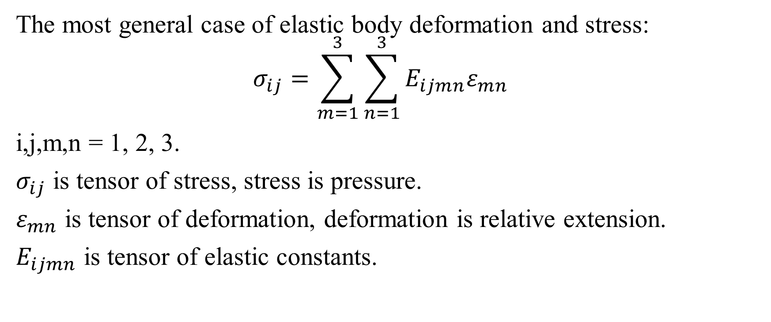
Elasticity
The most general case of elastic body deformation and stress:
$$σ_{ij}={\sum_{m=1}^{3}{\sum_{n=1}^{3}{E_{ijmn}ε_{mn}}}}_{}$$
i,j,m,n = 1, 2, 3.
$σ_{ij}$ is tensor of stress, stress is pressure.
$ε_{mn}$ is tensor of deformation, deformation is relative extension.
$E_{ijmn}$ is tensor of elastic constants.

Slide 41
Sound
Sound is a mechanical wave.
Sound is a longitudinal wave, which means that the propagation of the wave is in the same direction as oscillation.
Soundwave needs environment to propagate.
The denser the environment, the faster the sound in this environment.

Slide 42
Dopler effect
Dopler effect is change in frequency of the wave due to motion of the source of the wave.
Because the speed of the wave is constant, frequency of the wave changes: if motion of the source towards the observer, then frequency increases, if the motion of the source away from the observer, then the frequency decreases.

Slide 43
c = λf
c is the speed of sound, which is 343 meters per second in this case.
λ is the wavelength of the sound wave.
f is the frequency of the sound wave.

Slide 44
Question:
Calculate Doppler effect for sound.
Frequency changed; wavelength changed from 17 meters to 16 meters because of the speed of the source of sound.
Which direction does the source of sound move?

Slide 45
Frequencies:
f = c/BIG_Wave_Length
F = c/small_wave_length
f = Fc/(c+v)
v = -c + Fc/f
BIG_Wave_Length = 17
small_wave_length = 16

Slide 46
' c is speed of sound
c = 343
f_small = c / BIG_Wave_Length
F_BIG = c / small_wave_length

Slide 47
wavelengthchange = BIG_Wave_Length - small_wave_length
MsgBox wavelengthchange
v = -c + c * F_BIG / f_small
MsgBox v
https://physics16.weebly.com/uploads/5/9/8/5/59854633/doppler4effect2019nov.txt

Slide 48
Fluid
Buoyant force
F = ρgV
F is force.
ρ is density of the fluid.
V is volume of the body, which is submerged to the fluid.

Slide 49
Question:
Find buoyant force for water ρ = 1000 kg/m³, g = 10 m/s², V = s m³.
en.wikipedia.org/wiki/Archimedes%27_principle

Slide 50
s = 99107088
ro = 1000
g = 10
V = s
F = ro * g * V
MsgBox F

Slide 51
Thermodynamics
Increase in temperature of body means increase of average velocity of particles of body.

Slide 52
Black clothes vs white clothes
White clothes keep the temperature the same. Black clothes cause heat exchange.

Slide 53
Question:
Are black or white clothes warmer? Why?

Slide 54
If bodies are heated, then they expand because of bigger velocities of the particles.

Slide 55
There is linear extension of the length due to heat.
Volume change is not cubed but times 3 because linear extensions are small compared to 1.

Slide 56
Question:
The thermal expansion rate α is 1/k. The temperature change is T degrees.
a. Find the extension of m meters rod due to the temperature change.
b. Find the approximate volume change of m meters cubed cube due to the temperature change.

Slide 57
http://physics16.weebly.com/uploads/5/9/8/5/59854633/thermal4expansion.txt

Slide 58
Heat flows from hot to cold.
Specific heat capacity C is heat necessary to increase the temperature of the body by 1 degree.

Slide 59
Question:
There are two bodies in a thermodynamically isolated system: C₁ m₁ T₁ and C₂ m₂ T₂. Find the resulting temperature T. m₁ = k, m₂ = 2k. C₁ = k/11, C₂ = k/222, T₁ = k/111, T₂ = k/22

Slide 60
http://physics16.weebly.com/uploads/5/9/8/5/59854633/result4temperature.txt

Slide 61
P is directly proportional to V².
T is proportional to P.
T is temperature.
P is pressure.
V is velocity.

Slide 62
Energy of particles
E = 1.5kT
T is temperature.
k = 1.380649×10⁻²³ JK⁻¹
en.wikipedia.org/wiki/Boltzmann_constant

Slide 63
In ideal gas there is no interaction between the infinitely small particles.
Ideal gas is good enough model for many applications.

Slide 64
PV = nRT
P is pressure.
V is volume.
n is number of moles of substance.
R = 8.31446261815324 joules per kelvin per mole
T is temperature.

Slide 65
One mole contains N_{A} = 6.02214076×10²³ elementary entities, which can be atoms, molecules, ions, or other particles. The number of particles in a mole is the Avogadro number N_{A} expressed in mol⁻¹.
For gas at room temperature, one mole is approximately 22.4 litres.

Slide 66
Question:
Give P from PV = nRT. R = 2 + m₂₅. V = 3 + m₃₅. n = s.
https://en.wikipedia.org/wiki/Ideal_gas_law

Slide 67
s = 19107012
L = s Mod 10
m = s Mod 35
T = s Mod 100
k = s Mod 10000
E = s Mod 8
q = s Mod 17
R = s Mod 25
d = 2 + (T - L) / 10
Pi = 4 * Atn(1)
R = R + 2
V = 3 + m
n = s
P = n * R * T / V
MsgBox P

Slide 68
Real gas
In real gas particles interact and are finite in size.

Slide 69
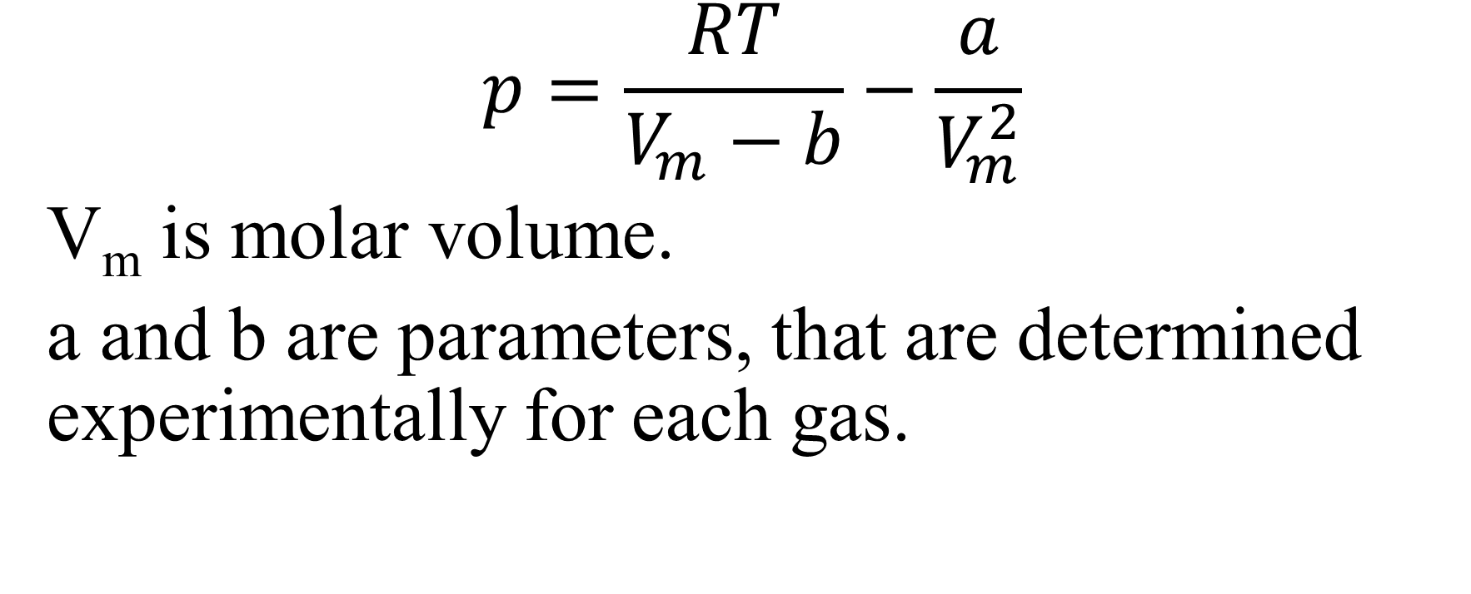
$$p=\frac{RT}{V_{m}−b}−\frac{a}{V_{m}^{2}}$$
V_{m} is molar volume.
a and b are parameters, that are determined experimentally for each gas.

Slide 70

Question:
Find real gas pressure.
https://en.wikipedia.org/wiki/Real_gas
$$p=\frac{RT}{V_{m}−b}−\frac{a}{V_{m}^{2}}$$

Slide 71
a = m₂₅
b = m₉
V_{m} = s
R = m₈
T = m₁₀₀

Slide 72
s = 19107012
m25 = s Mod 25
m9 = s Mod 9
m8 = s Mod 8
m100 = s Mod 100
a = m25
b = m9
Vm = s
R = m8
T = m100
p = R * T / (Vm - b) - a / Vm ^ 2
MsgBox p

Slide 73
Electromagnetism
Electric charge is physical property of matter that causes it to experience force when placed into electric field.

Slide 74
Electric field is space where electric force acts.

Slide 75
Electric current is flux of electric charges.

Slide 76
Electrostatics
Coulombs law in electrostatics is similar to Newton law of gravity, the difference is that gravity can only attract and gravity is much weaker than electrostatic force, which can repel and attract.

Slide 77
Question:
Find the force between two charges of L and T Coulombs, m meters apart.

Slide 78
http://physics16.weebly.com/uploads/5/9/8/5/59854633/coulomb_force.txt

Slide 79
Question:
Ed = V (uniform field strength (electric field)). E = m₈. d = d₂.

Slide 80
s = 19107012
L = s Mod 10
T = s Mod 100
k = s Mod 10000
E = s Mod 8
d = (T - L) / 10
V = E * d
MsgBox V
https://physics16.weebly.com/uploads/5/9/8/5/59854633/uniform4electromagnetic4field2019nov.txt

Slide 81
Question:
F = Eq (field and force (electricity)). E = m₈. q = m₁₇.

Slide 82
s = 19107012
L = s Mod 10
T = s Mod 100
k = s Mod 10000
E = s Mod 8
q = s Mod 17
F = E * q
MsgBox F
https://physics16.weebly.com/uploads/5/9/8/5/59854633/force4electromagnetic4field2019nov.txt

Slide 83
Electric circuits
There are many electronic elements in electric circuits.

Slide 84
Resistor causes drop of voltage.
Capacitor accumulates electric charge and then releases it.
Inductor induces electromagnetic field.
Diode allows electric current only in one direction.
Transistor is a switch.

Slide 85
Ohm law
V = IR

Slide 86
Question:
Calculate voltage V for I = T Amperes and R = L Ohms.

Slide 87
s = 99107088
T = s Mod 100
L = s Mod 10
I = T
R = L
V = I * R
MsgBox V

Slide 88
Resistivity $ρ$ for specific material is resistance of a wire of 1 meter long and 1 meter squared in cross-section.

Slide 89

Question:
Find $R=\frac{ρL}{A}.$ A = m₂₅. ρ = m₁₇. L = m₁₀.

Slide 90
s = 19107012
L = s Mod 10
ro = s Mod 17
A = s Mod 25
R = L * ro / A
MsgBox R
https://physics16.weebly.com/uploads/5/9/8/5/59854633/resistivity2019nov.txt

Slide 91
Question:
Calculate the series and the parallel circuits with e.m.f. of T Volts and the resistors L+1, 2 and 3 ohms respectively.

Slide 92
http://physics18.weebly.com/uploads/5/9/8/5/59854633/series_parallel_circuits.txt

Slide 93
Question:
Show that Maximum loss in circuit with internal resistance r and external resistance R is when R = r.
E = I(R+r)
waste = RI².
Take derivative, equate it to zero and find the Maximum.

Slide 94
Question:
Find the frequency and the period of the harmonic oscillator. L = k μH and C = T μF.

Slide 95
http://physics16.weebly.com/uploads/5/9/8/5/59854633/rlc4circuit4natural4frequency4period.txt

Slide 96
Question:
Find the electrical current i in the circuit for R = T, L = 1/k, C = 1/s, ω = k, and ε_{m} = T.
http://physics16.weebly.com/uploads/5/9/8/5/59854633/2054_ch21a.pdf

Slide 97
Question:
Explain NOT, AND, OR gates circuits using transistor.
m₃ = 0: NOT
m₃ = 1: AND
m₃ = 2: OR

Slide 98
Question:
Find V₁ for the transformer if V₂ = T volts, N₁ = k and N₂ = s.

Slide 99
http://physics16.weebly.com/uploads/5/9/8/5/59854633/transformer.txt

Slide 100
Question:
T kilowatts of electric power is sent to a town from a power plant. The transmission lines have the total resistance of 0.1T Ohms. Calculate the power loss if the power is transmitted at:
(a) 0.03k Volts (b) s Volts

Slide 101
http://physics16.weebly.com/uploads/5/9/8/5/59854633/losses4transmitting4power.txt

Slide 102
Question:
A circular coil of wire has a diameter of 0.002k cm and contains 10 loops. The current in each loop is 3A, and the coil is placed into 2TESLA external magnetic field. Determine the maximum and minimum torque exerted on the coil by the field.

Slide 103
http://physics16.weebly.com/uploads/5/9/8/5/59854633/torque.txt

Slide 104
Question:
T Watts lamp emits electromagnetic radiation in all directions. Assuming a lamp to be a point source, calculate the intensity of the radiation:
a. at distance of 1 m from the lamp.
b. at distance of 2 m from the lamp.

Slide 105
S = 4πR².
I = T/S.

Slide 106
s = 19107012
L = s Mod 10
T = s Mod 100
k = s Mod 10000
Pi = 4 * Atn(1)
S1 = 4 * Pi * 1 ^ 2
S2 = 4 * Pi * 2 ^ 2
I1 = T / S1
I2 = T / S2
MsgBox I1
MsgBox I2
https://physics16.weebly.com/uploads/5/9/8/5/59854633/intensity4radius2019nov.txt

Slide 107
Question:
Waves from a source have an amplitude of 5 cm and an intensity of T Wm⁻².
a. The amplitude of the waves is increased to 10 cm. What is their intensity now?
b. The intensity of the waves is increased to 100 Wm⁻². What is their amplitude?

Slide 108
I = CA².
C = I/A².
I = Intensity
A = Amplitude
C = Constant

Slide 109
s = 19107012
L = s Mod 10
T = s Mod 100
k = s Mod 10000

Slide 110
I = T
A = 5 * 10 ^ (-2)
C = I / A ^ 2

Slide 111
A = 10 * 10 ^ (-2)
I = C * A ^ 2
MsgBox I

Slide 112
I = 100
A = Sqr(I / C)
MsgBox A
https://physics16.weebly.com/uploads/5/9/8/5/59854633/amplitude4intensity2019nov.txt

Slide 113
Question:
Light of wavelength T nm in a vacuum travels into glass, where its speed decreases to 2×10⁸ms⁻¹. Determine:
a. the frequency of the light in vacuum
b. its frequency and wavelength in glass.

Slide 114
c = 3*10⁸ m/s in vacuum.

Slide 115
s = 19107012
L = s Mod 10
T = s Mod 100
k = s Mod 10000

Slide 116
c = 3 * 10 ^ 8
lambdainvacuum = T * 10 ^ (-9)
frequencyinvacuum = c / lambdainvacuum
MsgBox frequencyinvacuum

Slide 117
velocityinglass = 2 * 10 ^ 8
lambdainglass = velocityinglass / frequencyinvacuum
MsgBox lambdainglass
https://physics16.weebly.com/uploads/5/9/8/5/59854633/wavelength4frequency4refraction2019nov.txt

Slide 118
Question:
An astronomer observes light from a distant star. A particular line in its spectrum has a wavelength of T nm. When measures in the laboratory, the same spectral line has a wavelength of L nm. Determine:
a. the change in the wavelength of the spectral line
b. the speed of the star
c. the direction of the movement of the star (towards or away from the observer).

Slide 119
f = c/T
F = c/L
f = Fc/(c+v)
v = -c + Fc/f

Slide 120
s = 19107012
L = s Mod 10
T = s Mod 100
k = s Mod 10000

Slide 121
c = 3 * 10 ^ 8
f_small = c / (T * 10 ^ (-9))
F_BIG = c / (L * 10 ^ (-9))
wavelebgthchange = T * 10 ^ (-9) - L * 10 ^ (-9)
MsgBox wavelebgthchange

Slide 122
v = -c + c * F_BIG / f_small
MsgBox v
https://physics16.weebly.com/uploads/5/9/8/5/59854633/doppler4effect2019nov.txt

Slide 123
Question:
Find x. λD = ax Young double-slit experiment (waves). D = d₂. a = m₂₅. λ = L = m₁₀.

Slide 124
s = 19107012
L = s Mod 10
T = s Mod 100
k = s Mod 10000
E = s Mod 8
q = s Mod 17
a = s Mod 25

Slide 125
d = (T - L) / 10
Lambda = L
x = Lambda * d / a
MsgBox x
https://physics16.weebly.com/uploads/5/9/8/5/59854633/young4double4slit4experiment2019nov.txt

Slide 126
Question:
Give n. d sinA = nλ diffraction grating (waves). d = d₂. A = m₂₅. λ = L = m₁₀.

Slide 127
s = 19107012
L = s Mod 10
T = s Mod 100
k = s Mod 10000
E = s Mod 8
q = s Mod 17
A = s Mod 25

Slide 128
d = (T - L) / 10
Pi = 4 * Atn(1)
A = A * Pi / 180
Lambda = L
n = d * Sin(A) / Lambda
n = Round(n)
MsgBox n
https://physics16.weebly.com/uploads/5/9/8/5/59854633/diffraction4grating2019nov.txt

Slide 129
Question:
Solve the simplified Maxwell Equations for c = 300000000-s, red light. Take amplitude 1 V/m. Find the intensity of electric field after s seconds at m meters.

Slide 130
s = 16108088
Ttt = s Mod 100
m = s Mod 35
L = s Mod 10

Slide 131
t = s
x = m
c = 3 * 10 ^ 8 - s
E = Sin(x - c * t)
MsgBox E
http://physics16.weebly.com/uploads/5/9/8/5/59854633/maxwell_equations_solution.txt

Slide 132
Question:
Suppose a star has a surface temperature of 4k degrees. What are the wavelength and the color this star appears?

Slide 133
http://physics16.weebly.com/uploads/5/9/8/5/59854633/color4black4body.txt

Slide 134
Question:
A man 0.25k mm tall stands in front of a vertical plane mirror. His eyes are 10 cm bellow the top of his head. What are the sizes and the best location of the smallest possible mirror so that he can see his entire body?

Slide 135
http://physics16.weebly.com/uploads/5/9/8/5/59854633/height4mirror.txt

Slide 136
Question:
For convex mirror with a radius of curvature of 0.002k meters, determine the location of the image and its magnification for an object 0.0012k meters from the mirror.

Slide 137
http://physics16.weebly.com/uploads/5/9/8/5/59854633/mirror.txt

Slide 138
Question:
A spy satellite camera can recognize T cm objects from the altitude of n meters. If diffraction was the only limitation (the wave length Lambda = 0.1k nanometers), determine what diameter lens the camera has.

Slide 139
http://physics16.weebly.com/uploads/5/9/8/5/59854633/satellite4spying.txt

